Slide 1
Environmental Management Systems
Training
Aligned to ISO 14001:2015
Notes:
[This presentation is intended to inform employees in operational areas of key environmental interest of the structure and purpose of an environmental management system. his presentation is not designed to be used as is, but rather has been developed as an example and may act as a framework from which to develop a more refined presentation to use for educating staff to the requirements of an Environmental Management System].
This presentation aims to introduce you to the structure and purpose of an Environmental Management System.

Slide 2


Emergency Requirements etc
Are there any fire drills planned today?
Should a fire alarm be sounded, everyone should evacuate the building to the muster point following the evacuation instructions.
Refreshments are provided throughout the day and there will also be comfort breaks at approx. 10.30am and 3.00pm
Lunch break will be 12.30 to 1.00pm, with training commencing at 1.05pm (please be prompt)
Mobile phone should be switched to silent, but it is fully accepted that calls may need to be taken from time to time, if that is the case please leave the room to take your call

Slide 3

Training Delivery
The style of training that will be delivered over the course of the next 3 days will be;
  Presentation around power point slides
  Demonstration of elements of an EMS through an FQM software product
  Open dialogue of questions and answers through out the training. Please don’t wait to be asked if you understand, please ask any questions you wish. If I can not answer I will ensure to provide you with an answer by email or follow up call
  Open dialogue between peers to gain an understanding of the differences of locations within the agency, positions within the agency and the behaviours within the room

Slide 4

Meet the Trainer and You

Slide 5

About OPA
The OPA operate 6 Oil Fuel Depots (OFD) around the UK and their aim is to;
provide a marine fuel receipt, storage, delivery and jetty service
manage, operate and maintain the OFDs safely and securely in accordance with all regulatory requirements
manage and maintain those sites previously in GPSS which were not part of the recent GPSS sale, safely and efficiently
Is this correct?

Slide 6
About OPA
Ministry Of Defence
Commercial Clients
OPA London
Gosport OFD
Thanckes OFD
Garelochhead OFD
Campbeltown OFD
Loch Striven OFD
Loch Ewe OFD

Slide 7
About FQM Ltd
WWW.FQMLTD.COM
WWW.FQMTRAINING.COM

Slide 8

Course Outline
ISO 14001:2015 Introduction (Day1 )
Background and Evolution of Standard
Overview of Principles
Overview of the Family of Standards
Detailed Review of the Requirements
Implementing an EMS (Day 2)
Gap Analysis Process
Roles and Responsibilities
System Design, Development and Implementation
Example systems
Certification Process
Implementing an EMS (Day 3 – Half day)
Management of the system
Development workshop
Questions / Answers

Slide 9
Objectives
Get an insight in to what ISO14001:2015 is
Greater understanding of an Environmental Management System
The benefits of an EMS system
How it may apply to your company
Roles and Responsibilities
Provide you with information on the requirements of the standard
Understand what EMS documentation is needed (minimum)
Give understanding of Environmental Legislation
What a good implementation looks like
What a Electronic system looks likes
Understand how to prepare and manage a system for certification
Why continual improvement is important

Slide 10
Environmental Management System (EMS)
Introduction Training (day 1)
Aligned to ISO 14001:2015
Delivered by: Chris Docherty
Notes:
[This presentation is intended to inform employees in operational areas of key environmental interest of the structure and purpose of an environmental management system. his presentation is not designed to be used as is, but rather has been developed as an example and may act as a framework from which to develop a more refined presentation to use for educating staff to the requirements of an Environmental Management System].
This presentation aims to introduce you to the structure and purpose of an Environmental Management System.

Slide 11
Foreword
European public authorities spend each year over €1,800 billion on goods and services (14% -16% of the GDP). Directing this spending power towards the purchase of greener products and services can:
Achieve huge direct environmental benefits
Help drive the market for greener products
Result in considerable cost saving
Set an example for corporate and private consumers
For example, the EU Public authorities buy 2.8 million computers annually, which is 12% of the European computer market. If the European market could be moved to producing slightly more efficient computers then over 8 million tonnes CO2 could be saved - equivalent to the emissions of almost 1 million people.

Slide 12
What is ISO 14001
An international standard for requirements of an environmental management system.
Produced by the International Organisation for Standardisation.
Adopted by greater than 300,000 companies globally
Used as basis for third party and accredited certification of environmental management systems.
Notes:
The International Organization for Standardization (ISO) is a non-government network of national standards institutes. It develops and publishes international standards. ISO 14001:2015 provides an international standard for the requirements of an environmental management system. Certification of management systems is obtained by UKAS accredited certification bodies or 3rd part certification bodies.

Slide 13
What is an EMS
Part of an organisation’s management system used to develop and implement its environmental policy and manage its environmental aspects.
(ISO 14001:2015)
A demonstrable system to direct and control an organisation with regard to the environment
What your company does to minimise the harmful effects on the environment caused by its activities
To conform to applicable regulatory requirements
To manage it’s environmental risks
To achieve continual improvement in its environmental performance

Slide 14
Generic
ISO 14001 is a generic standard
Can be applied to any organisation large or small, using any product or service, in any sector of activities
You can be a private business, government department. It does not matter!
The ISO 14001 standard tells you what the requirements are but not how to apply them. This is because every organisation is different in some way and it must interpret how to meet the requirements of the standard from their risks to the environment.
The 2015 version of the standard provides much more flexibility for the organisation;
  Decrease the emphasis on Documentation
  Increase the emphasis on Achieving Value for the Organisation and its customers
  Increase emphasis on Risk Management to achieve objectives

Slide 15
The Origin
ISO 14001 was developed in response to the environmental problems that the world face today. First published in 1996, the latest improved version is ISO 14001:2015 and was only released in September 2015. The new standard takes the basis of the 2004 standard and brings it in line with the Risk and Process approach to management systems and uses the Annex SL platform;
Mandated by ISO’s Technical Management Board (TMB)
High level structure, identical core text and common terms and core definitions for use in all Management System Standards
Purpose - Enhance the consistency and alignment of different management system standards
Organisations who implement a single system addressing multiple standards (e.g. QMS, EMS, HSMS, ISMS etc.) will see the most potential benefit

Slide 16
Status
As of December 2014 – more than 10,000 companies in the UK have been certified to ISO 14001, with companies in over 138 countries taking up certification and many more apply the principals of an EMS but choosing not to have their system externally certified.
It is the most recognised Environmental Standard globally

Slide 17
Benefits of an EMS
Improve management of environmental impacts
Set targets to reduce energy use, water use & waste to landfill
Initiate and maintain procedures to improve efficiencies including:
  Use a quality approach to drive continual improvement
  Use of less evasive chemicals
  Risk management approach to Environmental incidents
  Work with contractors to ensure your expectations are driven down through the supply chain
  Preferred business travel option
Define key responsibilities for achieving targets
Promote a culture of environmental awareness among staff and contractors to encourage good adoption of the EMS, but also gain knowledge on improvement ideas
Monitor and measure environmental performance against key indicators
Regularly assess progress towards achieving set objectives
Notes:
There are a large number of criteria to consider when deciding on whether our organisation should have an environmental management system in the first place, and seek certification to the requirements of ISO 14001 in the second place.

Slide 18
Benefits of an EMS
Ensure due diligence and ongoing consideration of legal and other environmental requirements
Assist with environmental reporting as required by DECC
Driven by government policy and communicates good practise to industry and communities
Contribute to preferred employer status
Achieve cost savings
Show leadership, nationally and/or internationally
Obtain competitive advantage
May be required by clients, customers and/or regulators
Build goodwill from customers, employees and stakeholders
Notes:
All government agencies, authorities and companies must report annually on how activities or administration of legislation accorded with the principles of ecologically sustainable development as well as the environmental impacts of their activities and measures taken to minimise the negative environmental impacts

Slide 19
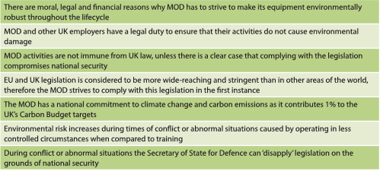
MOD Website Info

Slide 20
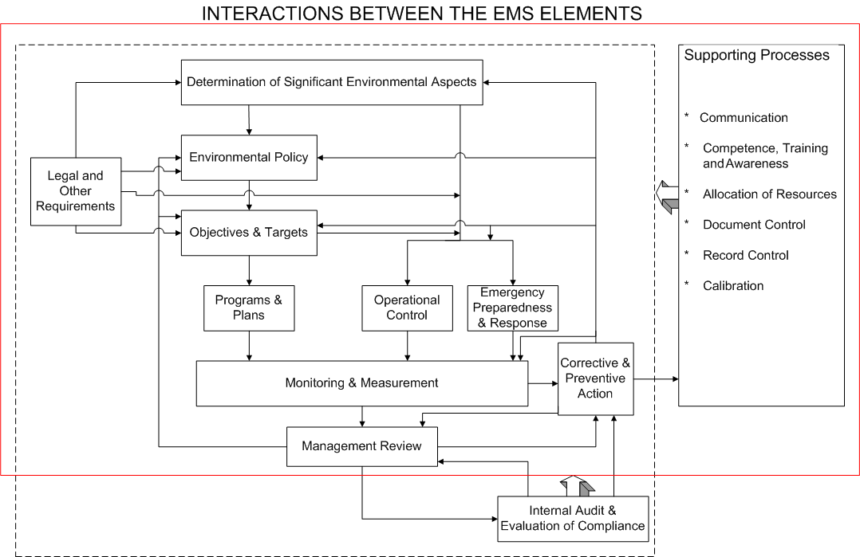
Interaction of EMS Elements
Notes:
This slide shows that an environmental management system is established and implemented as a set of elements, or components or processes that interact with each other. Each element has inputs from other elements, and provides outputs to other elements. The overall system is all designed to ensure continual improvement. [This may be a good slide to provide in hardcopy for the audience to refer back to throughout the presentation].

Slide 21
Role of Management
Develop & approve environmental policy as a statement of commitment
Provide the necessary resources
Provide the budget to train resources or appoint external support
Take responsibility to ensure EMS is established, implemented and maintained, and to report on performance of EMS including recommendations for improvement (Management may wish to appoint a management representative)
Be a constant advocate of the EMS, it’s benefits and need Provide regular communication for employee engagement
If a management representative is appointed, ensure they understand that they are acting on behalf of the management and accountability for establishment, implementation and continual improvement remains with the management
Provide the necessary support to overcome barriers
Regularly review the EMS to ensure its continuing suitability, adequacy and effectiveness.
Notes:
If senior managers are keen, they could become members of a steering committee to establish the EMS.

Slide 22
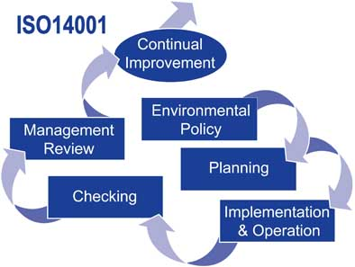
Top Level Structure

Slide 23
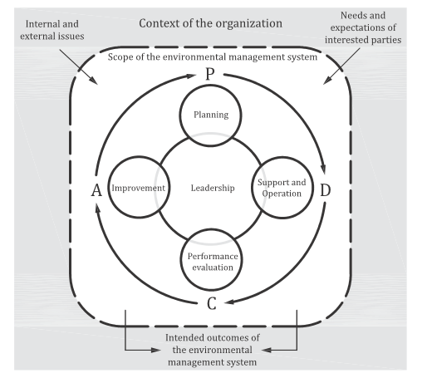
Plan Do Check Act (PDCA)

Slide 24
Comfort Break

Slide 25
Plan Do Check Act (PDCA)
Plan
  To determine scope of the system during the initial phase, which will continually develop throughout the lifecycle
Do
  To develop appropriate documentation and assign responsibilities in order to ensure that relevant issues are managed effectively
Check
  Period monitoring and checking to ensure the system is working efficiently and effectively to meet the requirements
Act
  Appropriate measures to rectify any shortfalls and updating where the circumstances change or incidents / findings need actions taken

Slide 26

Key Elements
  Policy Statement
  Identification of Significant Environmental Aspects
  Development of Objectives and Targets
  Implementation Plan to Meet Objectives and Targets
  Training and Competence
  Management Review
  Improvement
  How you meet the elements is up to you

Slide 27
ISO 14001:2015 Elements
  3 Terms and Definitions
  Terms related to the organisation and leadership
  Terms related to planning
  Terms related to support and operations
  Terms related to performance evaluation and improvement
  4 Context of the Organisation
  Understanding the organisation and its context
  Understanding the needs and expectations of interested parties
  Determining the scope of the EMS
  The Environmental Management System

Slide 28
ISO 14001:2015 Elements
  5 Leadership
  Leadership and commitment
  Environmental Policy
  Organisational roles, responsibilities and authorities
  6 Planning
  Actions to address risks and opportunities
    General
    Environmental Aspects
    Compliance obligations
    Planning action
  Environmental objectives and planning to achieve them
    Environmental objectives
    Planning actions to achieve environmental objectives

Slide 29
ISO 14001:2015 Elements
  7 Support
  Resources
  Competence
  Awareness
  Communication
    General
    Internal
    External
  Documented Information
    General
    Creating and updating
    Control of documented information
  8 Operations
  Operational planning and control
  Emergency preparedness and response

Slide 30
ISO 14001:2015 Elements
  9 Performance evaluation
  Monitoring, measurement, analysis and evaluation
    General
    Evaluation of compliance
  Internal Audit
    General
    Internal audit programme
  Management Review
  10 Improvement
  General
  Nonconformity and corrective action
  Continual improvement

Slide 31
Policy Statement
  Management’s declaration of commitment to the environment.
  Policy Statement
    3 Main Elements (Big 3)
      Commitment to Compliance
      Commitment to Prevention of Pollution and Accident
      Commitment to Continual Improvement
  Broader definition of pollution prevention
  Must be appropriate to the nature, scale and environmental impacts of the organisation’s activities, products or services
  Provides a framework for setting and reviewing objectives and targets
  Way of communicating environmental mission internally and externally
  Can be cascaded down from higher level group (government) statements

Slide 32
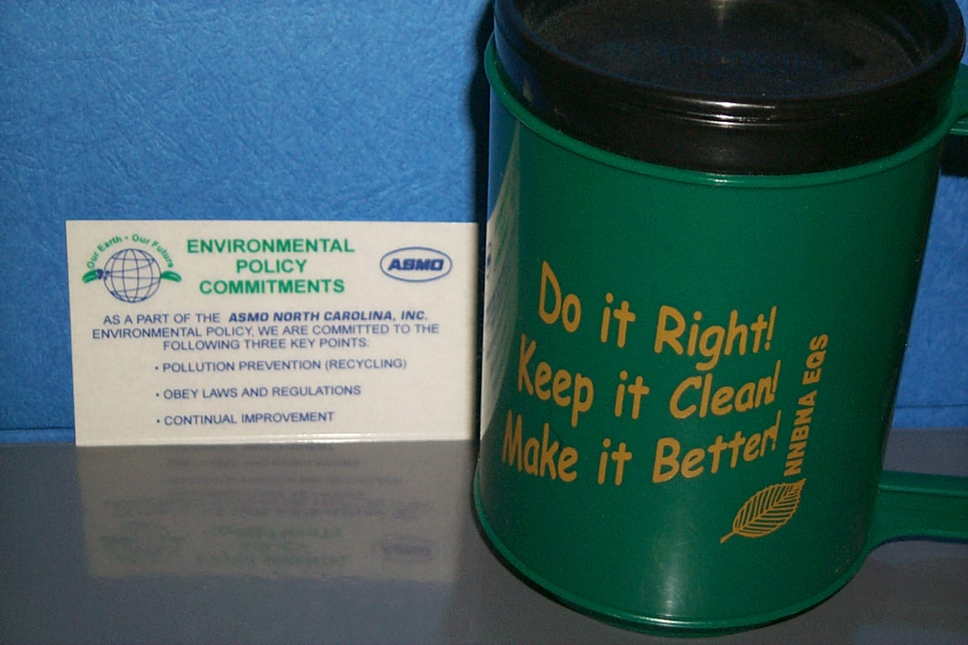
Communication

Slide 33
Aspects and Impacts
An organisation evaluates and addresses its own significant aspects, including non-regulated aspects
May be positive or negative
Think from the fence line:
  Aspect: Cause or Input: Element of an organisation’s activities, products, or services which can interact with the environment
  Impact: Effect or Output: Any change to the environment, whether adverse or beneficial, resulting from an organisation’s activities, products, or services

Slide 34
Aspects and Impacts
Consider:
  Air emissions
  Solid/hazardous waste
  Water effluents
  Contamination of land
  Noise, vibration and odour
  Land use, energy use, water use
  Raw material and resource use
  Positive environmental issues
Example:
  Aspect: Radioactive material
  Impact: Transportation and storage issues;
  Environmental contamination in storage, Likelihood of incident in transportation

Slide 35
Aspects and Impacts
Ranking of Aspects:
The organisation shall establish a documented procedure to identify its environmental aspects in order to determine those which can have a significant impact on the environment
Ranking/Significance Scoring, consider:
  Environmental Concerns
    Regulatory/legal exposure; health/env - Risks and Conservation
  Business Concerns:
    Effect on the public image; community concerns
    Cost savings; cost recovery period; equipment/facility
  Other issues:
    Scale, duration, and zone of impact
    Probability of occurrence - frequent, likely, possible, rarely, unlikely
    Severity of impact - catastrophic, severe, moderate, minor

Slide 36
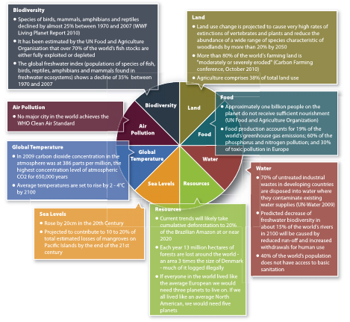
Aspects and Impacts

Slide 37
Legal and Other Requirements
Setting legal framework for the EMS
  have a process to identify and access the legal requirements: local, national and international
  have a documented system for keeping up-to-date
  communicate to the right people
Industry-specific requirements
Other voluntary requirements

Slide 38
Planning
Policy
Leadership
Intent
Aspects and Impacts
Risk Based
Requirements
Legal
Other
Significance
Establish
Objectives and
targets

Slide 39
Video 1

Slide 40
Lunch Break

Slide 41
Objectives and Targets
The organisation shall establish and maintain documented environmental objectives and targets.
Can include commitment to:
  reduce waste
  reduce or eliminate release of pollutant
  design product to minimise environmental impact in production, use, and disposal
  improve efficiency in operation to reduce environmental impact
  Implementation of a certified EMS
Be realistic. Keep objectives simple, flexible, measurable and achievable.
Consider alignment with group / government objectives

Slide 42
Objectives and Targets
Objective: Reduce Electricity Use in Office
Target: Reduce Electricity Use by 15% by year end 2015 by introducing a policy to turn off all computer monitors, install energy efficient light bulbs and install heat exchange pumps
Objective: Reduce company fuel use
Target: Reduce fuel use by 20% by year end 2015 by reducing the amount of business travel by 10% and increasing the use of web or tele based meetings, by using contractors with fuel efficient plant and equipment.
Exercise 1:
What potential objectives & targets could your department, division, subsidiary, organisation, group possibly implement?

Slide 43
Programme Action Plan
Utilise existing action plan process to help achieve the objectives and targets e.g.
Traffic Light System
Do you have a similar action plan system?

Slide 44
The Standard in Detail

Slide 45

3.0 Terms and Definitions
Terms and Definitions
Terms related to the organisation and leadership
  Management System
  Policy
  Organisation
  Top management
  Interested parties
Terms related to planning
  Environment
  Environmental aspects
  Environmental Condition
  Environmental Impacts
  Objectives
  Prevention and Pollution
  Requirements
  Compliance
  Risk and opportunity
Notes:
Management System – Interrelating or interacting elements of an organisation to establish policies and objectives and processes to achieve requirements
Policy – Intentions and direction of an organisation, in this case related to environmental performance. Formally expressed by top management
Organisation – Person or group of people that has its own function with responsibilities, authorities and relationships to achieve objectives
Top Management – Person or group that directs and controls an organisation
Interested parties – person or organisation affected by or perceive itself to be affected by the decisions or activities of an organisation. E.g. customers, communities, suppliers, regulators, government agencies, investors, employees
Environment – the surroundings to which an organisation operates; water, land, natural resources, flora, fauna, humans and all interrelations
Environmental Aspects – Elements of an organisations operations which interact or can interact with the environment.
Environmental Condition – The state of the environment as determined at a certain point
Environmental Impact – Change to the environment, either adverse or beneficial, which is as

Slide 46

3.0 Terms and Definitions
Terms and Definitions
Terms related to support and operations
  Competence
  Documented information
  Life cycle
  Outsource
  Process approach
Terms related to performance evaluation and improvement
  Audit
  Conformity
  Non Conformity
  Corrective action
  Continual improvement
  Effectiveness
  Indicator
  Monitoring
  Measurement
  Performance

Slide 47
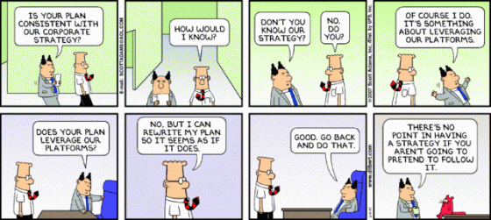
4.0 Context of the Organisation
Context of the Organisation
Understanding the organisation and its context
Understanding the needs and expectations of interested parties
Determining the scope of the EMS
Environmental Management System

Slide 48

5.0 Leadership
Leadership
Leadership and commitment
  Must be demonstrated and lead from the top
  No longer able to delegate accountability
Environmental Policy
Organisational roles, responsibilities and authorities

Slide 49

6.0 Planning
Planning
Actions to address risks and opportunities
  General
  Environmental Aspects
Compliance obligations
  Planning action
Environmental objectives and planning to achieve them
  Environmental objectives
  Planning actions to achieve environmental objectives

Slide 50


7.0 Support
Support
Resources
Competence
Awareness
Communication
  General
  Internal
  External
Documented Information
  General
  Creating and updating
  Control of documented information

Slide 51


8.0 Operations
Operations
Operational planning and control
Emergency preparedness and response

Slide 52


9.0 Performance Evaluation
Performance evaluation
Monitoring, measurement, analysis and evaluation
  General
  Evaluation of compliance
Internal Audit
  General
  Internal audit programme
Management Review

Slide 53

10.0 Improvement
Improvement
General
Nonconformity and corrective action
Continual improvement

Slide 54
Video 2

Slide 55
Monitor and Measure
The organisation shall establish and maintain documents (Processes / Procedures) to monitor and measure the key characteristics of its operations that can have a significant impact on the environment.
Track how well the system is working
Measure the key characteristics of those activities that can have significant impacts
Analyse the root causes of problems

Slide 56
Evaluation of Compliance
Develop a process / procedure for periodically evaluating compliance with applicable legal requirements
Keep records of evaluations.
Can be done during EMS Internal Audits

Slide 57
Non Conformity and Action
Develop processes / procedure for investigating, correcting, and preventing system deficiencies
Set up process for assigning responsibilities for and tracking completion of corrective action
Set up process to revise EMS processes / procedures based on corrective actions

Slide 58
Control of Records
The organisation shall establish and maintain processes / procedures for the identification, maintenance and disposition of environmental records
Include - training records, audits, management reviews

Slide 59
Internal Audit
Develop internal EMS audit program
Are all EMS requirements met?
  (Are we meeting the standard?)
Is the system working?
  (Are we doing what we said we would?)
Determine audit frequency and procedures; train auditors; keep records of audits, findings, and follow up actions

Slide 60
Comfort Break

Slide 61
Management Review
Reviews EMS to ensure its continuing suitability, adequacy and effectiveness
Reviews process to ensure necessary information is collected for evaluation
Review must be documented
Consider changes to:
  policy
  objectives
  other EMS elements

Slide 62
Overlapping Requirements
The following requirements are found as general requirements across many different standards, including ISO 14001 and ISO 9001:
Control of Documents
Control of Records
Internal Auditing
Management Review
Corrective and Preventive Action
Competence, Training and Awareness
Improvement

Slide 63
Guidelines for Auditing
The general principles contained in BS EN ISO 19011: 2002 embrace well proven and accepted practices in the performance of management system audits.
BS EN ISO 19011: 2002 provides useful guidance on the procedures to be adopted to ensure a satisfactory EMS audit process for both auditor and auditee.

Slide 64
Legislation Overview
Source of environmental legislation
International: | Rio, Kyoto, Agenda 21, Montreal Protocol
National: | Air, Water, Land
Local: | Noise, Nuisance, Litter

Slide 65
Legislation
Statutes (acts)
Statutory instruments (regulations)
Local by-laws
Land Use – Town and Country Planning Act 1990
For example:
Land use - the town and country planning regulations requires developers of major projects to produce an environmental statement – a detailed EIA.

Slide 66
Legislation
Air Pollution: regulates atmospheric emissions leading to acid rain, global warming, air pollutants, solvent release, ozone depletion and vehicle emission pollutants. European directives and international agreements reinforce the EPA 1990 and Environment Act 1995.
In the UK, two pollutant control regimes operate in the areas of LAPC (Local Air Pollution Control) and IPC (Integrated Pollution Control).
EC Directives – NO2, SO2, particulates, CFCs, Lead, vehicle exhausts
Environmental Protection Act 1990 – IPPC, Parts A1, A2, B
Environmental Act 1995 – Part 4 Air Quality
Climate Change Legislation

Slide 67
Legislation
Effluent and Water: there are a number of legislation control discharge to water and require consent in advance. The EPA 1990, Water Act 1989, Water Industry Act 1991, Water Resources Act 1991 and in Scotland, Control of Pollution Act 1974, Sewerage (Scotland) Act 1968 and Water(Scotland) Act 1980.
Discharges of effluent to sewer, water courses and the sea are subject to consent for levels of COD (Chemical Oxygen Demand), BOD, Ph level, mineral content and other chemical constituents.
EC Directives – water quality, sea water, groundwater, urban waste, water treatment
Environmental Protection Regulations – Red list of prescribed substances 1991, black list EU
Water Resources Act 1991
Control of Pollution Act 1974 – consent to discharge
Sewerage (Scotland) Act 1968
Water (Scotland) Act 1980
Water Act 1989 – water quality

Slide 68
Legislation
Waste Management : Waste disposal comes under the EPA 1990 where it imposes a ‘duty of care’ on all producers of waste. A licensing system regulates the consigning and disposal of various types of waste.
‘Special Waste’ – hazardous, ‘Controlled Waste’.
Management of landfill sites is regulated through Part 2 of EPA 1990.
‘Packaging Waste’ – is regulated through the Producer Responsibility Obligations (Packaging Waste) Regulation 1997, under the Environmental Act 1995.
The control, storage and handling of hazardous substances under the COSHH 1994 Regulations, places the responsibility for protection of employees on the Employers.
Control measures include: information and training as well as routine monitoring and health surveillance.

Slide 69
Other Legislation
Noise and Statutory Nuisance Act 1993 give local authorities power to deal with noise or vibration which is prejudicial to health.
Occupational noise is covered by the Health & Safety at Work Act 1974.
Statutory Nuisances – state of premises, odours, gases, accumulations, animals and others which create a nuisance.
EU ECO-Labelling – is a voluntary scheme administer by an independent board. This needs a Life Cycle Analysis of the products evaluating environmental impacts from birth to death of the products.
    Life-cycle analysis – researching through raw material usage, manufacturing, distribution, use, maintenance and disposal.
Others – Air quality, Sox, Nox, greenhouse gases, vehicle CO2 emissions, electrical and electronic waste disposal etc.

Slide 70
EU Legislation
EU Legislation:
EU Regulations – mandatory
EU Directives – national legislation to schedule
EU Recommendations – no legal enforcement
Regulatory Agencies:
Environment Agency (EA) – England & Wales
Scottish Environment Protection Agency (SEPA)
Department of Energy and Climate Change (DECC)
Environment and Heritage Service (EHS) – Northern Ireland
Local Councils
Water Authorities

Slide 71
Legislation For Aspects
IDENTIFICATION OF RELEVANT LEGISLATION
COMPLIANCE ISSUES
UPDATING ROUTINE
REPORTING AND COMMUNICATION

Slide 72
Documentation
Documentation importance:
Provides signposting to system components
Must comply with ISO 14001 Requirements
Align with system operations
Definitive criteria for audit
A thorough knowledge of the system documentation is essential for the EMS Manager and for the individual auditors.

Slide 73
System Documentation
The purpose of the system documentation is to provide the reference for all activities and procedures involved in the operation and control of the environmental management system.
Control function reference
Can be hard/soft copy format
Controlled Issue as required by Document Control
Available to all Users
Appropriate Coverage for understanding
Environmental Initial Review
Environmental Manual
Environmental Procedures
Environmental Registers – ASPECT, LEGISLATION
Environmental Records

Slide 74
Document Structure
Document / Document set | Components
Preliminary Environmental Review | Data gathering and analysis. Relevant data held by all employees. This review will locate the documents needed to determine your aspects and impacts. This is done during implementation phase
Environmental System | Environmental policy Provides the documentary basis for auditing the EMS Refers to other systems - quality, health & safety, etc Address all clauses of the standard Where appropriate, refers to procedures, registers and records Describes document control system
Environmental Processes / Procedures | Provide the means of implementing the EMS policies Process for assessing environmental aspects Process for assessing relevant regulations Process for developing objectives and targets Auditing procedures Effluent disposal procedures etc.
Environmental Registers | Authorisations and consents from the statutory bodies Policy documents form parent organisation Register of regulations Register of objectives and targets
Environmental Records | Electricity and fuel bills Waste disposal Effluent analysis | Air emissions analysis Accident reports Audit reports

Slide 75
Minimum Requirements
There are certain necessary requirements in ISO 14001:
Identification of environmental aspects & determination of significance.
Identification of legislation and regulations and the associated procedure for maintaining the currency of the information.
Communication within the organisation and with customers, suppliers, the general public and regulatory agencies.
Document Control
Emergency preparedness and response – environmental risk assessment with the methodologies for reducing the risk and mitigating the associated environmental impacts.
Non-conformance and Corrective Actions - methodology for information of non-conformances and providing the follow-up to ensure appropriate corrective actions are applied.

Slide 76
Management Requirements
There are certain necessary management requirements in ISO 14001:
Maintenance of environmental records – methods of storing, retrieving, updating and destruction of records of environmental importance.
Audit Process - providing a consistent framework for the conduct of audits on the system or operational components of the environmental management system.
Operational Procedures:
Solid Waste Management
Effluent Management
Monitoring of Emissions
Spillage Containment
Ground Contamination Assessment

Slide 77
Review and Improve
Review of Documentation
In working with documentation in preparing for the audit, the auditor needs to consider the value of the procedure.
Management or Operational?
Roles and responsibilities
Prescribed or Non-prescribed?
Recognised Format?
Understandable Language?
Referenced Correctly?
Records Identified?

Slide 78
End of Day 1
Questions ??

Slide 79


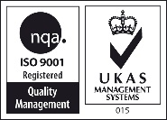
Environmental Management System (EMS)
Implementation Training
Aligned to ISO 14001:2015
Delivered by: Chris Docherty
Notes:
[This presentation is intended to inform employees in operational areas of key environmental interest of the structure and purpose of an environmental management system. his presentation is not designed to be used as is, but rather has been developed as an example and may act as a framework from which to develop a more refined presentation to use for educating staff to the requirements of an Environmental Management System].
This presentation aims to introduce you to the structure and purpose of an Environmental Management System.

Slide 80
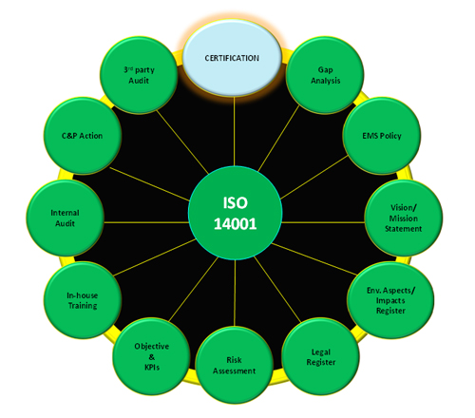


Foreword
An organisation can have the best processes, procedures and supporting documentation and equipment in the world. But without the correctively trained, competent and motivated people, the system will not be effective.
YOU MUST CONSIDER THE HUMAN AS PART OF THE SYSTEM!!
Notes:
There are a large number of criteria to consider when deciding on whether our organisation should have an environmental management system in the first place, and seek certification to the requirements of ISO 14001 in the second place.

Slide 81
Benefits of an EMS - Reminder
Improve management of environmental impacts
Set targets to reduce energy use, water use & waste to landfill
Initiate and maintain procedures to improve efficiencies including:
  Use a quality approach to drive continual improvement
  Use of less evasive chemicals
  Environmentally friendly purchasing procedures
  Work with contractors to ensure your expectations are driven down through the supply chain
  Using more innovative equipment to reduce impact
Define key responsibilities for achieving targets
Promote a culture of environmental awareness among staff and contractors to encourage good adoption of the EMS, but also gain knowledge on improvement ideas
Monitor and measure environmental performance against key indicators
Regularly assess progress towards achieving set objectives
Ensure due diligence and ongoing consideration of legal and other environmental requirements
Notes:
There are a large number of criteria to consider when deciding on whether our organisation should have an environmental management system in the first place, and seek certification to the requirements of ISO 14001 in the second place.

Slide 82

Benefits of an EMS
Assist with environmental reporting as required by law
Driven by government policy and communicates good practise to industry and communities
Contribute to preferred employer status
Achieve cost savings
Show leadership, nationally and/or internationally
Obtain competitive advantage
May be required by clients, customers and/or regulators
Build goodwill from customers, employees, stakeholders (Including the public)
Notes:
All government agencies, authorities and companies must report annually on how activities or administration of legislation accorded with the principles of ecologically sustainable development as well as the environmental impacts of their activities and measures taken to minimise the negative environmental impacts

Slide 83
Continual Improvement
Notes:
The structure of ISO 14001:2015 follows a Plan-Do-Check-Act (or PDCA) management approach. The steps are as follows:
PLAN : Establish the objectives and processes necessary to deliver results in accordance with the specifications.
DO : Implement the processes.
CHECK : Monitor and evaluate the processes and results against objectives and specifications and report the outcome.
ACT : Apply actions to the outcome for necessary improvement. This means reviewing all steps (Plan, Do, Check, Act) and modifying the process to improve it before its next implementation.
In ISO 14001:2015, the Plan-Do-Check-Act approach is shown as a continual improvement spiral starting with development of the environmental policy. The outcome of management review is a set of changes to the rest of the system designed to improve the system, and ultimately, environmental performance.

Slide 84
Interaction of EMS Elements
Notes:
This slide shows that an environmental management system is established and implemented as a set of elements, or components or processes that interact with each other. Each element has inputs from other elements, and provides outputs to other elements. The overall system is all designed to ensure continual improvement. [This may be a good slide to provide in hardcopy for the audience to refer back to throughout the presentation].

Slide 85


Engagement & Communication
At the earliest stage develop internal engagement process taking in to consideration the impact of the EMS and how wide spread it will be
Decide how to keep the engagement process open and positive, thus ensuring that you learn from your workforce and external parties you interact with
Using a communication strategy and process may be a good approach to ensure open, often, consistent and provide positive leadership direction.
Engagement with external parties is undertaken should this be deemed necessary at the early stage of implementation
Notes:
Government agencies generally have good processes in place for internal communication—these need to be tapped into so that information on the EMS can be exchanged both upwards and downwards in the structure.
Government agencies also usually have good records management systems—just need to ensure that external communications on environmental issues are appropriately received, documented and responded to.
The third point is a requirement of ISO 14001 to document a decision about whether to communicate proactively externally about an organisation’s significant environmental aspects. There are three likely options:
Publication of significant environmental aspects on the Internet, or in annual reports, or in some other form.
No publication of significant environmental aspects.
Dealing with significant environmental aspects on a case-by-case basis.

Slide 86


Implementation Planning
The impact on an organisation can often be far deeper than anticipated at the early stages. Fear of the unknown can drive resistance
Sharing of information, experiences and concerns is a good way to ensure that plans are well placed for success. It also allows for open dialogue and removes fear
Notes:
Planning the EMS involves three elements of the EMS:
Environmental aspects
Legal & other requirements
Objectives, targets & programs

Slide 87



Implementation Planning
Often something new can bring about lots of questions. Utilise resources at your disposal to understand the unknown
Understand why you are doing what you are doing, what it is you are going to undertake, when and by whom
Make your plans dynamic, but ensure all stakeholders are engaged and in agreement
Notes:
Planning the EMS involves three elements of the EMS:
Environmental aspects
Legal & other requirements
Objectives, targets & programs

Slide 88
Steps to Establish an EMS
Obtain commitment from top management.
Define responsibilities, appoint management team or delegate to a representative(s), establish EMS steering committee, develop implementation plan, initial training on EMS.
Planning—identify environmental aspects, legal & other requirements; formulate environmental policy; establish environmental objectives & targets & programs.
Implementation & operation—develop documentation & processes
Checking—develop processes for monitoring & measurement & corrective & preventive action
Develop and deliver presentation on awareness of the EMS in the agency.
Notes:
The following 10 steps are involved in establishing and implementing an EMS that is based on the international standard ISO 14001:2015. They could be used as the basis for a project plan.
Step 3 could include an initial environmental review. ISO 14004 recommends an EIR when an organisation is establishing an EMS from scratch. The main aim of the review is to consider the environmental aspects as the basis for the EMS. It can also cover identification of legal & other requirements, examination of existing environmental management practices and procedures, and evaluation of previous emergency situations and accidents. We can use ISO 14004 for further guidance on this.

Slide 89
Steps to Establish an EMS
Establish internal audit program, including training; conduct initial internal audit to evaluate conformity to requirements of ISO 14001, including evaluation of compliance
Follow up internal audit with improvements to system
Conduct initial management review of EMS
Implement improvements from management review
Continuous communication and employee engagement to ensure effective implementation of the system
Ongoing analysis, engagement and improvement

Slide 90
Video 3

Slide 91
Comfort Break

Slide 92
Phase 1
On-site gap analysis (Phase 1)
Implementation Action Plan identifying responsibilities (Phase 1)
Document EMS Policy, Aspects & Impacts and Objectives (Phase 2)
Document EMS processes and procedure (Phase 2)
Create supporting documents, templates, guidance and records (Phase 2)
‘Health Check’ utilising Implementation Action Plan for ‘progression’ (all phases – see Phase 1 for explanation)
Internal audit of ‘implemented’ system (Phase 3)
Management Review of ‘implemented’ system (Phase 3)
Certification management (Phase 4)

Slide 93

Gap Analysis
Audit of existing processes, procedures, supporting documents, records and delivery within an organisation against ISO 14001 standard (Or any other standard)
Gap analysis checklist used to facilitate this process by identifying gaps from ISO 14001
Gap Analysis Report documents the gaps and gives advice as to how to close the gaps
Project Tracker (traffic light system) – Action Implementation Plan used for managing the project, which includes identified gaps from gap analysis and delegates actions to individuals

Slide 94
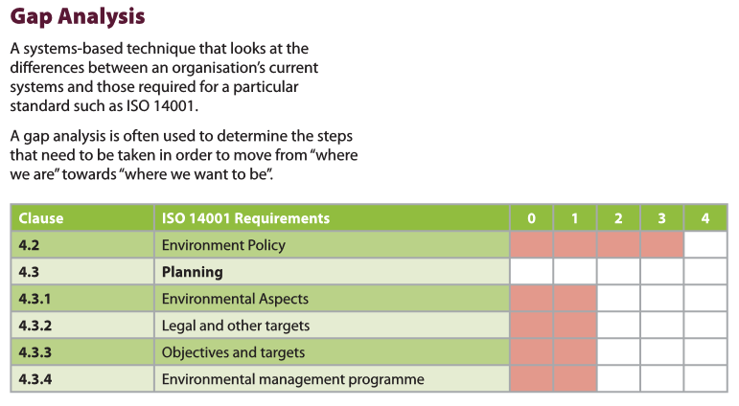
Gap Analysis

Slide 95

Gap Analysis Report
Element by element Guidance
Report written identifying the gaps between current processes and those necessary to meet the requirements of the standard (ISO 14001) for your organisations specific requirements
Gaps documented in Action Plan – Project Tracker

Slide 96

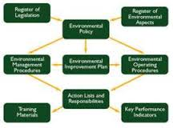
Project Action Plan
Simple, flexible, ‘traffic light’ system for managing implementation
Identifies responsibilities
Used as main tool during regular project progression meetings
Gives ‘Green’ for ‘Go’ for full implementation and project completion

Slide 97
Project Action Plan
 | QHSE Manager : Joe Bloggs |  |  | ISO Tracker
 | Consultant : Michael Freeman |  |  | Issue 8
Item No | Element | Actionee | Status | Comments
1 | Documentation Review | MF |  | This includes streamlining existing manual and drafting new process map. Modify 6 required documented procedures.
2 | Audits and preparation for Management Review | MF |  | M.R set for 03/10/07. Audit management system using existing procedures. MR took place on the 13th Nov.
3 | Preparation for Management Review | TMG/MF |  | Ensure available documentation is ready. Agenda from standard etc Data being collected - Ongoing- Prep will include the review of ATEX
4 | Results of Internal Audits | TMG/MF |  | Collate results, enter into CAPA system - new IT logging system being developed- reamaining audits to be done w/c 19th Nov. Follow up audits we 7th Dec
5 | Customer Feedback | TMG |  | Customer satisfaction forms, obtain data back 1 week prior to M.R Complete by next MR 5th Nov.Completed
6 | Analysis of NCR system | TMG/MF/EC |  | Give output from this for analysis and inclusion into MR 1 week prior to M.R - Analysis will be avaiable for MR 2 on the 5th Nov
7 | Status of preventive & corrective actions | TMG/FM |  | Include in pack for M.R - information currently being collated
8 | Follow up actions from previous reviews | TMG |  | Copies of previous sales reviews, meetings since no previous M.Rs - Infomration being collated - Ongoing next meeting set for 3rd week jan 08
9 | Housekeeping prior to audit | ALL |  | Require complete blitz including office areas 1 week prior to final audit
10 | Notification to staff and availability for audit | ALL |  | Communication to staff audit taking place 2 weeks before final audit
11 | Records in Management System | TMG/MF/EC |  | Review for evidence against measurement as part of audit - underway and ongoing - to be completed within 10 days
12 | Notice Board | TMG/RH |  | Require notice board for quality policy and measures of performance. Populate with information. Quality Policy to be signed
13 | Administration for day of audit | TMG |  | Ensure all staff know auditor is coming and why.
17 | Print out of Documentation | TMG |  | Ensure clear, quality copy available for audit. Do on week of audit.
18 | Review and finalise objectives & Policy | TMG/MF/RH |  | Finalise quality objectives, include achievement of UKAS ISO 9001:2000. & policy statement. To be completed w/c 19 nov.
19 | Provide performance measurements against objectives | TMG/MF/RH |  | Provide information as to how we are performing against these now & set targets. Do in consultation with MF- 3 main objectives will be in line with financial/eng/QA and will be documented
20 | Review customer returns process | TMG/MF |  | Establish what status is. Analysis of customer returns and create for MR - Work instruction being collated
21 | Review non conforming product | TMG/MF/AA |  | What is decision of this material, scrap, rework, how is this recorded ? List created / material still to be reviewed.-
22 | Review non conforming process | TMG/MF/AA |  | Establish if practice follows current written process and provide feedback.
25 | Audit maintenance in terms of internal audits | TMG |  | Ongoing - revievied schedule 26/09/07. 13th Nov identified another 4 audits to be completed. Deadline 21st Nov
26 | Contact FM approvals to confirm scope of registration | TMG |  | Application form completed. Awaiting FM response
27 | Practical Management on day of audit i.e. Who | ALL |  | Create list of audit areas against responsibilities
28 | Training Matrix and records | TMG |  | Populate training matrix and create records to support categories in matrix . MF to audit HR on 24th Oct 07- Ongoing
29 | Updated documentation | TMG |  | Ensure updated documentation is transferred onto network
30 | Hard copy updated documentation | TMG |  | Ensure updated documentation is transferred onto network

Slide 98

Role of Management
Develop & approve environmental policy as a statement of commitment
Provide the necessary resources
Provide the budget to train resources or appoint external support
Take responsibility to ensure EMS is established, implemented and maintained, and to report on performance of EMS including recommendations for improvement (May wish to appoint a management representative)
Be a constant advocate of the EMS, it’s benefits and need. Provide regular communication for employee engagement
If a management representative is appointed, ensure the understand that they are acting on behalf of the management and accountability for establishment and implementation remains with the management
Provide the necessary support to overcome barriers
Regularly review the EMS to ensure its continuing suitability, adequacy and effectiveness.
Notes:
If senior managers are keen, they could become members of a steering committee to establish the EMS.

Slide 99
Phase 2
On-site gap analysis (Phase 1)
Implementation Action Plan identifying responsibilities (Phase 1)
Document EMS Policy, Aspects & Impacts and Objectives (Phase 2)
Document EMS processes and procedure (Phase 2)
Create supporting documents, templates, guidance and records (Phase 2)
‘Health Check’ utilising Implementation Action Plan for ‘progression’ (all phases – see Phase 1 for explanation)
Internal audit of ‘implemented’ system (Phase 3)
Management Review of ‘implemented’ system (Phase 3)
Certification management (Phase 4)

Slide 100

Environmental Policy
Sets the direction for the way the organisation plans to manage its environmental impacts
Set by top management with input as required from appropriate people in the organisation
Acts as the pinnacle of the EMS
Includes commitments to pollution prevention, legal compliance, communication & continual improvement
Includes framework for objectives & targets
Must be effectively communicated through employee and contractor engagement & importantly it must be maintained to reflect changes

Slide 101
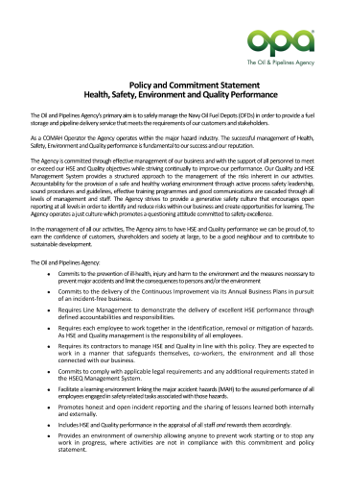
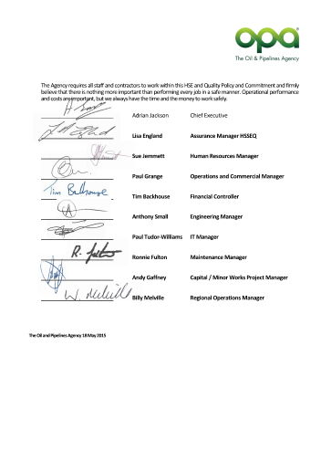
OPA Policy

Slide 102

Objectives and Targets
Objective: overall goal consistent with environmental policy that the agency wants to achieve
Target: detailed performance requirement to achieve objective
Consider how your supply chain and contractors fit within these.
Notes:
[Explain what environmental objectives and targets are from the first two points.]
Together, objectives and targets must be measureable, where practicable. Ideally, they should be SMART (Specific, Measureable, Realistic and Time-based).

Slide 103

Objectives
Policy statement indicates what is important for the organisation in general terms, Environmental objectives must show specific goals to be achieved within a certain time frame, and must be measurable
Examples are:
reduce scrap by 10% within the next 6 months;
increase recycling by 50% in next year;
remove repeat Env incidents within the next year;
reduce number of nonconforming products by 15% within the next year;
Implement supply chain environmental plan in next year
Start small … and build on a firm foundation. You should have at least one ‘macro’ level objective regarding supplier performance, overall system effectiveness, and customer satisfaction – you will be required to monitor and measure performance in these areas anyway

Slide 104

Environmental Aspects
Identify environmental aspects
Determine aspects with significant environmental impact
Document & maintain in an aspects register
Ensure that significant environmental aspects are the focus of the rest of the EMS
Notes:
An environmental management system (EMS) is the system by which an organisation controls the activities, products and services that cause, or could cause, environmental impacts and in doing so minimises the environmental impacts of its operations. Those activities, products and services are called environmental aspects.
This approach is based on the management of ‘cause and effect’ where an organisation’s activities, products and services are the causes or ‘aspects’, and their resulting effect, or potential effect, on the environment are ‘impacts’.
Identification of environmental aspects is fundamental to the EMS. Once this is done, the aspects and associated impacts can be analysed to determine risk. The risks can in turn be evaluated to determine which environmental aspects and impacts are significant risks to the environment and/or the organisation.
Environmental aspects must be documented and kept up to date. The significant environmental aspects are the focus of the rest of the EMS.

Slide 105
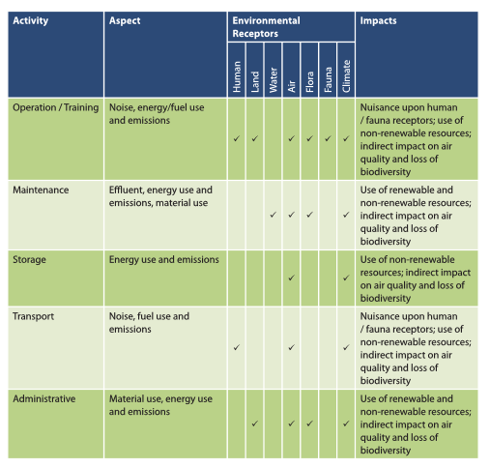
High Level Aspects & Impacts

Slide 106
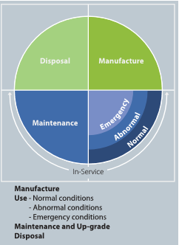
Consider Impact In Use

Slide 107
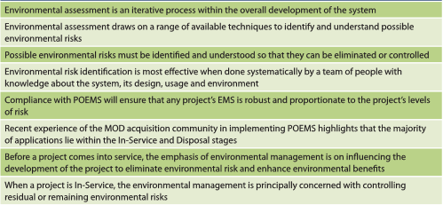
Risk Matrix

Slide 108
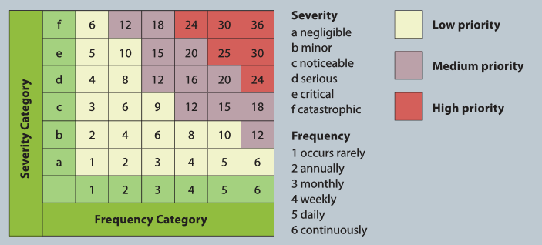
Risk Matrix

Slide 109
Aspects & Impacts
Discussion

Slide 110
Lunch Break

Slide 111

Legal Requirements
Identify environmental legal requirements applicable to the operations of the organisation
Show how legal requirements apply to environmental aspects
Keep these up-to-date & incorporate them into other elements of the EMS
Notes:
The environmental policy must include a commitment to complying with legal and other requirements. It is therefore important to identify those requirements, show how they relate to the environmental aspects, and keep them up-to-date.
Legal and other requirements must be incorporated in the rest of the EMS. Accordingly, most organisations automatically regard an environmental aspect as significant if there is a legal or other requirement associated with it.

Slide 112
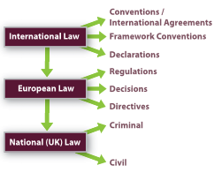
Legal Requirements
Notes:
The environmental policy must include a commitment to complying with legal and other requirements. It is therefore important to identify those requirements, show how they relate to the environmental aspects, and keep them up-to-date.
Legal and other requirements must be incorporated in the rest of the EMS. Accordingly, most organisations automatically regard an environmental aspect as significant if there is a legal or other requirement associated with it.

Slide 113

Other Requirements
Identify other environmental requirements to which the agency subscribes
  MOD requirements
  Government direction
  Commercial client requirements
  Etc
Show how other requirements apply to environmental aspects
Keep these up-to-date & incorporate them into other elements of the EMS
Notes:
The environmental policy must include a commitment to complying with legal and other requirements. It is therefore important to identify those requirements, show how they relate to the environmental aspects, and keep them up-to-date.
Legal and other requirements must be incorporated in the rest of the EMS. Accordingly, most organisations automatically regard an environmental aspect as significant if there is a legal or other requirement associated with it.

Slide 114
Requirements - Discussion
Legal and other requirements discussion

Slide 115

Program
Environmental program/action plan:
  to achieve objectives & targets
  Includes responsibility, means & timeframe
Notes:
To achieve the objectives and targets, the agency needs an environmental program, or action plan, or a set of programs/plans.

Slide 116

Roles and Responsibility
Management provides appropriate resources
Document roles, responsibilities & authorities
Management delegate some responsibilities to a management representative or ensure management take responsibility to:
  Co-ordinate establishment, implementation & maintenance of EMS
  Report to top management on performance of EMS & recommend improvements
  Drive continual improvement through lessons learned and PDCA
Notes:
We have already looked at management roles. One vital role is the provision of resources for the EMS. There is no doubt that additional resources will be required. However, if we do it properly, this will be an investment that will yield benefits.
The standard requires roles, responsibilities and authorities relevant to environmental management to be documented—they are that important!
.

Slide 117

Competence and Training
Does the company have a Competence Management System?
Identify positions & roles associated with significant environmental aspects
Including senior management roles
Assess competence to meet requirements
Identify training needs (Training Needs Analysis)
Fulfil training needs
Assess if training needs meet requirements
Assess if coaching / mentoring is needed to meet competence needs
Is there the desire to meet the competence needs
Continual assessment of competence
Notes:
Those positions or roles that have potential to cause a significant environmental impact, that is, are working in areas or jobs associated with the agency’s significant environmental aspects, need to be identified. The people occupying those positions or roles then have to be assessed as competent on the basis of appropriate education, training or experience.
Following on from this, the training needs of people in these roles and positions has to be identified, and then training or other action has to be provided to meet those needs.
Everyone in the agency is required to have a general awareness of the EMS, especially:
The importance of conformity with the environmental policy and other requirements of the EMS
Significant environmental aspects and related impacts associated with their work
Environmental benefits of improved personal performance
Roles and responsibilities relevant to the EMS
Potential consequences of departure from specified processes / procedures.

Slide 118

Awareness
Ensure all appropriate members of staff and contractors are aware of EMS requirements and the system
Propagate awareness of the EMS
Engagement
Notes:
Everyone in the agency is required to have a general awareness of the EMS, especially:
The importance of conformity with the environmental policy and other requirements of the EMS
Significant environmental aspects and related impacts associated with their work
Environmental benefits of improved personal performance
Roles and responsibilities relevant to the EMS
Potential consequences of departure from specified procedures.
We have another presentation / employee engagement programme that is used to propagate awareness.

Slide 119
Communication
Ensure that communication from external parties is appropriately managed
Decide how to proactively communicate externally about significant environmental aspects
Notes:
Government agencies generally have good processes in place for internal communication—these need to be tapped into so that information on the EMS can be exchanged both upwards and downwards in the structure.
Government agencies also usually have good records management systems—just need to ensure that external communications on environmental issues are appropriately received, documented and responded to.
The third point is a requirement of ISO 14001 to document a decision about whether to communicate proactively externally about an organisation’s significant environmental aspects. There are three likely options:
Publication of significant environmental aspects on the Internet, or in annual reports, or in some other form.
No publication of significant environmental aspects.
Dealing with significant environmental aspects on a case-by-case basis.

Slide 120
Engagement
As the system starts to get implemented, this can often be a time when barriers appear. Ensuring that the engagement process remains in place and is positive, will allow these barriers to be reduced
Ensure that engagement with external parties is appropriately managed and undertaken
Decide how to keep the engagement process open and positive, thus ensuring that you learn from your workforce and external parties you interact with
Notes:
Employee engagement is a significant part of the implementation of any new system, but one with such wide spread impact such as an EMS, brings about greater importance as it touches every person working in and with the agency and as such engagement is of upmost importance for the success of the implementation and on going management and improvement

Slide 121

Documentation
Environmental statement of intent (May be driven by a group or government body – MOD)
Environmental policy
Environmental Strategy
Environmental Plan
Environmental objectives and targets
Description of the scope of the environmental management system
Description of the main elements of the environmental management system and their interaction, and reference to related documents (Including how they interact with Quality, Health and Safety)
Documents and records required by the standard
Documents and records determined by the organisation to be necessary to ensure the effective planning, operation and control of processes that relate to its significant environmental aspects.
Notes:
There is a minimum list of documentation required for a certified environmental management system:
Environmental policy, objectives and targets
Description of the scope of the environmental management system
Description of the main elements of the environmental management system and their interaction, and reference to related documents
Documents and records required by the standard
Documents and records determined by the organisation to be necessary to ensure the effective planning, operation and control of processes that relate to its significant environmental aspects.
The last point will come up again shortly.

Slide 122
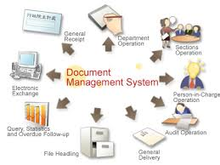

Document Control
Document Template (Numbering convention)
Document approval
Document review, update and re-approval
Identification of changes and current revision status
Management of change
Roles and responsibilities
Availability at points of use
Legibility and identification
Identification and distribution of external documents
Management of obsolete documents.
Notes:
Document control refers to a process for:
Document approval
Document review, update and re-approval
Identification of changes and current revision status
Availability at points of use
Legibility and identification
Identification and distribution of external documents
Management of obsolete documents.
This is usually easy for government agencies, as most of this will already be in place.

Slide 123
Operational Control
Physically control all activities, functions, products and processes associated with significant environmental impacts
Operational control must include documented processes, work instructions and operating procedures defining the manner in which control will be maintained, on a risk management basis
Control of work practices may form the basis of how these risks are managed (Which will include E risks)
Operational control extends to significant environmental aspects of goods & services used by the agency, for communication to suppliers & contractors.
Notes:
The first point is simply about the need for operational control (or internal control) of significant environmental aspects to ensure that they are carried out in accordance with requirements of the EMS.
The second point is about providing documented work instructions and procedures to control processes and operations which do or could have a significant environmental impact. This is the same as a requirement made two slides ago regarding documentation required for an EMS:
“Documents and records determined by the organisation to be necessary to ensure the effective planning, operation and control of processes that relate to its significant environmental aspects.”
The international standard clearly puts the responsibility on the organisation to determine when operational procedures need to be documented. You do not have to document everything! Instead, a risk management approach should be used. The criteria that could be considered when adopting a risk based approach to documenting procedures include:
Likelihood and consequences of environmental impact
Legal and other requirements
Size and complexity of the organisation and the need to ensure that a procedure is undertaken consistently throughout the organisation
Benefits for training.
Finally, operational control procedures are also required for significant environmental aspects of goods and services used by the organisation. These do not strictly have to be documented, but documentation facilitates communication of them to suppliers, including contractors.

Slide 124
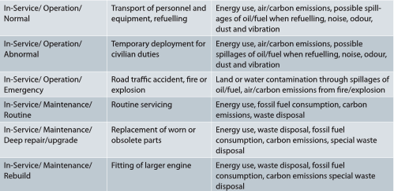
Operations In-Service
Notes:
The first point is simply about the need for operational control (or internal control) of significant environmental aspects to ensure that they are carried out in accordance with requirements of the EMS.
The second point is about providing documented work instructions and procedures to control processes and operations which do or could have a significant environmental impact. This is the same as a requirement made two slides ago regarding documentation required for an EMS:
“Documents and records determined by the organisation to be necessary to ensure the effective planning, operation and control of processes that relate to its significant environmental aspects.”
The international standard clearly puts the responsibility on the organisation to determine when operational procedures need to be documented. You do not have to document everything! Instead, a risk management approach should be used. The criteria that could be considered when adopting a risk based approach to documenting procedures include:
Likelihood and consequences of environmental impact
Legal and other requirements
Size and complexity of the organisation and the need to ensure that a procedure is undertaken consistently throughout the organisation
Benefits for training.
Finally, operational control procedures are also required for significant environmental aspects of goods and services used by the organisation. These do not strictly have to be documented, but documentation facilitates communication of them to suppliers, including contractors.

Slide 125
Video 4

Slide 126
Comfort Break

Slide 127
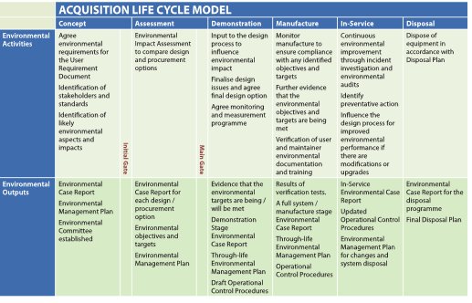
Supply Chain Management
Notes:
Provide example contract management plan and tools

Slide 128
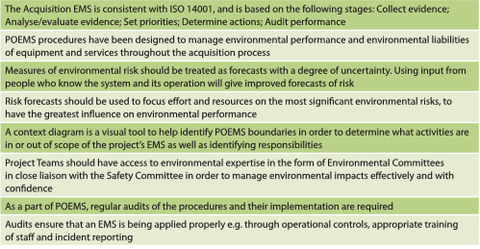
Supply Chain Management
Notes:
Provide example contract management plan and tools

Slide 129
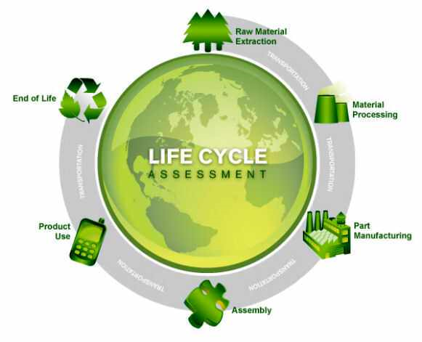
Life Cycle Assessment
Notes:
Provide example contract management plan and tools

Slide 130
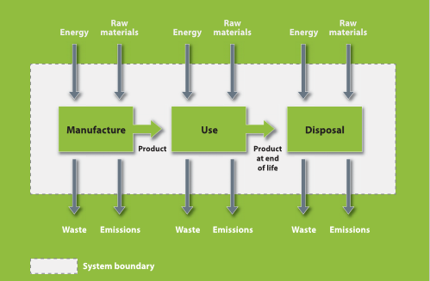
Life Cycle Assessment
Notes:
Provide example contract management plan and tools

Slide 131
Life Cycle Assessment
Life cycle assessment (LCA) is a formal process as part of your EMS to assess the Environmental aspects and impacts throughout the lifecycle of a product or service
It is used in particular related to purchasing of products or services that will be embedded as part of a operational control or life of a facility
For example pollution arising from a production process may be reduced by changes to raw materials or equipment used in the process, but the lifecycle impact must be looked at, from grade to grave.
Importantly this includes the disposal or decommissioning
Even during the earliest stages of a lifecycle or planning, the assessment of impact at later stages should be considered.
Notes:
Provide example contract management plan and tools

Slide 132
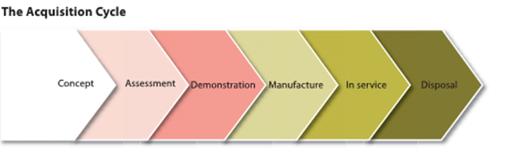
Contract Management
A significant risk to any large organisation or agency is the utilisation of contractors
Development of a Contract Management Process and supporting processes, procedures and supporting documents is of upmost importance if significant Environmental Risks could come from or be managed by contractors
Assessment of the supply chain, to identify that they meet a minimum set criteria
Working closely to ensure they understand the agencies EMS requirements. This may require interface documents to understand who manages what and in particular during emergency situations
Continual management and improvement of the supply chain through performance assurance and improvement programmes
Notes:
Provide example contract management plan and tools

Slide 133
Contract Management
Demonstrate Contract Management Process
Notes:
Provide example contract management plan and tools

Slide 134
Emergency Preparedness
Preparedness is the processes and procedures in place to ensure the organisation is prepared for any form of natural or manmade disasters.
In the next slide we talk of response and management of an incident or disaster, but the preparedness is in relation to;
  Communication (to all)
  Everyone must no what to do in such a situation
  The protocols are in place and have been tested regularly
  The equipment used and services relied on in a disaster situation are fully compliant with their requirements
  All possible scenarios are considered
Management is fully engaged
Notes:
Most large office-based organisations already have an emergency preparedness & response plan as an OH&S requirement. The requirement for an EMS are the same, with some modification related to the impact.

Slide 135
Emergency Response
Processes / Procedures to identify potential for accidents and emergency situations, appropriately respond to, and minimise the environmental impact of, accident and emergency situations
Ensure the appropriate training is provided to the assigned persons
  Dependent on level within the company this can be anything from awareness, ER coordinator, through to ER manager – often many people share these roles.
Test emergency response
Review emergency preparedness & response procedures, especially after incidents
Notes:
Most large office-based organisations already have an emergency preparedness & response plan as an OH&S requirement. The requirement for an EMS is the same.

Slide 136
Crisis Management
Processes / Procedures to identify the method of how the agency will manage the crisis, including the communication internally and externally
Ensure the appropriate training is provided to the assigned persons
  Dependent on level within the company this can be anything from awareness to command center manager
Test crisis management programme
Review crisis management processes / procedures, especially after incidents and tests.
Notes:
Most large office-based organisations already have a crisis management and communication plan as an OH&S requirement. The requirement for an EMS is the same.

Slide 137
Phase 3
On-site gap analysis (Phase 1)
Implementation Action Plan identifying responsibilities (Phase 1)
Document EMS Policy, Aspects & Impacts and Objectives (Phase 2)
Document EMS processes and procedure (Phase 2)
Create supporting documents, templates, guidance and records (Phase 2)
‘Health Check’ utilising Implementation Action Plan for ‘progression’ (all phases – see Phase 1 for explanation)
Internal audit of ‘implemented’ system (Phase 3)
Management Review of ‘implemented’ system (Phase 3)
Certification management (Phase 4)

Slide 138
Management Review
Complete EMS should be reviewed by top management on a regular basis.
Management decide the ‘frequency of review (usually anything from quarterly to once a year to review all system)
Management reviews are not implementation status meetings … they are system effectiveness review sessions
Review looks at data over time to see if the desired results (objectives and plans) are being achieved … and taking action if/when needed (this must be factual data)
Management reviews make management systems dynamic!!! If they did not take place then the systems become static and ineffective

Slide 139
Review of Implementation
To be effective, management reviews should be well prepared i.e. agenda, data/trends etc
Allows top management to assess the effectiveness of the Management System based on the policy, objectives and to define the opportunities for improvement and the need for changes
Attendees must come with data/trends … know what it means … and be prepared to offer related recommendations
The results of management reviews should be in the form of specific actions, ensuring that improvements are made in products/services and processes/systems, and that resource needs are identified

Slide 140
Review of Implementation
Management review outputs can also set the direction for the future;
  new/revised policy can be considered
  improvement objectives can be established
  specific improvement initiatives can be agreed
  Depends on how the company operates the process
Many companies split their meeting to 4 quarterly meetings each one covering a certain part of the Management System
  The meeting is often best being part of other business / operational / management systems meetings (HS / Q)
The output of the review meeting is in the form of a Management Review Report.
The report should be used to drive changes in the system for continual improvement and should be shared with other sites and interested parties

Slide 141
Monitoring and Measurement
Monitor the activities, functions and processes that are associated with a significant environmental impact
Monitor performance, operational controls, & conformity with environmental objectives & targets
Calibrate or verify any monitoring & measurement equipment
Notes:
In the context of an environmental management system, environmental performance is the measureable results of an organisation’s management of its environmental aspects.
The standard requires an organisation to have a procedure for monitoring and measuring, on a regular basis, the key characteristics of its operations that can have a significant environmental impact. The procedure must include the recording of information to monitor environmental performance, operational controls, and progress on achieving the organisation’s environmental objectives and targets.
Any monitoring or measuring equipment that requires calibration or verification must have its calibration and verification maintained, as evidenced by records.

Slide 142
Evaluation of Compliance
Periodically evaluate compliance with legal & other requirements
  Can form part of internal audit programme
  Driven by changes in international standard
  Driven by changes to the legal obligations
  Driven by changes imposed and agreed by clients
Record the evaluations
Notes:
In addition to monitoring and measurement of operational activities, the standard requires an organisation to periodically evaluate its compliance with applicable legal requirements and with other requirements to which it subscribes, and keep records of the results of the evaluations. This is consistent with that commitment to compliance made in the environmental policy.
The distinction between monitoring and measurement on the one hand and periodic evaluation of compliance on the other is not always appreciated:
Monitoring and measurement is an ongoing process to collect data required by legal and other requirements.
Evaluation of compliance is about analysing and comparing the data collected over a period of time with legal and other requirements.
The evaluation can be conducted in a compliance audit.

Slide 143
Nonconformity
Identify actual & potential nonconformities
  From employee engagement
  Incident or accident
  Internal Audit
  External Audit
Take action to stop / correct nonconformities and mitigate environmental impact – immediately if impact is significant
Short term actions should be following emergency / incident response processes and procedures
Notes:
Nonconformity is non-fulfilment of a requirement, that is, when something does not go to plan. In the context of an environmental management system, environmental nonconformity occurs when:
an environmental control is not implemented or is ineffective,
an environmental emergency or accident happens,
a licence condition is breached,
acceptable levels of a monitored or measured characteristic are exceeded,
an environmental objective or target is not met,
a neighbour or member of the public complains about an environmental issue from your site,
a documented procedure or work instruction is not followed, and so on.
Actual and potential nonconformity is identified and suggestions for improvement are made by:
Internal audit
External audit
Site inspections
Feedback from external parties
Complaints from customers or other stakeholders
Suggestions for improvement from staff and contractors
Occurrence of environmental emergencies and accidents
Testing of emergency preparedness and response
Management review
Corrective and preventive action are used when a nonconformity is identified, regardless of its source. They involve getting to the root cause of the nonconformity, then determining and taking corrective action to ensure the actual nonconformity does not recur, or preventive action to ensure the potential nonconformity does not occur in the first place.
The next slide shows how this works in practice.

Slide 144
Root Cause Corrective Action
Identify actual & potential nonconformities
Investigate nonconformities & determine root cause
  Ensure person or team have the necessary RCCA training
Take corrective action to avoid recurrence (consider does action prevent occurrence in the future
Review effectiveness of action taken, if not long term effective then take appropriate measures
Consider sharing with other sites or peers
Notes:
Nonconformity is non-fulfilment of a requirement, that is, when something does not go to plan. In the context of an environmental management system, environmental nonconformity occurs when:
an environmental control is not implemented or is ineffective,
an environmental emergency or accident happens,
a licence condition is breached,
acceptable levels of a monitored or measured characteristic are exceeded,
an environmental objective or target is not met,
a neighbour or member of the public complains about an environmental issue from your site,
a documented procedure or work instruction is not followed, and so on.
Actual and potential nonconformity is identified and suggestions for improvement are made by:
Internal audit
External audit
Site inspections
Feedback from external parties
Complaints from customers or other stakeholders
Suggestions for improvement from staff and contractors
Occurrence of environmental emergencies and accidents
Testing of emergency preparedness and response
Management review
Corrective and preventive action are used when a nonconformity is identified, regardless of its source. They involve getting to the root cause of the nonconformity, then determining and taking corrective action to ensure the actual nonconformity does not recur, or preventive action to ensure the potential nonconformity does not occur in the first place.
The next slide shows how this works in practice.

Slide 145
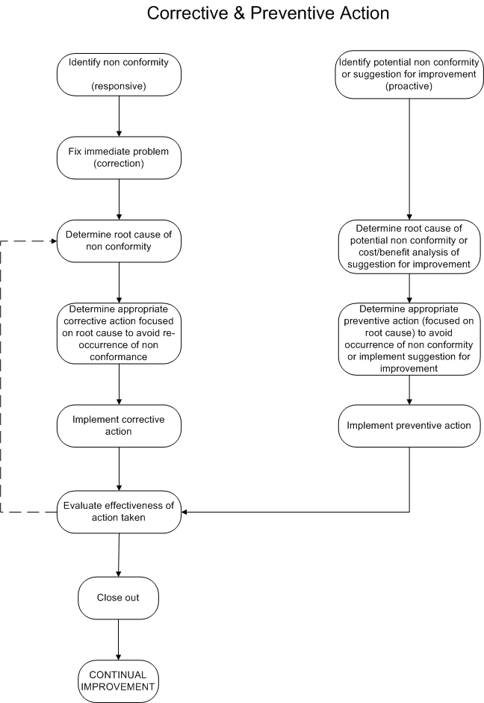
Corrective Action
Notes:
This shows a flowchart of the corrective and preventive action process. The objective of the process is to drive continual improvement of the EMS.

Slide 146
Control of Records
Retain all environmental records required for the successful development, implementation and maintenance of the EMS, including any legal or environmental agency obligations
Notes:
Our agency has a good records management system—all we need to do is ensure that it is used by the EMS.

Slide 147
Internal Audit
Establish & implement internal audit program to:
  evaluate conformity with requirements of EMS & international standard
  evaluate effectiveness of EMS
  opportunity for improvement
  provide information to top management
More during Auditor Training
Notes:
Internal audits of an environmental management system provide information to management on whether the system conforms to planned arrangements and has been properly implemented and maintained. Ideally, an internal audit looks forward and evaluates the effectiveness of a management system in fulfilling the commitments made in the management system policy and achieving the objectives and targets established for the management system.
In the early days of establishing the EMS, internal audits will focus on conformity with the international standard so that certification can be achieved and maintained. It is also appropriate to evaluate compliance with legal and other requirements in an internal audit.
In a mature EMS, an internal audit program should be established on a risk basis by considering the environmental importance of an organisation’s operations in terms of its environmental aspects and impacts, and the results of previous audits.

Slide 148
Questions?

Slide 149
Environmental Management System (EMS)
Implementation Training
Aligned to ISO 14001:2015
Delivered by: Chris Docherty
Notes:
[This presentation is intended to inform employees in operational areas of key environmental interest of the structure and purpose of an environmental management system. his presentation is not designed to be used as is, but rather has been developed as an example and may act as a framework from which to develop a more refined presentation to use for educating staff to the requirements of an Environmental Management System].
This presentation aims to introduce you to the structure and purpose of an Environmental Management System.

Slide 150
Steps to Establish an EMS
Obtain commitment from top management.
Define responsibilities, appoint management team or delegate to a representative(s), establish EMS steering committee, develop implementation plan, initial training on EMS.
Planning—identify environmental aspects, legal & other requirements; formulate environmental policy; establish environmental objectives & targets & programs.
Implementation & operation—develop documentation & processes
Checking—develop processes for monitoring & measurement & corrective & preventive action
Develop and deliver presentation on awareness of the EMS in the agency.
Notes:
The following 10 steps are involved in establishing and implementing an EMS that is based on the international standard ISO 14001:2015. They could be used as the basis for a project plan.
Step 3 could include an initial environmental review. ISO 14004 recommends an EIR when an organisation is establishing an EMS from scratch. The main aim of the review is to consider the environmental aspects as the basis for the EMS. It can also cover identification of legal & other requirements, examination of existing environmental management practices and procedures, and evaluation of previous emergency situations and accidents. We can use ISO 14004 for further guidance on this.

Slide 151
Steps to Establish an EMS
Establish internal audit program, including training; conduct initial internal audit to evaluate conformity to requirements of ISO 14001, including evaluation of compliance
Follow up internal audit with improvements to system
Conduct initial management review of EMS
Implement improvements from management review
Continuous communication and employee engagement to ensure effective implementation of the system
Ongoing analysis, engagement and improvement

Slide 152
Integration
In some organisations it will be beneficial both administratively and for the purpose of expanding knowledge to combine both the environmental and safety case in order to produce a single set of information.
The advantages of combining the two may be outweighed by the disadvantages, which may result in overly complex documentation, management resource and increased administrative burdens.
It may be an area to consider however.

Slide 153
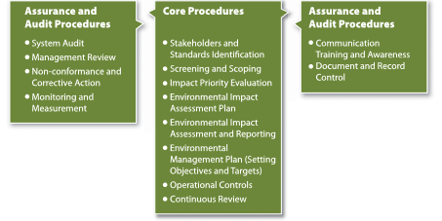
Core System

Slide 154
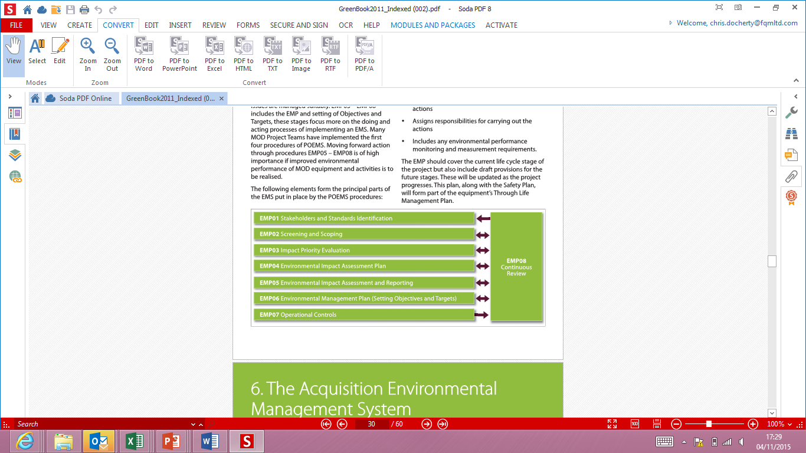
Establishing Continual Review
Continual Review

Slide 155
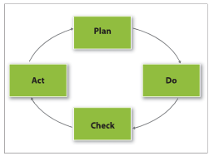
Continual Improvement

Slide 156
Continual Improvement
Plan
  To determine scope of the system during the initial phase, which will continually develop throughout the lifecycle
Do
  To develop appropriate documentation and assign responsibilities in order to ensure that relevant issues are managed effectively
Check
  Period monitoring and checking to ensure the system is working efficiently and effectively to meet the requirements
Act
  Appropriate measures to rectify any shortfalls and updating where the circumstances change or incidents / findings need actions taken

Slide 157
Phase 4
On-site gap analysis (Phase 1)
Implementation Action Plan identifying responsibilities (Phase 1)
Document EMS Policy, Aspects & Impacts and Objectives (Phase 2)
Document EMS processes and procedure (Phase 2)
Create supporting documents, templates, guidance and records (Phase 2)
‘Health Check’ utilising Implementation Action Plan for ‘progression’ (all phases – see Phase 1 for explanation)
Internal audit of ‘implemented’ system (Phase 3)
Management Review of ‘implemented’ system (Phase 3)
Certification management (Phase 4)

Slide 158

Steps to Gaining Certification
1. Apply to UKAS accredited certification body for ISO 14001 certification
2. External comprehensive documentation review & preliminary audit to evaluate readiness for certification (Stage 1)
3. Implement improvements from documentation review & preliminary audit
4. Certification audit (Stage 2)
Notes:
These steps are in addition to establishing an EMS and may be taken if the decision is made to apply for independent certification of the system.

Slide 159
Steps to Gaining Certification
5. Management review, & implementation of further improvements
6. Plan corrective action in response to any nonconformities raised
7. Certification granted for 3 years
8. Surveillance audits initially 6-monthly then annually
9. Regular management reviews
10. Triennial recertification audits.

Slide 160
Comfort Break

Slide 161
Electronic BMS Demo

Slide 162
External Resources
Model environmental management system for government agencies.
International standards ISO 14001:2015, ISO 14004:2004, ISO 19011:2003
Training on environmental management systems and auditing
Consultancy to assist with development of the EMS
Software to simply the whole process
Conformity assessment bodies to certify the EMS to the requirements of ISO 14001:2015.
Notes:
There are several resources that can help the agency establish and implement an EMS.
A model EMS using the FQM BMS approach and devised for Government agencies:
A guide to the EMS
An EMS manual with essential procedures
A list of legal requirements to be used as the starting point for compiling a register of legal and other requirements.
A glossary and reference list to all the relevant standards.
Training packages that can be adapted by a government agency, like this package.
A decision support spreadsheet.
There are three standards directly relevant to environmental management systems:
ISO 14001:2004 has the requirements for an EMS—this is the standard to which an EMS can be certified.
ISO 14004:2004 has guidelines on principles, systems and support techniques for an EMS
ISO 19011:2003 has guidelines for managing internal audit programs as part of an EMS.
The model EMS was devised by FQM using a BMS approach. That way, the agency will own the EMS, but FQM is still available to assist with the adaptation in an efficient and effective way. As a consultant, FQM will provide guidance, but agency staff will do all the work. This keeps external costs down.

Slide 163
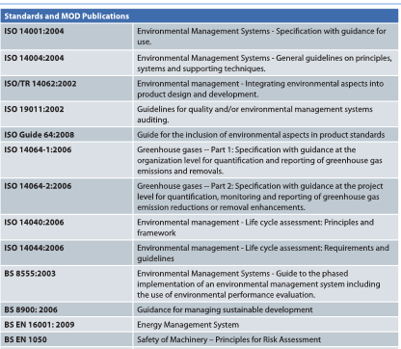
External Resources
Notes:
There are several resources that can help the agency establish and implement an EMS.
A model EMS using the FQM BMS approach and devised for Government agencies:
A guide to the EMS
An EMS manual with essential procedures
A list of legal requirements to be used as the starting point for compiling a register of legal and other requirements.
A glossary and reference list to all the relevant standards.
Training packages that can be adapted by a government agency, like this package.
A decision support spreadsheet.
There are three standards directly relevant to environmental management systems:
ISO 14001:2004 has the requirements for an EMS—this is the standard to which an EMS can be certified.
ISO 14004:2004 has guidelines on principles, systems and support techniques for an EMS
ISO 19011:2003 has guidelines for managing internal audit programs as part of an EMS.
The model EMS was devised by FQM using a BMS approach. That way, the agency will own the EMS, but FQM is still available to assist with the adaptation in an efficient and effective way. As a consultant, FQM will provide guidance, but agency staff will do all the work. This keeps external costs down.

Slide 164
External Resources
Other Useful Websites
www.netregs.gov.uk This aims to make environmental legislation clearer and provides generic environmental management and sector-specific guidance
www.legislation.gov.uk Another website from which UK Acts of Parliament, Statutory Instruments and Explanatory Notes can be downloaded. Also includes new and draft legislation
www.iema.net Institute of Environmental Management and Assessment
http://ec.europa.eu/environment/gpp/index_en.htm European Commission Green Public Procurement webpages
www.aof.mod.uk Acquisition Operating Framework webpages, which provides information on policy and good practice for the MOD and industry partners concerned with acquisition
http://wwf.panda.org/ World Wide Fund for Nature
Notes:
There are several resources that can help the agency establish and implement an EMS.
A model EMS using the FQM BMS approach and devised for Government agencies:
A guide to the EMS
An EMS manual with essential procedures
A list of legal requirements to be used as the starting point for compiling a register of legal and other requirements.
A glossary and reference list to all the relevant standards.
Training packages that can be adapted by a government agency, like this package.
A decision support spreadsheet.
There are three standards directly relevant to environmental management systems:
ISO 14001:2004 has the requirements for an EMS—this is the standard to which an EMS can be certified.
ISO 14004:2004 has guidelines on principles, systems and support techniques for an EMS
ISO 19011:2003 has guidelines for managing internal audit programs as part of an EMS.
The model EMS was devised by FQM using a BMS approach. That way, the agency will own the EMS, but FQM is still available to assist with the adaptation in an efficient and effective way. As a consultant, FQM will provide guidance, but agency staff will do all the work. This keeps external costs down.

Slide 165
Internal Resources
Management team (Steering committee) or delegated representative to co-ordinate establishment, implementation & maintenance of EMS & report to top management.
Steering committee to establish the EMS, and possibly continue to maintain the EMS.
Training of management representative & steering committee members on environmental management systems & ISO 14001.
Training of management representative & internal auditors on internal auditing.
Delivery of awareness training on environmental management system to all staff.
Possible resources for waste segregation, energy & water efficiency measures, and other environmental action plans.
Notes:
The next two slides take a realistic view of the additional resources that will be required for an agency to establish and implement an EMS.

Slide 166
Implementation Barriers
Lack of management support and commitment
Lack of support from staff
Inadequate resources
Inadequate awareness and culture within the organisation
Lack of clear responsibilities and authorities
EMS too complex for the organisation
Organisational politics & culture within functional areas
Notes:
These are all potential barriers to successful establishment and implementation of an EMS. The model environmental management system for government agencies has been put together with these barriers in mind. It is very practical, and is tailored to the requirements of small to large, mainly office-based organisations, with potential for application organisations with substantial field operations.

Slide 167
Constraints
Best Available Techniques (BAT)
  Bat is a concept applied by regulations to limit the pollutant discharges from industrial processes, with particular regard to the preferred abatement strategy
  The best technically feasible option under the circumstances, to reduce the environmental impacts arising from a process or an organisations activities.
Best Practicable Means (BPM)
  Refers to options that are financially and technologically feasible. It can include such factors as the design installations, maintenance and manner or period of operation for plant and machinery, construction and maintenance of including buildings.
  It looks at areas where money, time or trouble are disproportionate to the benefits likely to be achieved. Lack of finance is not a reasonable defence.

Slide 168
Final Words
An environmental management system takes time and commitment from the entire organisation.
Effective running of an EMS will provide ongoing environmental benefits, cost savings and contribute to building an attractive work place culture.
The process approach to management systems allows for easier adoption, simpler understanding and importantly identification of roles and responsibilities against tasks associated with the requirements of the EMS. The use of electronic tools to simplify these steps, make for a more efficient and well controlled system.

Slide 169
Questions?

Slide 170
Thank You
Contact Details; info@fqmltd.com chris.Docherty@fqmltd.com

Slide 171
