Slide 1
Introduction to Global Standard for Packaging & Packaging Materials – Issue 4

Slide 2
Management Systems
Global Standard for Packaging & Packaging Materials – Issue 4 – Feb 2011

Slide 3
Course Content
Background to Standard
Principles of Standard
Benefits to Users
Requirements of Packaging Standard
Certification Process

Slide 4
Background
Leading global Standard adopted by major retailers, manufacturers.
The standard was created in close collaboration with the Packaging Society (formerly The Institute of Packaging)and BRC (British Retail Consortium)
Originally created to establish a Standard for the suppliers of packaging and packaging materials for the food industry
Fourth issue

Slide 5
Background - cont
The British Retail Consortium
BRC is the trade association that represents the retail trade in the UK and is directly involved in issues affecting retailing and the consumer, including food safety, all forms of legislation, ecommerce, the environment and retail crime.
Packaging Society
Formerly known as Institute of Packaging. Created in 1947. Professional membership body for the packaging industry with members drawn from all sectors of industry.

Slide 6
Principles of Standard
Based on three key components:
Senior Management Commitment
Risk-based system
Quality Management System

Slide 7
Principles of Standard
Senior Management Commitment:
Lead from the top
Implementation of system needs support, resources, system involvement
Policy development

Slide 8
Principles of Standard
Risk-based system:
Identification, Evaluation and Control of Risks (Risk Assessment Process)
Focus on Product Quality and safety of manufacture
Examples: Maintenance of Plant, Equipment Use etc.

Slide 9
Principles of Standard
Quality Management System (ISO 9001):
Framework for describing policies, procedures, work instructions, and records needed to meet the requirements of the standard
Environmental and operating conditions necessary to make safe, legal products under hygienic conditions
Culture of continuous improvement

Slide 10
Principles of Standard
Improve Processes
through PDCA Cycle
Results
Baseline Performance
Plan Do
Act Check
Measure/Monitor Results Against Objectives - Improve Process and Change MS as Needed to Achieve and Sustain Desired Results
QMS
Improvement Objective

Slide 11
Benefits of Standard
International third party accredited certification
Addressing company legislative requirements
Single audit report recognised by clients
No requirement for client audits, thus reducing costs
Baseline for developing management system for improvement

Slide 12
Requirements of Standard
Product Categories (audit):
Divided into 2
High Hygiene risk – Packaging that comes into direct contact with food products (this is Webtech category)
Low hygiene risk – Packaging for consumer products and the secondary and tertiary packaging for all uses
The standard uses a decision tree (see next slide) for determining which category applies

Slide 13
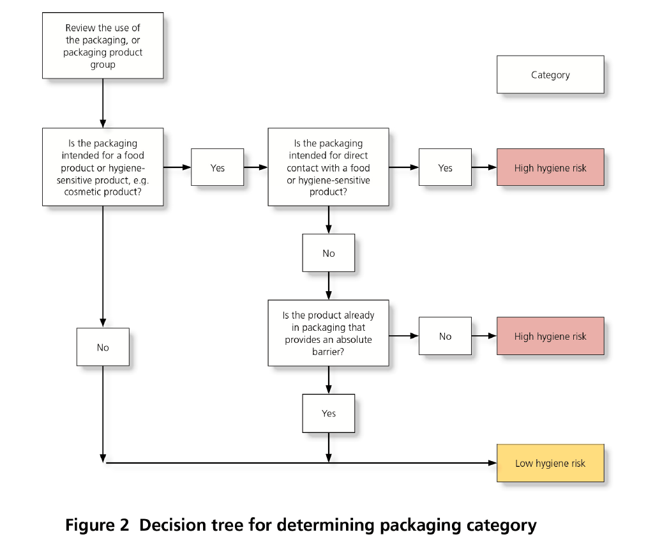
Requirements of Standard

Slide 14
Requirements of Standard
Fundamentals (must be in place)
1.2 – Senior Management Commitment
2.2 – Hazard & Risk Analysis
3.3 – Internal Audit
3.7 – Specifications
3.9 – Traceability
4.9 – Housekeeping & Cleaning
5.3 – Process Control
6.1 – Training & Competence
* Note – each requirement in standard has a Statement of Intent

Slide 15
Requirements of Standard
1 Senior Management Commitment and Continual Improvement
1.1 - Product safety and quality management policy
1.1.1 - The policy shall state the company’s intention to meet its obligation to produce safe and legally compliant products to the specified quality, and its responsibility to its customers. This shall include a commitment to a process of continuous improvement
1.1.2 - The company’s senior management shall ensure the policy is communicated to all staff involved with activities relating to product safety, legality, regulatory compliance and quality
Statement of Intent - The company’s senior management shall develop and document a product safety and quality policy, which is authorised, reviewed, signed and dated by an appropriate senior manager

Slide 16
Requirements of Standard
1 Senior Management Commitment and Continual Improvement
1.2 - Senior management commitment (Fundamental)
1.2.1 - The company’s senior management shall ensure that product safety and quality objectives are measurable, established, documented, monitored and reviewed
1.2.2 - The company’s senior management shall provide the human and financial resources required to implement the processes of the quality management system and product safety programme
1.2.3 - Clear communication and reporting channels shall be in place to report on and monitor compliance with the Standard

Slide 17
Requirements of Standard
1 Senior Management Commitment and Continual Improvement
1.2 - Senior management commitment
1.2.6 - The company’s senior management shall ensure that non-conformities identified at the previous audit against the Standard are effectively actioned
1.2.7 - The company shall have a current, original copy of the Standard available on site
1.2.8 - Where the company is certificated to the Standard they shall ensure that recertification audits occur on or before the audit due date indicated on the certificate.

Slide 18
Requirements of Standard
1 Senior Management Commitment and Continual Improvement
1.2 - Senior management commitment – continued
1.2.4 - The company’s senior management shall have a system in place to ensure that the company is kept informed of all relevant legislative requirements in the country of manufacture and, where known, the country in which the packaging material will be sold. The company shall also be aware of any scientific and technical developments and industry codes of practice applicable
1.2.5 - The company shall ensure that the materials manufactured comply with the relevant legislation (including any legislation concerning the use of recycled content) in the country of manufacture and in which the products are intended to be sold and/or ultimately used, where known
.

Slide 19
Requirements of Standard
1 Senior Management Commitment and Continual Improvement
1.2 - Senior management commitment - continued
Statement of Intent - The company’s senior management shall demonstrate that they are fully committed to the implementation of requirements of the Global Standard for Packaging & Packaging Materials. This shall include provision of adequate resources, effective communication and systems of management review to effect continual improvement. Opportunities for improvement shall be identified, implemented and fully documented

Slide 20
Requirements of Standard
1 Senior Management Commitment and Continual Improvement
1.3 - Organisational structure, responsibilities and management authority
Statement of Intent - The company shall have a clear organisational structure and define the responsibilities, reporting relationships and job functions of those personnel whose activities affect product safety, legality, regulatory compliance and quality
- Org chart
- Competent Manager & Deputy
- Job Descriptions
- Staff cover

Slide 21
Requirements of Standard
1 Senior Management Commitment and Continual Improvement
1.4 – Management Review
Statement of Intent - The company’s senior management shall ensure that a management review is undertaken to ensure that the product safety and quality programme is fully implemented, effective and that opportunities for improvement are identified
- Annual Meetings
- Standard agenda input
- Meeting sets objectives and improvement programmes
- Staff cover
- Review report & action plans
- Action Plans communicated and managed

Slide 22
Requirements of Standard
2 Hazard and Risk Management
2.1 – Hazard and Risk Management Team
Statement of Intent - A multidisciplinary hazard and risk management team shall be in place to develop and manage the hazard and risk analysis system and ensure this is fully implemented
- Internal/External team
- Competent team leader
- Trained team in hazard and risk analysis

Slide 23
Requirements of Standard
2 Hazard and Risk Management
2.2 – Hazard and Risk Analysis
Statement of Intent - A formal hazard and risk management system shall be in place to ensure that all hazards to product safety and integrity are identified and appropriate controls established
- Define scope covering all products/processes
- Team awareness of all hazards and legislative requirements
- Product descriptions
- Process Flows for each product/process
- Hazard identification at each step of process
- Control measures for all hazards
- Identify critical control points

Slide 24
Requirements of Standard
2 Hazard and Risk Management
2.2 – Hazard and Risk Analysis - continued
Statement of Intent - A formal hazard and risk management system shall be in place to ensure that all hazards to product safety and integrity are identified and appropriate controls established
- Identify critical control points limits
- Monitor critical control points
- Annual review of hazard and risk management system
- Audit system based on standard requirements

Slide 25
Requirements of Standard
2 Hazard and Risk Management
2.3 – Exemption of requirements based on the risk analysis
Statement of Intent - A formal hazard and risk management system shall be in place to ensure that all hazards to product safety and integrity are identified and appropriate controls established
- Hazard and Risk Analysis study supported by the implementation of the prerequisites set out in requirements clauses 4 to 6
- Document exemptions of requirements in clauses 4 to 6
- Review at internal audit

Slide 26
Requirements of Standard
3 Product Safety and Quality Management System
3.1 – Product safety and quality manual
Statement of Intent - The company shall have a manual which describes how the requirements of the Standard are met. These requirements shall be fully implemented, reviewed at appropriate planned intervals and improved where necessary
- outline of working methods and practices or references to where such an outline is documented
- Manual available to all staff

Slide 27
Requirements of Standard
3 Product Safety and Quality Management System
3.2 – Customer focus and contract review
Statement of Intent - The company’s senior management shall ensure that processes are in place to determine customer needs and expectations with regard to quality and safety and ensure these are fulfilled
- Identify staff responsible for communicating with staff
- Document customer requirements
- Review customer requirements
- Agree changes to customer requirements

Slide 28
Requirements of Standard
3 Product Safety and Quality Management System
3.3 – Internal Audits
Statement of Intent - The company shall audit those systems and procedures which cover the requirements of the Standard to ensure they are in place, appropriate and complied with
- Internal audit schedule
- All processes in management system audited annually
- Internal auditors will be competent
- Auditors will not audit their own work
- Audit Report detailing non-conformance
- Timely Corrective Action taken

Slide 29
Requirements of Standard
3 Product Safety and Quality Management System
3.4 – Supplier approval and performance monitoring
Statement of Intent - The company shall operate procedures for approval and monitoring of its suppliers. This shall include suppliers of materials and services to the company and ensure that materials and services procured conform to defined requirements
- Documented supplier approval procedure
- Continual assessment programme
- Record supplier assessments
- Certificate of Conformance (compliance)

Slide 30
Requirements of Standard
3 Product Safety and Quality Management System
3.5 – Subcontract of Production
Statement of Intent - Where production processes are subcontracted this shall be with the agreement of customers. Procedures shall be in place for the effective control of subcontractors and the work undertaken
- Customer notification
- Continual assessment programme
- Record supplier assessments
- Certificate of Conformance (compliance)

Slide 31
Requirements of Standard
3 Product Safety and Quality Management System
3.6 – Documentation control
Statement of Intent - The company’s senior management shall ensure that documented procedures and recording forms critical to the management of product safety, legality and quality are in place and effectively controlled
- Version Control
- Available to all staff
- Amendments
- Obsolete Documents
- Master List

Slide 32
Requirements of Standard
3 Product Safety and Quality Management System
3.7 – Specifications
Statement of Intent - The company shall ensure that appropriate specifications exist for raw materials, intermediate and finished products, and any product or service which could affect the integrity of the finished product and customer requirements
- Compliance
- Customer Agreement
- Company – DoC. Minimum requirements
- Legal Requirements - Product
- Trademarking
- Review Process

Slide 33
Requirements of Standard
3 Product Safety and Quality Management System
3.8 – Record Keeping
Statement of Intent - The company shall maintain records to demonstrate the effective control of product safety, legality and quality
- Signed Records
- Amendment Control
- Documented procedure
- Retention Period

Slide 34
Requirements of Standard
3 Product Safety and Quality Management System
3.9 – Traceability
Statement of Intent - The company shall have a system in place to identify product batches and to trace and follow all raw materials through processing to the distribution of the finished product to the customer. Records shall be retrievable in a timely manner
- Full Process Traceability
- Numbering (Product identification)
- Annual Traceability Testing
- Retention Period

Slide 35
Requirements of Standard
3 Product Safety and Quality Management System
3.10 – Complaint Handling
Statement of Intent - The company shall have a system for the effective capture, recording and management of product complaints
- Records, Investigation, Action
- Continual Improvement – Trend Analysis
- Timely

Slide 36
Requirements of Standard
3 Product Safety and Quality Management System
3.11 – Management of incidents, product withdrawals and recalls
Statement of Intent - The company shall have a plan and systems in place to effectively manage incidents, product withdrawals and recalls, in order to ensure that all potential risks to the quality, hygiene and legality of products are controlled
- Document Procedure
- Identification of Incidents – Competency of Staff
- Recall Procedure – Minimum Requirements
- Review Process
- Preventive Action

Slide 37
Requirements of Standard
4 Site Standards
4.1 – External standards
Statement of Intent - All grounds within the site shall be finished and maintained to an appropriate standard
- Contamination Control & Review
- Grounds Maintenance
- Plant Maintenance
- Drain Control
- Road Maintenance
- Storage Control
- Refuse Control

Slide 38
Requirements of Standard
4 Site Standards
4.2 – Building fabric, Raw material handling, preparation,
processing, packing and storage areas
Statement of Intent - The internal site, buildings and facilities shall be suitable for the intended purpose and shall be designed, constructed, maintained and monitored to effectively control the risk of product contamination
- Plant Cleaning
- Inspection & Cleaning – Suspended Ceilings
- Work Environment
- Internal Drain Control
- Ventilation Control
- Protected Windows (Glass)

Slide 39
Requirements of Standard
4 Site Standards
4.3 – Utilities
Statement of Intent - All utilities to and within the production and storage areas shall be designed, constructed, maintained and monitored to effectively control the risk of product contamination
- Water Treatment
- Microbiological and chemical quality (water, steam etc.)
- Risk Assessment
- Legislation

Slide 40
Requirements of Standard
4 Site Standards
4.4 – Security
Statement of Intent - Security arrangements shall be assessed to ensure the integrity of products and processes
- Documented Procedure (reduce risk)
- Site Access Control
- Staff Training – Site Security
- References – P/T & Temp workers
- Contractor Control (qualified person)
- Transport Control
- IT Backup & Storage

Slide 41
Requirements of Standard
4 Site Standards
4.5 – Layout & Product Flow
Statement of Intent - Premises and plant shall be logically designed, constructed and maintained. Procedures shall be in place to control the risk of product contamination and to comply with all relevant legislation
- Minimise Contamination
- Work & Storage Space
- WIP identification
- Product Handling Areas

Slide 42
Requirements of Standard
4 Site Standards
4.6 – Equipment
Statement of Intent - Equipment shall be suitably designed for the intended purpose and shall be maintained and used so as to minimise the risk to product safety, legality and quality
- Equipment Design (Minimise Contamination)
- New Equipment Installation ( spec)
- Cleaning & Maintenance
- Notices on equipment

Slide 43
Requirements of Standard
4 Site Standards
4.7 – Maintenance
Statement of Intent - A documented system of planned maintenance shall be in place, covering all items of equipment and plant that are critical to product safety, legality and quality.
- Fixtures & Fittings
- Preventative Maintenance
- Documented Procedure (Equipment Check)
- Storage
- Temp Repairs (tape, cardboard – time bound)
- Corrective Action
- Wooden Equipment
- Workshop (swarf)
- Commissioning

Slide 44
Requirements of Standard
4 Site Standards
4.8 – Staff Facilities
Statement of Intent - Staff facilities shall be sufficient to accommodate the required number of personnel, and designed and operated to minimise the risk of product contamination. Such facilities shall be kept in a good and clean condition
- Hand Washing (Minimum Requirements)
- Food Contact
- High Risk Products
- Segregation – Toilets, Locker Rooms, PPE
- Eating, Drinking, Smoking (control measures)
- Visitor Facilities

Slide 45
Requirements of Standard
4 Site Standards
4.9 – Housekeeping & Cleaning
Statement of Intent - Housekeeping and cleaning systems shall be in place, which ensure that appropriate standards of hygiene are maintained and that risk of contamination to the product is minimised
- ‘Clean as you go’ Policy
- Cleaning Schedules (minimum requirements in standard)
- Storage – cleaning materials, chemicals (strong odour), labelling
- Segregation – Toilet cleaning material

Slide 46
Requirements of Standard
4 Site Standards
4.10 – Waste and Waste Disposal
Statement of Intent - Suitable facilities shall be provided for the storage and disposal of process and other waste
- Waste Containers – frequency, maintenance, labelling
- Waste Streams – Legislation, separation
- Destructive Process – substandard trademark materials
- Segregation – Toilet cleaning material

Slide 47
Requirements of Standard
4 Site Standards
4.11 – Pest Control
Statement of Intent - The company shall be responsible for minimising the risk of pest infestation on the site
- Prevention Programme – Pest entry,
- Internal/External competency
- Inspection (documented) Frequency – RA
- External – service contract
- Hazard elimination - infestation
- Catch analysis – flying control devices
- Documented procedures – pest activity (minimum requirements)
- Corrective Action

Slide 48
Requirements of Standard
4 Site Standards
4.12 – Transport, storage and distribution
Statement of Intent - The transport, storage and distribution of raw materials and finished products shall be undertaken in a manner to minimise the risk of contamination or malicious intervention
- Identification & Protection – Recycling Material
- Stock Rotation – Shelf Life (FIFO)
- Goods Inward Inspection
- Pallet Control
- On/Off site Storage Control
- Documented procedures – storage, hygiene checking
- WIP labelling
- Drivers – Site rules, cleaning
- Third Party contractors

Slide 49
Requirements of Standard
5 Product and Process Control
5.1 – Product design and development
Statement of Intent - Product design and development processes shall be in place to ensure the production of safe and legal products to defined quality parameters
- Customer Requirements – Design Process
- Product Specification
- Final Product Concepts
- Production Trials – validation of manufacture
- Procedures/Records
- Samples - retention

Slide 50
Requirements of Standard
5 Product and Process Control
5.2 – Packaging Print Control
Statement of Intent - Where packaging is printed with allergen/safety/legal information, procedures shall be in place to ensure that the information is fully legible and correctly printed to the customer’s specification
- Assessment & Control – Print Process
- Print equipment traceability (Printing Plates)
- Storage – Printing Plates
- Print Run Control
- Printing Errors identification
- Composite Print – segregation of variants
- Production Records – competency,
- Samples - Packaging
- Unused printed product control

Slide 51
Requirements of Standard
5 Product and Process Control
5.3 – Process Control
Statement of Intent - Procedures shall be in place to ensure effective quality assurance of operations throughout the process
- Critical Processes
- SPC points – Process Limits
- Documented process check
- Supplier Conformity (COC etc.)
- Final Inspection
- Composite Print – segregation of variants
- Management of Process Change

Slide 52
Requirements of Standard
5 Product and Process Control
5.4 – Product inspection and analysis
Statement of Intent - The company shall use appropriate procedures and facilities when undertaking or subcontracting inspection and analyses critical to product safety, legality and quality
- Quality Control (each stage)
- Competent inspection staff
- Test procedures
- Testing Frequency
- Subcontractor control (Calibration accreditation – UKAS approved lab)

Slide 53
Requirements of Standard
5 Product and Process Control
5.5 – In-line testing and measuring equipment
Statement of Intent - The company shall use hazard and risk analysis principles to determine the need for in-line product testing equipment to ensure the integrity and quality of products
- Tolerances
- Procedures – Testing Regime
- Nonconformance Removal
- Corrective Action – equipment failure
- Batch recall

Slide 54
Requirements of Standard
5 Product and Process Control
5.6 – Calibration
Statement of Intent - Measuring equipment used to monitor critical manufacturing process points and product safety and legality shall be calibrated
- Test equipment identification (label etc.)
- Traceability of equipment – National standards
- Frequency
- Competent staff
- Equipment protection
- Equipment measurement (out of calibration)

Slide 55
Requirements of Standard
5 Product and Process Control
5.7 – Control of Nonconforming Product
Statement of Intent - The company shall ensure that out-of-specification product is clearly identified, labelled and quarantined
- Documented procedures – labelling, quarantine
- MRB – review of failed product
- Corrective Action

Slide 56
Requirements of Standard
5 Product and Process Control
5.8 – Foreign body contamination control
5.8.1 – Foreign body control
Statement of Intent - The company shall be able to demonstrate that effective controls are in place to ensure product is protected from contamination during production and storage
- Physical contamination (RA)
- Glass, Plastic (Risk)
- Protection
- Control Register
- Inspection
- Breakages (incident reporting)

Slide 57
Requirements of Standard
5 Product and Process Control
5.8 – Foreign body contamination control
5.8.2 – Sharps control
Statement of Intent - The company shall be able to demonstrate that effective controls are in place to ensure product is protected from contamination during production and storage
- Documented Policy - Control
- Blades, equipment, tools, instruments
- Internal/external control
- Snap off blades
- Protection – Notice Boards

Slide 58
Requirements of Standard
5 Product and Process Control
5.8 – Foreign body contamination control
5.8.3 – Chemical and biological control
Statement of Intent - Controls shall be in place to prevent contamination from chemical hazards
- Cleaning materials, lubricants and adhesives - grading
- Chemical control
- Risk Analysis - contamination

Slide 59
Requirements of Standard
6 Personnel - Raw materials handling, preparation, processing, packing and storage areas
6.1 – Training Competence
Statement of Intent - The company shall ensure that all employees are adequately trained, instructed and supervised commensurate with their activity and are competent to undertake their job role
- Documented Procedure
- Induction Training
- Competency Review – packaging QA, contamination etc.
- Training Records (also previous key staff)
- Refresher Training

Slide 60
Requirements of Standard
6 Personnel - Raw materials handling, preparation, processing, packing and storage areas
6.2 – Access and movement of personnel
Statement of Intent - The company shall ensure that access and movement of personnel, visitors and contractors shall not compromise product safety and quality
- Site Plan - Access
- Production Walkways - segregation

Slide 61
Requirements of Standard
6 Personnel - Raw materials handling, preparation, processing, packing and storage areas
6.3 – Personal Hygiene
Statement of Intent - The company’s personal hygiene standards shall be documented and adopted by all personnel, including visitors to the production facility. These standards shall be developed with due regard for risk of product contamination
- Jewellery Policy - specified
- Wrist bands
- Personal items e.g. mobile phones, medicines
- Hand wash – toilet, eating, drinking (staff, external)
- Fingernails – false, painted, gloves (external)
- Eating – sweets, chewing gum etc.
- Drinking Water – segregated area

Slide 62
Requirements of Standard
6 Personnel - Raw materials handling, preparation, processing, packing and storage areas
6.4 – Medical Screening
Statement of Intent - Health conditions likely to adversely affect product safety shall be monitored and controlled
- Medical screening procedure
- Health Questionnaire
- Cuts/Grazes – coloured bandage/metal strip/finger stall

Slide 63
Requirements of Standard
6 Personnel - Raw materials handling, preparation, processing, packing and storage areas
6.5 – Protective Clothing
Statement of Intent - Appropriate protective clothing shall be worn in production and storage areas to minimise the risk of product contamination
- Risk Assessment – Policy for use (away from production), footwear, snoods, hair
- Protective clothing – Upper torso, no external pockets, sewn on buttons, laundered, disposable
- Segregation – dirty clothing

Slide 64
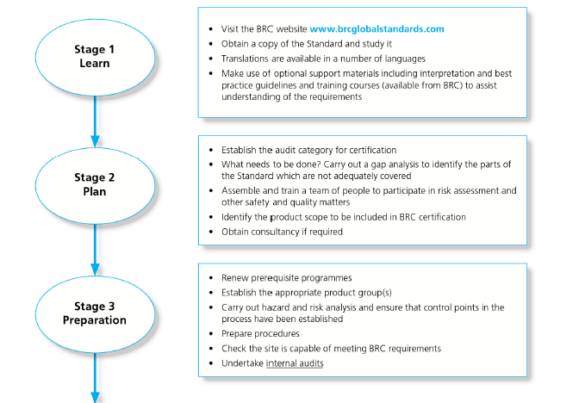
Certification Process

Slide 65
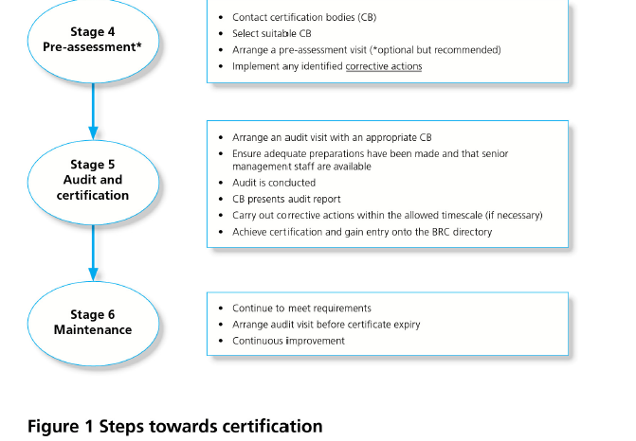
Certification Process

Slide 66
Thank You
www.fqmltd.com
www.fqmtraining.com

