Slide 1
Construction (Design and Management) Regulations 2015
(CDM 2015)
Introduction
Rev - April 2018

Slide 2
ISO Background
ISO = International organisation for Standardisation
based in Switzerland
made up of over 100 National Standards Bodies (NSB’s)
more than 20,000 standards in the ISO portfolio
all standards are based on international consensus
ISO standards are usually developed by its Technical Committees (TC’s) and Sub-committees (SC’s)
ISO/TC176/SC2 (Quality Systems) is responsible for ISO 9001

Slide 3
Trainer Introduction
Worked in the industry since 1976. Chartered member of IOSH with hands on experience in the chemical and construction industry, retail outlets and offices.
Brian Christie

Slide 4
Course Aims
To inform CDM Duty Holders of their duties and responsibilities under the CDM 2015 Regulations
‘This training is not intended to provide sufficient training, knowledge and skills to allow the recipient to competently perform their duties under the new regulation but is intended to provide information regarding the changes and guidance on how to proceed.’

Slide 5
Course Objectives
To describe the main requirements of duty holders under the CDM regulations 2015
To list the main items of documentation required for compliance under CDM 2015
To understand how the duty holders interact with each other during the course of a construction project
‘This training is not intended to provide sufficient training, knowledge and skills to allow the recipient to competently perform their duties under the new regulation but is intended to provide information regarding the changes and guidance on how to proceed.’

Slide 6
Changes / Transition Period
Regulations came into force on 6 April 2015 but with a transition period. Now fully in place from 6 October 2015
CDM 2007 – appoint CDM Coordinator
CDM 2015 – appoint Principal Designer (PD) in writing. (If not, Principal Contractor responsible for H&S File). PD not a direct replacement of CDM Coordinator
Domestic Clients now under CDM 2015
Notes:
CDM Co-ordinator assisted client, made arrangements for health and safety measures and collect pre-construction information.
CDM 2015 – Principal designer does this.
More than one contractor and construction phase not started

Slide 7
Changes / Transition Period
CDM Co-Ordinator ( 2007 ) Duties
Advise and assist Client in their duties
Notify HSE
Co-ordinate H&S aspects of design and co-operate with others involved with the project
Facilitate good communications between Clients; Designers and Contractors
Liaise with the Principal Contractor regarding ongoing design
Identify, collect and pass on Pre-construction Information
Prepare / update the Health and Safety File
Notes:
CDM Co-ordinator assisted client, made arrangements for health and safety measures and collect pre-construction information.
CDM 2015 – Principal designer does this.
More than one contractor and construction phase not started
New Split of CDM Co-Ordinator Duties 70:25:5 Client / PD / PC

Slide 8
Why Change ?
CDM 2007 did not fully meet requirements of EEC Directive 92 / 57 / EEC (Temporary or Mobile Construction Sites)
Designed to reduce fatal accidents in certain areas
‘Competence’ removed from guidance
No longer an Approved Code of Practice (ACOP)
‘L’ Series Guidance now (L 153) – slightly lesser standing
In line with the ‘busy builder’
More logical process – Regulation by Regulation

Slide 9
European and UK Legislation
Health and Safety at Work
etc. Act 1974
EU Directives
Regulations
Approved Codes of Practice
Guidance
British and European Standards
Information including Free Publications

Slide 10
European and UK Legislation
Approved Codes of Practice
Practical guidance on how to comply with the law
Follow the advice - complying with the law
May use alternative methods to show compliance
Special legal status - need to show you have complied
Prosecuted for breach of health and safety law
Notes:
Define ACOP; Guidance etc

Slide 11
European and UK Legislation
Guidance
Usually issued by the Health and Safety Executive
Following Guidance is not compulsory unless specifically stated
Free to take other actions
Normally doing enough to comply with the law
Inspectors seeking compliance may refer to Guidance
Notes:
HSG 65; HSG 170; HSR 25 etc

Slide 12
Recent HSE Statistics - 1
‘Fatal injuries remaining broadly level’ – Source:
Health and Safety Executive – July 2018
38 UK construction workers killed during 2017 – 2018
30 killed in 2016 / 2017
47 killed in 2015 / 2016
35 killed in 2014 / 2015
Average deaths for last five years was 39
Agriculture, Waste Recycling and Manufacturing also high risk areas
Points to note include:
30 in 2016 / 2017 is the lowest number of deaths on record
144 fatalities in total for 2017 / 2018. Up 9 from 2016 / 2017
Average fatalities for last 5 years was 142 – Not in decline !
Older and self employed workers fatalities increased
Agriculture (44% of fatalities) and Construction (30 % of fatalities)

Slide 13
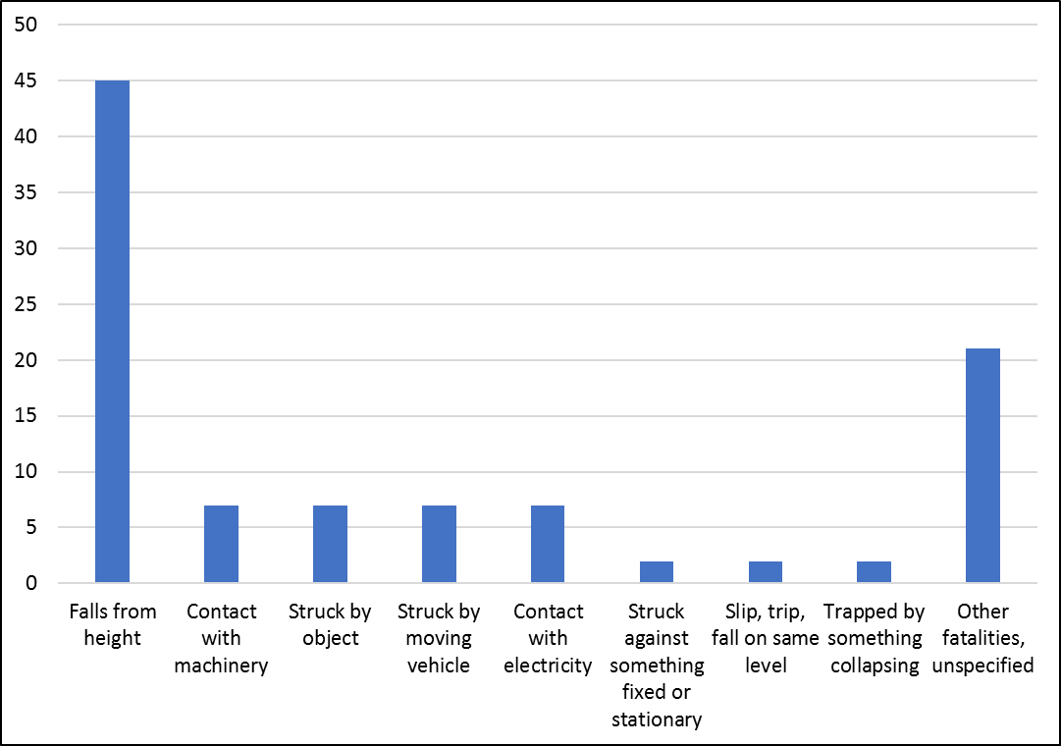
Recent HSE Statistics - 2
Types of Fatal Injuries in Construction
Notes:
Fatalities from Falls from Height; Struck by Moving Vehicles and Struck by Moving Objects total more than half of all fatalities every year since 2001 / 2002

Slide 14
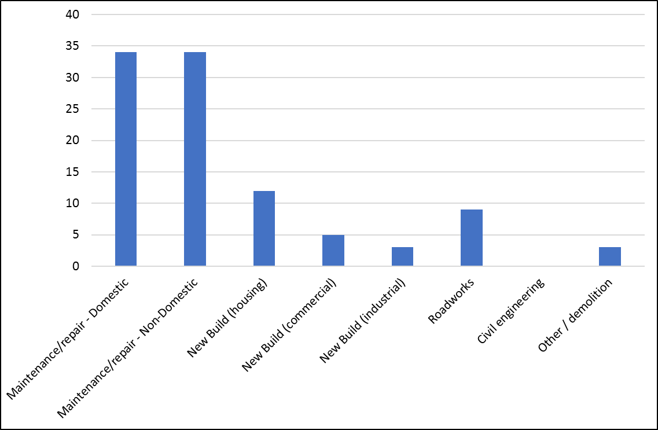
Recent HSE Statistics - 3
Proportion (%) of Fatalities in Various Construction Activities

Slide 15
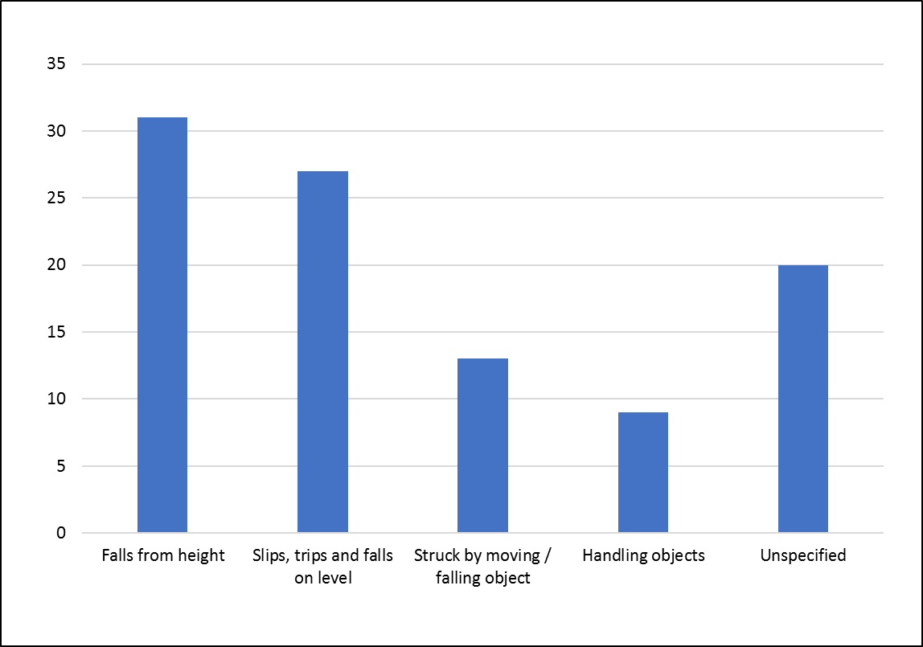
Recent HSE Statistics - 4
Causes of Major Injuries in Construction
Notes:
Occupations where Falls From Height occurred included:-
Painters and Decorators
Bricklayers and Stonemasons
Scaffolders, Stagers and Steeplejacks
Electricians

Slide 16
Recent HSE Statistics - 5
Other relevant statistics include:
1.2 million workers suffer from a work related illness
2595 mesothelioma deaths due to past exposure to asbestos (2016)
76,000 other injuries reported under RIDDOR
27.3 million working days lost due to work related illness and injury
£14.8 billion estimated cost of injuries and ill health from current work conditions (2016 – 2017)

Slide 17
Enforcement Notices
Analysis carried out in 2016 / 17 – First full year of CDM 2015
3155 enforcement notices to construction duty holders
1793 were prohibition notices / 1362 were improvement notices / 7993 were potential breaches of acts or regulations
HASAWA 3391
Work at Height Regulations – 1790
CDM 2015 – 1699 (third largest)
CDM 2015 - Principal Contractor (489); Contractor (278); Client Duties (99); Principal Designer (5) and Designer (2)
Principal Contractor – plan, manage, monitor & co-ordinate work
Contractor – plan….etc; skills, knowledge of site staff and welfare facilities
Also, issues around excavations (86); fire safety (58) and stability of structures (54)
Notes:
Potential Breaches – HASAWA; WAH; CDM 2015

Slide 18
Sentencing Guidelines
Introduced in February 2016 – England and Wales at present

Slide 19
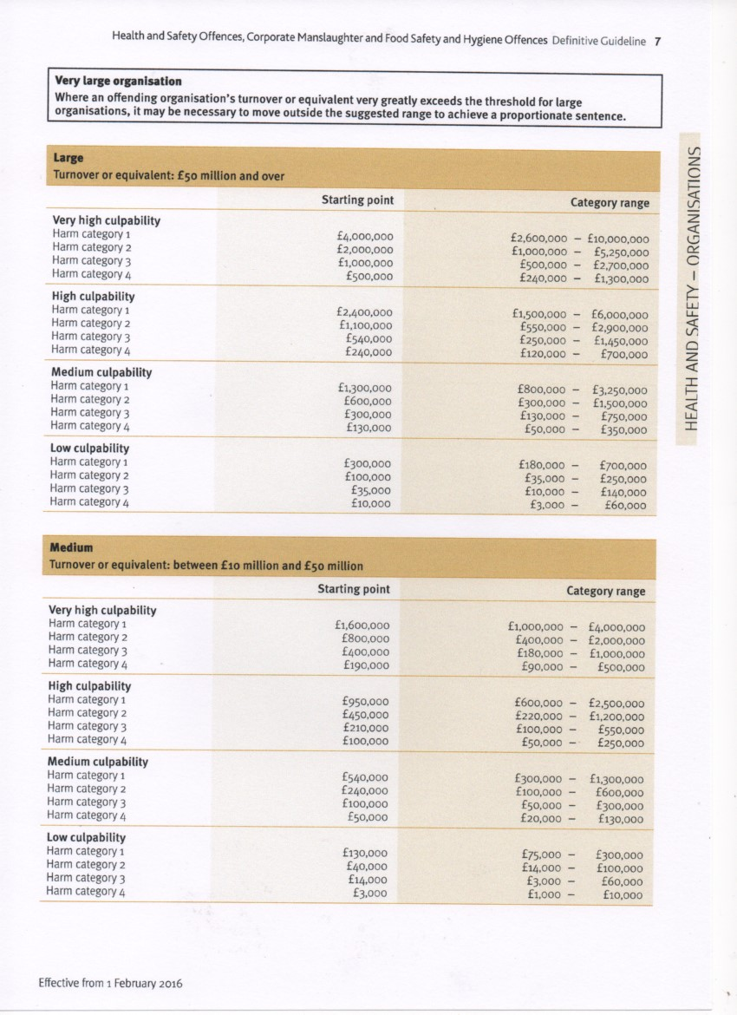
Sentencing Guidelines

Slide 20
Structure and Applications
Structure
Part 1 Commencement, Interpretation and Application
Part 2
Client Duties
Part 3
Other Health and Safety Duties and Roles
Part 4
General Requirements for Construction Sites
Part 5
General
Schedules
Schedule 1
Particulars to be notified under Regulation 6
Schedule 2
Minimum welfare facilities required for construction sites
Schedule 3
Work involving particular risks
Schedule 4
Transitional provisions – no longer in force
Schedule 5
Amendments (to other legislation)
Appendices
Appendix 1
General principles of prevention
Appendix 2
Pre-construction information
Appendix 3
The construction phase plan
Appendix 4
The health and safety file
Appendix 5
“Information flow during a project involving more than one contractor”
Appendix 6
Working with a domestic client
Notes:
Schedules include Notification requirements; welfare arrangements; work involving particular risks;
Appendices include General principles of prevention; PCI; CPP; Health and Safety File; working for a domestic client

Slide 21
Important Definitions
Definitions for all Duty Holders including Domestic Client
Principal Contractor
Contractor appointed to perform duties under Regulations 12 to 14
Principal Designer
Designer appointed to perform duties under Regulations 11 and 12
Pre-construction Phase
Structure *
Construction Phase - Period of time from start to finish of construction work in a project
Construction Phase Plan - Plan drawn up under Regulations 12 – 15
Construction work - carrying out of any building, civil engineering or engineering construction work
Health and Safety File - Prepared under Regulation 12(5)
Pre-construction Information
Notes:
Construction work includes: alteration, conversion, fitting out, renovation, repair, site clearance, assembly of prefabricated elements etc…
* Define Structure from Guidance
Pre-construction Information – in client’s possession relevant to the work including health and safety hazards, information in an appropriate form.

Slide 22
Duty Holders
Duty Holders under CDM 2015 are:
Client including Domestic Client
Designer
Principal Designer (PD)
Principal Contractor (PC)
Contractor
Worker

Slide 23
Client Role / Main Duties
Clients are “organisations or individuals for whom construction work is carried out”
Duties include making sure:
arrangements are in place to manage the project *
health and safety risks are managed
other duty holders are appointed **
sufficient time and resources are allocated
relevant information is prepared and provided
the PD and PC carry out their duties
welfare facilities are provided
Notes:
* Arrangements include assembling a design team; providing pre-construction information; ensuring construction phase plan is prepared ensure Health and Safety file is prepared.
** Projects with more than one contractor, a PD and PC must be appointed
Not necessarily an active role but ensure it happens

Slide 24
Designers Duties
Designers generally form “Part of a business….. To prepare or modify designs for a product, building or system relating to construction work”
Eliminate, reduce or control foreseeable risks arising during:
Construction
+
Maintenance and use of building post construction

Slide 25
Principal Designers Duties
Principal Designers are generally “designers appointed by the client, in writing, in projects involving more than one contractor” (Regulation 5) *
Must demonstrate “sufficient knowledge, experience and ability”
Plan, manage, monitor and co-ordinate Health and safety in Pre-construction Phase**
Prepare and provide relevant information to other dutyholders
Provide relevant information on health and safety to Principal Contractor during construction phase
Notes:
* Or envisaged to be more than one contractor
**includes identifying eliminating or controlling forseeable risks
Ensuring designers carry out their duties
** Key words here are plan; manage; monitor and co-ordinate

Slide 26
Principal Contractor
Principal Contractors are “appointed by client” to “co-ordinate construction phase of a project“ where there is “more than one contractor”
Duties:
Ensure:
Plan, manage, monitor & co-ordinate
Liaise with client and PD
Prepare construction phase plan
Organise co-operation between contractors
Site inductions
Prevent unauthorised access
Consult and engage with workers on
H & S
Provide suitable welfare facilities

Slide 27
Contractors Duties
Contractors “do actual construction work” can be an “individual or a company”
Plan, manage and monitor work under their control
Projects more than 1 Contractor:
- Co-ordinate their activities within the project team
- Comply with directions from PD or PC
Single contractor projects:
- Prepare a Construction Phase Plan

Slide 28
Workers
Workers either “work for, or are under the control of, contractors on a building site”
They must:
Be consulted about health, safety and welfare matters
Take care of their own and others health and safety
Report anything endangering their, or others, health and safety
Cooperate with employer, colleagues, contractors and other duty holders

Slide 29
Domestic Clients
“has construction work done on their own home or that of a family member, not done in connection with a business”

Slide 30
Securing Health and Safety - 1
Key elements include:
General Principles of Prevention (Appendix 1)
Appointing the correct people
Providing “information, instruction, training and supervision” (HASAWA Section 2)
Co-operation, communication and co-ordination with dutyholders
Engaging and consulting with workers
Notes:
Information: - Health and Safety Law Poster; Safety signage;
Instruction:- information about how something should be carried out or operated
Training:- the action of teaching a person a particular skill or operation
Supervision:- the action of controlling or managing an individual

Slide 31
Securing Health and Safety - 2
Appendix 1 of CDM 2015
Eliminate or avoid risks
Evaluate risks that cannot be avoided
Combat risks at source
Give priority to collective measures
Provide appropriate information to employees
Adapt work to the individual
Adapt to technical progress
Replace dangerous with the non-dangerous
Develop a coherent overall prevention policy
Notes:
Adapt to individual by design of workplaces; choice of equipment and working methods; work rate
Overall prevention policy includes technology; working conditions; organisation of work etc

Slide 32
Time for a Break!

Slide 33
Any Questions
Notes:
PCI could include previous H&S File; asbestos survey; services drawings etc

Slide 34
Notification Requirements (Reg. 6)
A project is ‘notifiable‘ if:
More than 30 working days AND,
More than 20 workers simultaneously at any point in the project, OR
More than 500 person days
Client must notify the HSE, in writing, before construction phase begins
Notice must contain particulars as per Schedule 1
Clearly displayed in Site Office
Updated as necessary
Usually done on electronic form F10 (HSE website)
CDM 2015 applies whether notifiable or not

Slide 35
Notification Requirements (Reg. 6)
Notifiable or Not ?
A complicated basement development. Likely to last 2 months ( 40 days actual work time) with around 6 people on site every day
Yes
Refurbishment of a very large hotel, a few rooms each week. Work to last 3 months (60 days actual work time). 10 workers on site every day
Yes
No
Complete redecoration of a commercial premises. Anticipated to last 35 days. 6 workers on site most days but 25 on site on day 1 to help with furniture removal, soft strips etc

Slide 36
Notification Requirements (Reg. 6)
Schedule 1 Particulars
Date of the notice and address of construction site or precise description of location. Brief description of the project. Name of the Local Authority where site is located.
Contact details of the Client, Principal Designer and Principal Contractor ( if known )
Planned date of start of Construction Phase and time allocated and duration of construction Work
Estimated maximum number of people on the site
Planned number and names of contractors appointed
Names and addresses of designers appointed
Declaration signed by, or on behalf of the Client

Slide 37
Main Documentation – CDM 2015
Appointment letters for PD and PC (Client)
Notification Form F10 (Client)
Pre-construction information (PCI) (Appendix 2)
Construction Phase Plan (Appendix 3)
Construction Information Sheet CIS 80
CDM wizard CITB Smart Phone App
Health and Safety File (Appendix 4) - if more than 1 contractor on site
PAS 91:2013 + A1:2017 (Pre-qualification Questionnaires) *
Notes:
PAS – Publicly Available Specification ( Client, 3rd party via Safety Schemes in Procurement Forum, or self assessment
PCI could include previous H&S File; asbestos survey; services drawings etc. Needed to prepare Construction Phase Plan. Relevant; Appropriate level of detail and proportionate to the risks involved

Slide 38
Main Documentation – CDM 2015
PAS 91:2013 + A1:2017 * (Pre-qualification Questionnaires)
Questions to assess construction supply chains
Includes health and safety questions
Aim is to provide a common set of questions
Linked to Safety Schemes in Procurement (SSIP)
Encourage more participation from SME’s
Demonstrates professional competence
Referenced in CDM 2015
Notes:
PAS – Publicly Available Specification ( Client, 3rd party via Safety Schemes in Procurement Forum, or self assessment
Mention Build UK proposals for a Common Assessment System (CAS)
Updated due to superceded roles from CDM 2007
Cross – recognises CHAS; SafeContractor and Achilles
H & S one of 4 core modules

Slide 39
Other Regulations Within CDM 2015
Other relevant regulations within CDM 2015 include:
Safe places of construction work (access and egress)
Site security
Stability of Structures
Demolition and Dismantling
Excavations
Energy Distribution Installations
Prevention of Drowning
Traffic Routes and Vehicle Movements
Emergency Procedures / Routes and Exits
Fire Fighting and Detection
Temperature / Weather Protection / Site Lighting
Notes:
Mention prosecutions now starting to appear for breaches of CDM 2015 – Principal Contractors only so far…

Slide 40
Regulations Outwith CDM 2015
Other relevant Regulations and Guidance outwith CDM 2015 include:
Health and Safety at Work etc. Act 1974 Sections 2 and 3
Workplace (Health, Safety and Welfare) Regulations 1992
Construction Information Sheet CIS 59 “ Provision of welfare facilities during construction work”
Working at Height Regulations 2005
Control of Asbestos Regulations 2012
HSG 150 – Health and Safety in Construction
Notes:
HASAWA Section 2 – Duties of employers to employees include safe place of work; safe plant and systems; instruction information and training; safe environment with adequate welfare facilities
Section 3 – persons not in their employment ( public, other workers…) are not affected by their activities
Workplace Regs – 3 sections ; Working Environment; Accident Prevention and Welfare Facilities
Working environment includes – Ventilation; lighting; temperature; condition of floors; workstations
Safety / Accident Prevention includes – Maintenance of equipment etc; condition of floors and traffic routes; glazing and doors
Welfare – sanitary conveniences / washing facilities; drinking water; facilities to rest and eat meals; accommodation of clothing / changing facilities

Slide 41
Regulations Outwith CDM 2015
Management of Health and Safety at Work Regulations 1999
Provision and Use of Work Equipment Regulations 1998
Lifting Operations and Lifting Equipment Regulations 1998
Electricity at Work Regulations 1989
Confined Spaces Regulations 1997
Control of Vibration at Work Regulations 2006
Control of Noise at Work Regulations 2005
Control of Substances Hazardous to Health (COSHH)
Manual Handling Regulations 1992
Notes:
MHWR – Risk Assessments
Confined Spaces – AVOID !
Virbration and Noise – Action levels to keep below on a daily basis

Slide 42
Recent Prosecutions - CDM 2015
DIY Chain handed £450k fine after 4 workers fell 3.5 metres during warehouse refurbishment. Failed to recognise their role as Client and Principal Contractor
Infrastructure services company fined £600k after subcontractor set on fire after 11kV cable strike. Breach of Regulation 25 (4)
Notes:
Confined Spaces – AVOID !
Virbration and Noise – Action levels to keep below on a daily basis

Slide 43
Information Flow In Practice
Project Set-Up
Site Arrangements and Restrictions
Existing Occupants
Access
Security
Notes:
Arrangements and restrictions include – vehicle access; turning arrangements; adjacent land use – schools, railways..; location of existing services; ground conditions affecting use of plant and machinery; stability of structures; health hazards inc. asbestos, contaminated land, client’s own operations..
Existing occupants – hospitals; schools etc

Slide 44
Information Flow in Practice
Existing Information
Site Services
Drawings
Asbestos Information
Ground Conditions
Other Surveys
Existing Health and Safety File

Slide 45
Information Flow in Practice
Preconstruction
Existing Arrangements and Site Arrangements and Restrictions
Health and Safety information relating to design for construction and use
Unusual, significant, not obvious or hard to manage risks
Any key assumptions made in design, etc.
Specific job sequencing
Phased handovers
Temporary support required
Notes:
Arrangements and restrictions include – vehicle access; turning arrangements; adjacent land use – schools, railways..; location of existing services; ground conditions affecting use of plant and machinery; stability of structures; health hazards inc. asbestos, contaminated land, client’s own operations..
Design assumptions and work methods used; handling of any ongoing design changes;
Key Assumptions:- any existing “as built drawings” are just what they say they are and information can be relied upon until proved otherwise.

Slide 46
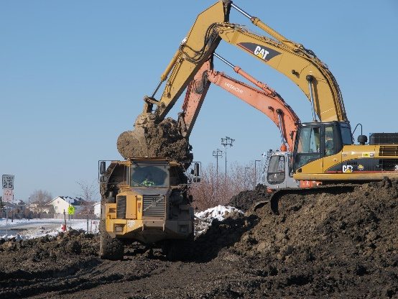
Information Flow in Practice
Construction and Handover
Existing information and site arrangements
Unusual construction risks
Key assumptions made
Specific sequencing
Temporary support
Phased handovers
Notes:
Unusual construction risks: - working or near with fragile materials; lifting operations; excavations; working near water;
Key Assumptions:- for example the construction of a new classroom / school extension is that access will be required during school time and (if in a built up area) no evening or weekend work involving noisy operations will be permitted.

Slide 47
Information Flow in Practice
Health & Safety File
Unusual maintenance & operational risks
Key structural principles
Key assumptions made
As built drawings
Existing health & safety information update
Notes:
Unusual maintenance / operational risks – removal or dismantling of plant or equipment; cleaning or maintaining the structure; health and safety information about any installed equipment; nature, location and marking of services; any hazardous materials used or still present (lead paint, special coatings etc);
Key Assumptions:- for example, any H&S risks associated with any plant or materials associated with the project will be supplied by the installer / supplier.
Structural principles – bracing; pre- or post-tensioned members; SWL’s on floors particularly if equipment or scaffolding to be placed there in future;
As built drawings: - includes means of safe access to and from service voids or ducts; fire doors; building compartmentalisation

Slide 48
Information Flow Summary

Slide 49
Working With Domestic Clients
Reminder…
“has construction work done on their own home, or that of a family member, not done in connection with a business”
Local authorities; landlords; charities; housing associations and businesses attached to a domestic premises ( e.g. shop ) not domestic under CDM 2015
Roles of duty holders normally no different to commercial clients
Transfer client duties to other duty holders

Slide 50
Working With Domestic Clients
Projects with one contractor
Client’s duties passes to Contractor (in addition to his own duties)
Contractor (“the client”) then works with any designers on project

Slide 51
Working With Domestic Clients
Working With Domestic Clients
Projects with more than one contractor
If client’s duties passes to Principal Designer (by written agreement) Principal Designer (“the client”) works with Principal Contractor
OR
If client’s duties passes to Principal Contractor or Contractor in control of Construction Phase, then Principal Contractor (“the client”) works with the Principal Designer
Requirements for the Health and Safety File still apply (but proportional) *
Notes:
* Proportional to the scale of the project…may only include manufacturers’ instructions or manuals and sketches if available

Slide 52
Working With Domestic Clients

Slide 53
Additional Competencies
Additional Competencies
An individual or team must have:
A technical knowledge of the construction industry relevant to the project
The understanding and skills to manage and co-ordinate the Pre-construction phase, including design work
Where there are high risk activities (such as Schedule 3 of CDM 2015) a greater level of H&S competence may be required
IOSH Managing Safely in Construction
NEBOSH Construction Certificate
It is strongly recommended that a needs analysis assessment be performed which will identify the training and competencies required and actions taken as a result.

Slide 54
Course Objectives
To describe the main requirements of duty holders under the CDM regulations 2015
To list the main items of documentation required for compliance under CDM 2015
To understand how the duty holders interact with each other during the course of a construction project

Slide 55
References
1. Managing health and safety in construction, Construction (Design and Management) Regulations 2015, L153 HSE Books
2. CDM 2015 A Practical Guide For Architects and Designers, Royal Institute of British Architects
3. CDM 2105 Industry Guidance for Principal Designers CDM15 / 2 Construction Industry Training Board (CITB)
4. CDM 2015 Questions and Answers. A Practical Approach. Pat Perry Institution of Civil Engineers
5. Introduction to Health and Safety in Construction. NEBOSH National Certificate in Construction Health and Safety. Phil Hughes & Ed Ferrett

Slide 56
Thank You
www.fqmltd.com
www.fqmtraining.com

