Slide 1
Fire Safety Awareness
Introduction
Rev - April 2018

Slide 2
Fire Statistics
Numbers
35,000 fires at work in UK
30 Fatalities
Costs
Financial costs are high
40% businesses never start up again
Not to be underestimated!
1985 Bradford City Football Stadium
1987 Kings Cross Underground
2,500 injuries
Small fires can become infernos

Slide 3
Fire Legislation
Since 1947 Fire Authority Responsibility
1971 Fire Precautions Act (FPA)
    Means of escape
    Basic fire protection equipment
    Fire certificates
    Only certain premises
1999 – Fire Precautions (Workplace) Regulations (FPWR)
    Wider range of premises
    Established principle of risk assessment
    Made under Health and Safety at Work Act (HASAWA)

Slide 4
Fire Legislation 2
2005 Regulatory Reform (Fire Safety) Order (RRFSO)
    FPA repealed and FPWR revoked
    Move towards fire prevention
    Duty to ensure safety of employees
    Risk assessments
    Fire Authority Employers
Scotland - Fire is a devolved matter
    Fire (Scotland) Act 2005
    Fire Safety (Scotland) Regulations 2016
    Police & Fire Reform (Scotland) Act 2012
      Scottish Fire & Rescue Service

Slide 5
Employer’s Duties
Health and Safety at Work etc. Act 1974
    Section 2 - Employees
    Safe plant and systems of work
    Safe use, handling and storage of substances
    Provision of information, instruction, training and supervision
    Safe place of work, access and egress
    Safe working environment / adequate welfare facilities

Slide 6
Employer’s Duties contd
Health and Safety at Work etc. Act 1974
    Section 3 – Persons not in their employment
    Members of the public
    Contractors
    Patients
    Customers
    Visitors
    Students
    Section 4 – Landlords, owners and those in control of premises
    Safe access and egress
    Safe plant and equipment
    Safe use of substances

Slide 7
Employee’s Duties
Health and Safety at Work etc. Act 1974
    Section 7
    Take reasonable care of themselves or others (acts and omissions)
    Co-operate with employer to fulfill their duties
    Section 8
    Misuse or interfere with safety provisions (“horseplay”)

Slide 8
Employer’s Duties
    Fire Safety Legislation
    Definition of a “responsible person”
      Employer or person in control of premises
    May need to agree arrangements if shared premises
    Enforcement is by area Fire and Rescue authority
    Does not cover “process related fire precautions”
      Health & Safety Executive / Local Authority
      General Duties of HASAWA
      Other Regulations
      Dangerous Substances and Explosive Atmosphere Regulations (DSEAR)

Slide 9
Employer’s Duties
    General Categories
    Suitable and sufficient risk assessment
    Keep risk assessment under review
    Eliminate or reduce risk
    Ensure premises provided with appropriate fire detection and fire fighting equipment
    Ensure emergency exits routes are clear
    Establish emergency procedures
    Include arrangements for fire drills
    Appoint competent persons to assist in measures (Fire Wardens)
    Provide information to employees and other persons
    Provide adequate training for staff
    Keep records (Fire Log Book or similar)

Slide 10
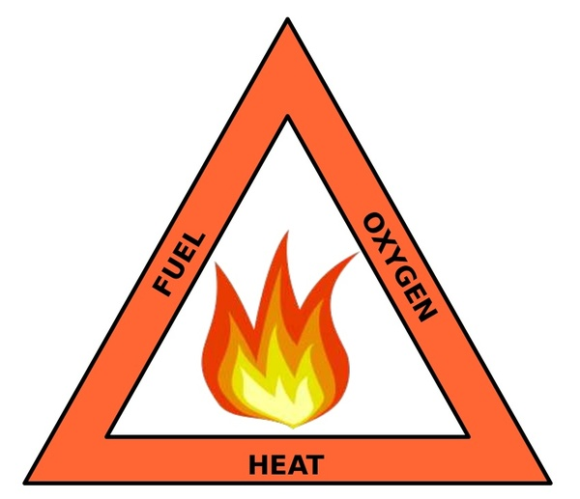
Basic Principles of Fire
Cannot occur unless three things present
Usually depicted as a fire triangle
Suggestions ?

Slide 11
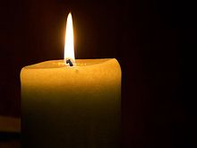
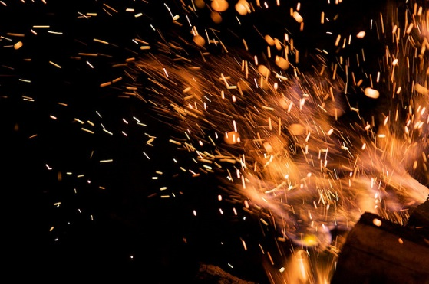
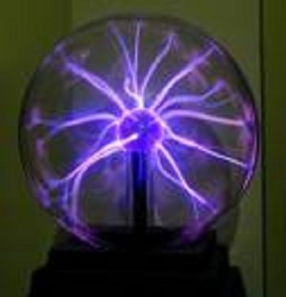
Sources of Ignition
    Naked flames
    External sparks
    Internal sparking
    Hot surfaces
    Static electricity

Slide 12


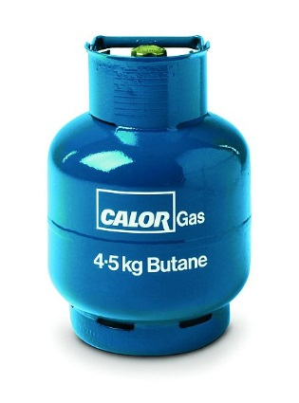
Sources of Fuel
If it burns, it’s a fuel!
    Solids
    Liquids
    Gases

Slide 13
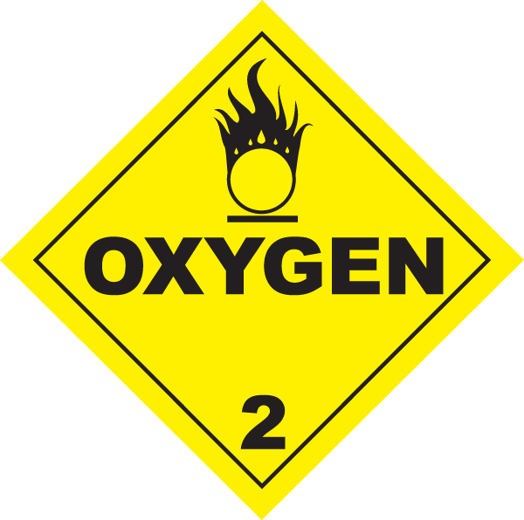
Oxygen
    Air (21% oxygen)
    Cylinders (e.g. welding)
    Certain chemicals containing oxygen
        Nitrates
        Phosphates
        Chlorates

Slide 14
Classifications of Fires
Five main classifications of fires.
How are they classified?
Class A
Solids - wood, paper, plastics, furnishings
Class B
Burning liquids - paint, oils, solvents
Class C
Gases, e.g. butane, propane
Class D
Burning metals
Class F
High temperature cooking oils and fats
Plus, electrical fires (provide source of ignition)
Extinguishers usually designed to tackle one or more classes of fires

Slide 15
Heat Transmission / Fire Spread
Fires transmit heat in several ways. How?
Convection - Hot air rises draws in cold air (with fresh oxygen) can ignite materials as it rises
Conduction - Through the material itself
good conductors – copper, steel, aluminium
poor conductors (insulators) – concrete, brickwork, asbestos
Radiation - Enough intensity to ignite adjacent surfaces or materials
Direct Contact - Catching fire through direct contact with flames
Simple example …. Open fire; roasting potatoes, using metal fork; warming hands, feeling heat on your face

Slide 16

Fire & Smoke Spread in

Slide 17
Causes of Fires
Fires in buildings (excluding dwellings) occurred in
Private garages and sheds (22%) 6700 fires
Retail distribution (14%) 4200 fires
Restaurants, cafes, pubs (9%) 2600 fires
Industrial (8%) 2400 fires
Recreational (6%) 1700 fires

Slide 18
Caused by:-
Deliberate (arson) 10,000
Faulty electrical appliances 5,000
Misuse of equipment 4,000
Accidental 3,800
Others 3,000
Anyone experienced a fire?
Notes:
OTHERS
Faulty fuel supplies
Chip pan fires
Careless handling of hot items
Articles close to hot surfaces
ACCIDENTAL
Cooking Appliances
Smoking Materials
Electrical Appliances

Slide 19
Consequences
Death
Real risk, but surprisingly low frequency
Overcome by gas or smoke 43%
Burns 26%
Burns and gas/smoke 20%
Personal injury - approx. 1,300 people
Building damage
Flora and fauna – forest and moorland fires
Loss of business and jobs
Underinsured
Not insured
Time and expense of restart
Environmental damage
Air pollution
Water pollution

Slide 20


Time for a Break!

Slide 21
Questions
Questions
?
?

Slide 22
Fire Risk Assessment
Comes under RRFSO - Basic five steps still apply
Identify the Hazards (Fire Triangle)
    Any combustibles
    Sources of heat/ignition
        Normal use
        Carelessness
      Cooking
      Smoking materials
      Hot equipment / activities
      Electrical equipment
      Deliberate (arson)
    Unsafe Acts / Unsafe Conditions
      Smoking next to combustibles
      Open stairwells
      Polystyrene tiles

Slide 23
Fire Risk Assessment 2
Identify Persons at Significant Risk
    Employees
    Visitors
    Contractors
    Special consideration or needs
    Young persons

Slide 24
Fire Risk Assessment 3
Evaluate and Reduce Risks
    Use “principles of prevention”
      Eliminate
      Tackle at the source
      Replace dangerous by non dangerous
      Giving appropriate instructions
    Considering
      Fire detection and warning
      Means of escape
      Information signage
      Fire fighting arrangements
Risk is either Low
Normal – nearly all workplaces
High

Slide 25
Fire Risk Assessment 4
Record Findings
    Date of assessment
    Hazards identified
    Staff or others at risk
    Produce action plan
    Recent conclusions
    Train staff

Slide 26
Fire Risk Assessment 5
Monitor and Review Regularly
Significant changes in :-
    Occupancy
    Activities
    Materials used or stored

Slide 27
Fire Prevention / Preventing Fire Spread
Builds on the EVALUATION part of Risk Assessment
Consider
    Good housekeeping and storage
    Control of fuel sources
    Control of ignition sources
    Safe systems and procedures
Good Housekeeping and Storage
    Reduces chances of blocked fire exits
    Reduces chances of concealing fire extinguishers and alarm points
    Waste kept in suitable containers and away from buildings

Slide 28
Fire Prevention / Preventing Fire Spread contd
Control of Fuel Sources
    Correct storage and disposal especially oils, solvents, gas bottles and aerosols
    Substitute for less hazardous
Control of Ignition Sources
    Proper use, maintenance and testing or electrical items (fixed and portable)
    Good management of smoking areas
    Proper control over heating appliances
    Regular cleaning and maintenance of cooking equipment

Slide 29
Fire Detection and
Alarm Systems
Vital that everyone is alerted as soon as possible
Able to escape before fire takes hold
Should have some form of detector and warning system
Ranges from
Shout of “FIRE”
Whistles, gongs, klaxon, air horn
Fixed fire warning system
Call points and siren
Control panel
Should
Alert everyone
Be recognisable
Be heard in all locations
Need to have alternatives for people with hearing difficulties
Buddy system
Visual display / vibrating pager

Slide 30
Fire Extinguishing Systems
4 Main ways to extinguish fires
Cooling
Reduces temperature
Takes heat out of the fire
water
Smothering
Limits oxygen availability
Prevents further combustion
Foam or fire blanket
Starvation
Limits fuel supply
Shutting gas supply off
Removing wood or paper etc.
Chemical reaction
Interrupts combustion
Chemical process involving chlorine and hydrogen
Used in Halon extinguishers
Notes:
Halon – Ozone depleting properties / environmental effects. No longer in general use. Specialist locations.

Slide 31
Fire Extinguishing Systems contd
Two types :-
Fixed Installations
    Good for retail or warehouse premised
    High initial installation cost
    Possible stock damage from accidental release
Portable
    Syndicate Exercise

Slide 32
Syndicate Slide

Slide 33
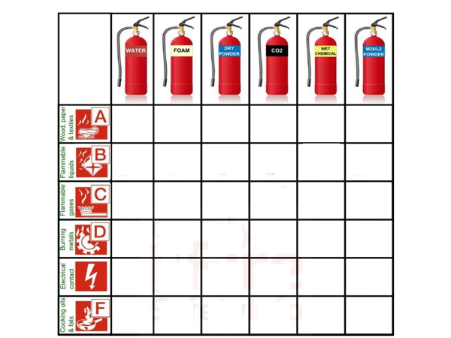
Know your Fire Extinguishers

Slide 34
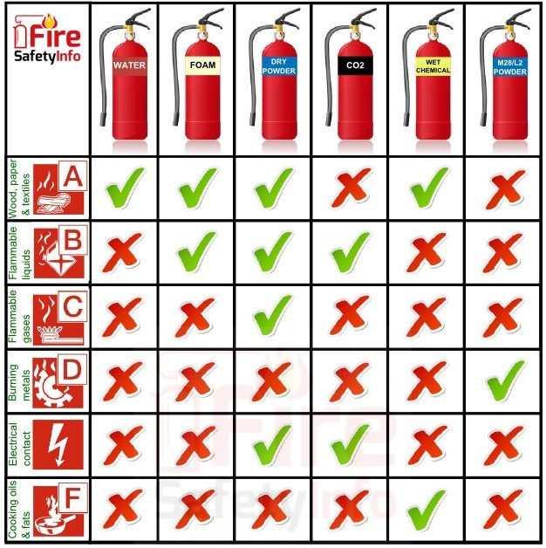
Know your Fire Extinguishers

Slide 35
Inspection, Maintenance & Testing of Fire Equip
Whatever is installed or in place it must be available to respond in an emergency
Includes
Detection and warning systems
Emergency lighting
Fire fighting equipment
Checked and maintained as per manufacturer’s recommendations
Records kept
Usually in a fire log book or similar

Slide 36
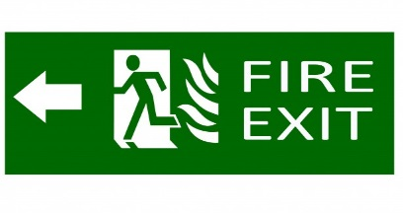
Evacuation and Means of Escape
Essential that people can escape quickly
People need to turn away from a fire OR
Pass it when it is very small
Corridors may need protecting by self closing fire doors
Doors usually open in the direction of travel
Escape routes must be clear of obstructions particularly fire hazards
Escape routes need to be checked regularly
Escape routes must be well lit
Additional lighting may need to be provided on escape routes (torches, for example)
Exit signs with direction arrows should be provided on escape routes

Slide 37
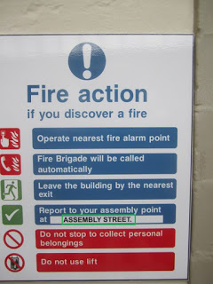
Evactuation Procedures / Emergency Plans
Normally carried out via a Fire Action Notice
Fire Drills
Carried out to ensure staff know procedures
Normally done twice per year
Ensure all staff are covered
Names are recorded in Fire Log Book

Slide 38
Fire Wardens – Day to Day Duties
Varies from company to company but could include:-
  Good standards of housekeeping maintained
  Exits/escape routes unobstructed
  Extinguishers/call points have good access
  Smoking rules enforced
  Staff are trained in use of fire equipment
  Emergency lighting tested monthly
  Fire alarms are tested weekly
  Assist in review of risk assessment
  Ensure electrical checks are carried out
  Ensure all documentation is filed and up to date

Slide 39
Fire Wardens – Emergency Situations
  Take charge in the event of an emergency
  Varies from company to company, but –
    Fight fire, if safe to do so
    Ensure alarm is raised
    Ensure all locations have been evacuated
    Fire and Rescue Service contacted
    Fire doors and windows are closed
    Equipment shut down if safe to do so
    Roll call is carried out at the Assembly Point
    Ensure persons with special needs are covered
    Report to Fire and Rescue Service on their arrival

Slide 40
Objectives
At the end of the course the participants will be able to :-
Describe the principles of fire initiation; classification and spread
Outline the principles of fire risk assessment
Describe the basic principles of fire prevention and prevention of fire in buildings
Identify appropriate fire alarm systems and fire fighting equipment in a simple building
Outline the factors to be considered when carrying out a successful evacuation of a building
Understand the basic legal requirements of fire prevention

Slide 41
Objectives
At the end of the course the participants will be able to :-
Describe the principles of fire initiation; classification and spread
Outline the principles of fire risk assessment
Describe the basic principles of fire prevention and prevention of fire in buildings
Identify appropriate fire alarm systems and fire fighting equipment in a simple building
Outline the factors to be considered when carrying out a successful evacuation of a building
Understand the basic legal requirements of fire prevention

