Slide 1
Safety – Lets Think Again Training
Introduction
Rev - April 2018

Slide 2
Safety
SAFETY
…LETS THINK AGAIN
K AGAIN

Slide 3
Hazard / Risk
Hazard
Something with the potential to cause harm
Risk
The likelihood and consequence of that harm occurring

Slide 4
Hazard / Risk
Incident
An unplanned event which has led to, or has the potential to lead to harm
Root Cause
Why? vs How?

Slide 5
Human Factors
Slips
Skills
Lapses
Errors
Rule based
Mistakes
Human Failures
Knowledge based
INTENTION
Routine
Violations
Situational
PROSECUTION
Exceptional

Slide 6
Situational Awareness (+)
RED
BLACK
ORANGE
PERFORMANCE
YELLOW
WHITE
AROUSAL

Slide 7
Situational Awareness (+)
RED
BLACK
ORANGE
PERFORMANCE
YELLOW
WHITE
AROUSAL

Slide 8
Situational Awareness (+)

Slide 9
Situational Awareness (+)

Slide 10
Situational Awareness (+)

Slide 11
Situational Awareness (+)

Slide 12
Situational Awareness (+)

Slide 13
Situational Awareness (+)

Slide 14
Situational Awareness (+)

Slide 15
Situational Awareness (+)

Slide 16
Situational Awareness (+)

Slide 17
Situational Awareness (+)

Slide 18
Situational Awareness (+)

Slide 19
Situational Awareness (+)

Slide 20
Situational Awareness (+)

Slide 21
Situational Awareness (+)
LIFE!

Slide 22
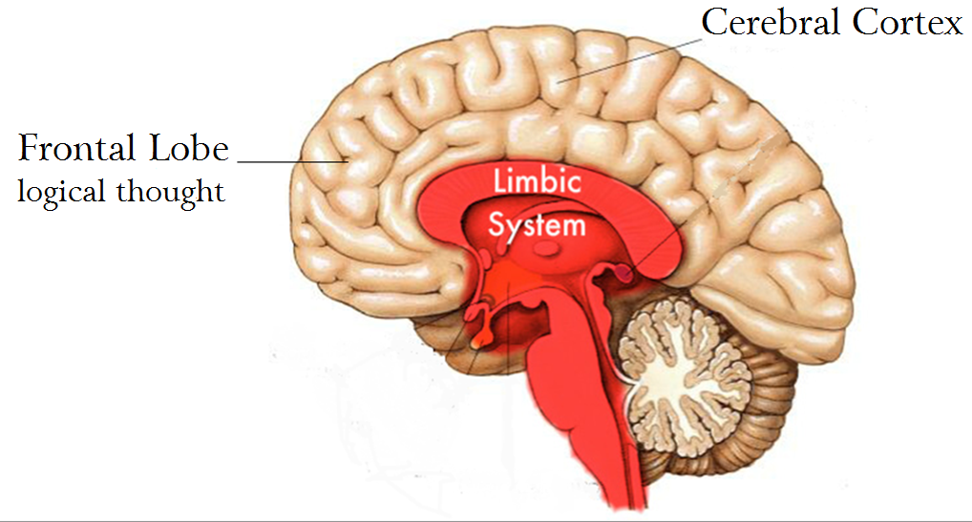
Situational Awareness (+)

Slide 23
Situational Awareness (+)

Slide 24
Situational Awareness (+)
Where are you today?

Slide 25
Thank you
25
Questions & Discussion

