Slide 1

HSE AWARENESS TRAINING
Introduction
Rev - April 2018

Slide 2
Course Objectives – Health & Safety
LEGAL SYSTEM
HAZARD & RISK
COMMON HAZARDS
Notes:
The purpose of the course is to help delegates understand the following:-
Legal System – The mechanics of Health & Safety Law and the Duties of Care imposed by the legal system in relation to Health & Safety
Hazard & Risk – To allow delegates to differentiate between hazard and risk to understand the risk assessment process.
Common Hazards – To allow delegates to understand the common hazards of the workplace and the steps that can be taken to reduce risks.

Slide 3
Course Contents
LEGISLATION
Health & Safety at Work Act 1974
Management Regulations

Slide 4
Course Contents
Hazard & Risk
Definitions
Risk Assessment
Accidents & First Aid
Accident Definition
Accident Investigation
Accident Prevention
First Aid

Slide 5
Course Contents
P.P.E.
Types / Uses
Considerations
COSHH
Definition & Purpose
COSHH Assessments

Slide 6
Course Contents
Noise
Risks
Controls
Manual Handling
Risks
Considerations
Assessments

Slide 7
Course Contents
Work at Height
Risks
Considerations
Access Types
Work Equipment
Hazard & Risks
Employer Duties
Main Types
Considerations

Slide 8
Course Contents
Electricity
Risks
Control Measures
Transport
Risks
Control Measures
Fire
Risks
Control Measures / Emergencies

Slide 9

Course Contents
Environmental Management
ISO 14001 requirements
Environmental Legislation
Environmental Documentation

Slide 10
Legislation
LEGISLATION

Slide 11
Health & Safety and the Legal System
Statute Law
Acts of Parliament
Framework of Principles
Regulations
Proposed by the HSC
Full Force of the Law
ACOP’s
Supplement to Act or Regulation
Approved by HSC with Consent
Non-compliance is not an offence
Guidance Notes
Issued by HSC / HSE
Opinions on good practice
Notes:
Statute Law is made up from –
Acts of Parliament – The written laws of the Land – Generally set down the principles and provides a framework for further regulations.
Regulations – Proposed by the HSC following consultation with a wide audience such as suppliers, contractors, solicitors, trades unions – Regulations carry the full force of the law and a breach of legislation is a criminal offence.
ACOPS – Codes of practices approved by the HSC and generally supplement Acts and Regulations with some detail and specific requirements. Non-compliance with an ACOP does not constitute a criminal offence, however, the defendant will need to prove that the actions he has taken fully comply with the Act or Regulation or do so better than the ACOP’s provisions.
Guidance Notes – Issues by the HSE/HSC and are basically opinions on how best to comply with Regulations – They have no legal standing and will not be produced in evidence at court.

Slide 12
Statutory Instruments
Regulations
ACOP’S
Health & Safety at
Work etc Act 1974
Guidance Notes
Notes:
SUMMARY OF LEGISLATION
Health & Safety at Work Act – Enabling Act
Regulations – Specific to Work Activities – Welfare/Electricity/Asbestos
ACOPS’s – Best practices
Guidance Notes – Opinions of HSE / HSC on compliance

Slide 13
Legal Summary
Statute Law
Written Law of the Land
Involves a Statutory Duty of Care
Burden of Proof with Defendant
Punishable by Fine / Imprisonment
Common Law
Based on Judicial Precedents
Involves a General Duty of Care
Burden of Proof with Plaintiff
Punishable by Award of Damages

Slide 14
Health & Safety at Work Act 1974
(THE CENTREPIECE OF UK SAFETY LEGISLATION)
APPLIES TO
Employers
Self - Employed
Employees
Manufacturers / Suppliers
FUNCTIONS
Health & Safety Provisions
Establish EMAS & HSE
Amendment of Previous Laws
Miscellaneous Provisions
Notes:
Purpose of Legislation
To Apply to all places of work where previous Acts did not.
To set down the principles of health and safety at work and allow the production of enforcement regulations
Sets duties of care for all involved in work – employer/employee
Shift the burden of proof to the defendant

Slide 15
Health & Safety at Work Act 1974
GENERAL DUTIES OF EMPLOYEES
Employees Must
Take Reasonable Care for their own Health & Safety and that of Others who may be Affected by their Acts or Omissions.
Co-operate with The Employer in his efforts to comply with his Duties under the Act.
Not Intentionally or recklessly interfere With or Misuse anything provided in the interest of HS & W
Notes:
The responsibilities of employees is often ignored or not made known to them.
Employees must take reasonable steps to ensure their HS & W as described in the act.
Employees are as liable to prosecution as employers.

Slide 16


Health & Safety at Work Etc. Act 1974
THE HEALTH & SAFETY COMMISSION & EXECUTIVE
Policy Development Responsibility
Nine Members Appointed by Government
Enforcement & Advisory Body of HSC
Lower Risk Activities Enforced by Council Environmental Health
Notes:
Nine Members Include – Trades Union Officials, Scientists, Legal Representatives and Industry Bodies.
Enforcement of lower risk activities and premises such as offices is generally dealt with by Environmental Health
Additionally the Fire Service ensure compliance with the Fire Precautions Act

Slide 17
Health & Safety at Work Act 1974
The Management of Health and Safety at Work Regulations 1999
MAIN DUTIES OF EMPLOYERS
Risk Assessment
To Make suitable and Sufficient Assessment of the risks to employees and others arising from his work activities.
Put in Place Adequate Control Measures to Eliminate or Minimise the Risks.
Record Significant Findings where 5 or more are employed.
Review and Revise as necessary.
Notes:
The employer is required to make suitable risk assessments for all work activities, put in place adequate controls to eliminate or minimise the risks – A safe system of work is required when hazards are not eliminated. Where an employer employs 5 or more people, the results of the risk assessment must be recorded.
Risk Assessments should be reviewed for every task to ensure suitability.
Risk Assessments should only be carried out by competent people.

Slide 18
The Management Regulations 1999
MAIN DUTIES OF EMPLOYERS
Imminent Danger
Establish and give effect to Procedures to be followed in the event of serious and imminent danger.
Nominate competent persons to implement evacuation procedures and restrict access to Danger areas.
Notes:
Imminent Danger – Fire, Bomb Scare etc – Procedures must be available and followed in the event of serious and imminent danger.
An adequate number of competent persons must be appointed and named to implement these procedures and restrict access to danger areas.

Slide 19
The Management Regulations 1999
MAIN DUTIES OF EMPLOYERS
Competent Persons
Appoint adequate Numbers of Competent Persons to Assist the employer to comply with his H&S Obligations.
Information / Training
Provide information on H&S Arrangements.
Provide all Employees with suitable H&S Training.
Notes:
Competent Persons – Employers must appoint one or more competent persons to assist him in his obligations under H&S Legislation – This should be a safety professional employed by the Company or a H&S Consultant.
Information / Training – Employers must provide information to employees on the H&S arrangements applicable in the place of work and provide suitable training for all work activities.

Slide 20
The Management Regulations 1999
MAIN DUTIES OF EMPLOYERS
Health Surveillance
Provide Employees with Routine Health Surveillance when required as part of the Risk Assessment.
Notes:
Health Surveillance – Where the risk assessment indicates…generally for serious occupational health risks such as solvents/asbestos. Health Surveillance can be by questionnaire, EMAS or appointed GP or nurse.

Slide 21
The Management Regulations 1999
MAIN DUTIES OF EMPLOYEES
Must Use any equipment provided properly and in a safe manner.
Must Use any safety device provided to him.
Must comply with all training and instructions given to him.
Report any instruction to carry out work which presents a serious danger or for which they are not adequately trained.
Notes:
Employees must use all safety equipment provided to him properly, in a safe manner and in compliance with the instructions and training given to him.
Report any instruction to carry out any unsafe work to a higher level of supervision – Not commonly done due to employer pressure.

Slide 22
HAZARD & RISK
Notes:
Hazard and risk are easily confused and it is extremely important to properly define the differences in order that we may comply with our duties of care.

Slide 23
Hazard & Risk
DEFINITIONS
HAZARD
RISK
The inherent ability of any article or substance to cause harm to people or property.
The probability of the hazard to cause harm and the extent of harm which may be caused.

Slide 24
Hazard & Risk
EXAMPLES
HAZARD
RISK
TOOLS ON FLOOR INJURY FROM TRIPPING
DUST FROM RIP SAW AT HEIGHT INJURY FROM DUST INHALATION
WORKING AT HEIGHT INJURY OR DAMAGE FROM FALL
CORROSIVE CHEMICALS INJURY FROM SPLASH
EXPOSED MOVING PARTS INJURY FROM ENTRAPMENT
Notes:
INJURY FROM TRIPPING – Head Injury, Impact Injury
INJURY FROM DUST INHALATION – Occupational Asthma, Plural Injuries, Irritation to respiratory tract.
INJURY FROM FALL AT HEIGHT – Death or serious debilitating injury.
INJURY FROM SPLASH – Chemical Burns, Injury to Internal Organs from absorption – LIVER, KINDEYS, CNS
INJURY FROM ENTRAPMENT – Death, Loss of Limb from entrapment in press brake

Slide 25
Risk Assessment
FIVE STEPS TO RISK ASSESSMENT
HAZARD EVALUATION
IDENTIFY ALL SIGNIFICANT WORKPLACE AND TASK HAZARDS
IDENTIFY WHO MAY BE HARMED
EMPLOYEES, MEMBERS OF THE PUBLIC, OTHER WORKERS
EVALUATE THE RISK
DECIDE ON PRECAUTIONS / IMPLEMENT CONTROL MEASURES
RECORD THE FINDINGS
RECORD ALL OF THE ABOVE
REVIEW WHEN NECESSARY
CHANGE TO SCOPE, EXTERNAL INFLUENCES

Slide 26
ACCIDENTS & FIRST AID

Slide 27
Accidents
A DEFINITION
‘An accident can be defined as an undesired and uncontrolled event, which results in physical harm and / or property damage, usually resulting from contact with a source of energy above the ability of a body or structure to withstand it’.

Slide 28
Accidents
CAUSE OF ACCIDENTS
Unsafe Acts
Carried out by People executing work.
Unsafe Conditions
Environmental Variables
Weather / Unguarded Machinery
Notes:
UNSAFE ACTS INCLUDE – Working without Authority, Failure to warn others of danger, Leaving equipment in a dangerous condition, Using equipment at the wrong speed, Disconnecting or bypassing safety devices, Using defective equipment, Using Equipment the wrong way, Failure to wear PPE, Horseplay, Smoking, Alcohol or drug use.
UNSAFE CONDITIONS – Missing guards, Defective Tools or Equipment, Fire Hazards, Excessive Noise, Poor Lighting or ventilation.

Slide 29
Accidents
PRINCIPLES OF ACCIDENT PREVENTION
HAZARD ELIMINATION
USE TECHNIQUES TO IDENTIFY AND REMOVE HAZARDS
RISK CONTROL
USE RISK ASSESSMENTS TO CONTROL RESIDUAL RISKS FROM HAZARDS
BEHAVIOUR AND ATTITIDE
USE TECHNIQUES TO INFLUENCE BEHAVIOUR AND ATTITUDE
Notes:
HAZARD ELIMINATION & RISK CONTROL – Where hazards cannot be eliminated, a safe system of work is required.
BEHAVIOUR & ATTITUDE – Dependant on Social Factors, Experience, Training , Supervision, Example of Management.

Slide 30
Accidents
ACCIDENT INVESTIGATION
PURPOSE
To establish whether a recurrence can be prevented…or, it’s effects lessened by the introduction of some other control measure such as training.
Notes:
Internal Investigation of accidents should not be imposed to apply blame to any individual – this will limit the investigation and evidence that can be compiled.

Slide 31
First Aid
DEFINITION
The provision of treatment for the preservation of life until medical attention is given…and, to treat minor injuries which would otherwise receive no treatment.

Slide 32
First Aid
DUTIES OF THE EMPLOYER
Provide First Aid
Every employer must provide equipment and facilities which are adequate and appropriate in the circumstances for administering first aid to his employees.
Publicise Arrangements
Employees must be informed of the arrangements for treatment.

Slide 33
First Aid
ASSESSING THE REQUIREMENT
Considerations
How many employees ?
The nature of the work or activity
Satellite Operations
Proximity of Nearest A & E
Collective Employers
Provision for Non – Employees ?
Holiday Cover
Notes:
More Employees = More Potential for Accidents.
NATURE OF WORK – PARTICULARLY HAZARDOUS, CHEMICAL MANUFACTURING etc
SATELLITE OPERATIONS – Work away from the main hub of the business, site work etc.
NEAREST HELP – How long will it take to get to Hospital?
COLLECTIVE EMPLOYERS – Operating within the same building may share the provision of a first aid facility.
NON EMPLOYEES – Members of the Public (Awaiting Court Test)
HOLIDAY COVER – Adequate cover must be maintained.

Slide 34
First Aid
TRAINING
First Aider
Someone who has completed recognised 2 day course in first aid.
Appointed Person
A named person who is familiar with basic Emergency Actions / CPR / Unconsciousness / Blood Loss Prevention & Wound Treatment. Must have completed ½ Day recognised training course.

Slide 35
First Aid
GENERAL GUIDLINES
Low Risk
Employs
Medium / High Risk
No First Aider <5 No First Aider
No First Aider <25 1 First Aider
1 First Aider <50 2 First Aiders

Slide 36
PERSONAL PROTECTIVE
EQUIPMENT
Notes:
The purpose of PPE is to act as a last line of defence against residual risks which cannot be reasonably eliminated by some other means.

Slide 37
Personal Protective Equipment
DEFINITION
Equipment worn by a person as the last line of defence against the residual risks created by hazardous articles or substances.

Slide 38
Personal Protective Equipment
TYPES
Hearing
Ear Plugs
Ear Defenders
Respiratory
Filtering Half Mask
Half Mask Respirator
Full Face Respirator
Powered Respirator
Breathing Apparatus
Fresh Air Hose
Compressed Airline
Self Contained
Eye Protection
Safety Glasses
Safety Goggles
Face Shields
Notes:
FRESH AIR HOSE – Clean air pumped by the breathing action.
COMPRESSED – Air supplied by operation of an air compressor by competent person.
SELF CONTAINED – Air delivered to the user via demand valve from cylinder often mounted on back – Normally short term emergency use.
SAFETY GLASSES – Protection against low energy projectiles such as metal swarf – No assistance against dusts or high energy impacts.
SAFETY GOGGLES – Protection against high energy projectiles and dusts. Also for chemical protection with additional treatment.
FACE SHIELDS – Protection against high energy projectiles to the whole face.

Slide 39
Personal Protective Equipment
TYPES
Protective Clothing
Head protection
Protective Garments
Gloves
Footwear
Skin Protection
Barrier Creams
Fall Arrest
Safety Harness
Notes:
HEAD PROTECTION – Safety Helmet and Scalp Protector (Bump Cap) – Protection against the elements and against impact damage to the head – Must be replaced following impact and must not be decorated with stickers, writing etc except as approved the manufacturer. Useful lifespan of circa 2 years.
PROTECTIVE GARMENTS – Outdoor and Indoor – Limited body protection against the elements and injuries.
GLOVES – Hazard Specific protection such as chemical, temperature extremes, abrasions, cuts etc
FOOTWEAR – Ankle and Foot Protection – Specifically Toes from impact injuries. Exposed metal on footwear may pose spark risk and should be changed.
BARRIER CREAMS – Generally chemical and nuisance protection – Such as Oils, Dirt.
SAFETY HARNESSES – Not replacements for effective fall prevention techniques – Purpose is to limit the fall and assist rescue in confined spaces.

Slide 40
Personal Protective Equipment
SELECTION
Nature of Hazard
Derived from Risk Assessment
Performance Data
Ability of PPE
Exposure Limit
Limit of allowable exposure
Compatibility
With other items of PPE
Notes:
NATURE OF HAZARD – Solid / Gas etc
PERFORMANCE DATA – What will the PPE do?
EXPOSURE LIMIT – Check whether the PPE will reduce the exposure to an acceptable level.
COMPATIILITY – Ensure that multiple items of PPE can be worn effectively together!

Slide 41
Personal Protective Equipment
DUTIES OF EMPLOYER
The Employer Must
Supply PPE to any employee exposed to any risk at work, except where risks have been adequately controlled.
Ensure compatibility of all PPE Provided to employees.
Ensure that all PPE is adequately inspected, maintained and cleaned as necessary and provide appropriate accommodation when not in use.
Give adequate an appropriate information, instruction & training.
Take reasonable steps to ensure that PPE is worn .

Slide 42
Personal Protective Equipment
DUTIES OF EMPLOYEE
The Employee Must
Use any PPE in accordance with the information and training provided to him.
Report any loss or defect to the employer immediately.

Slide 43
Personal Protective Equipment
LIMITATIONS
No Hazard Elimination
Increased risks in the event of failure of P.P.E.
Personal Factors
Individual Characteristics
Training for Use
Interference
Acceptability
Management Commitment
Notes:
Failure of PPE exposes the wearer to significant, otherwise uncontrolled risks to his health.
Personal Factors will affect the use of PPE and include :-
INDIVIDUAL – The PPE may not comfortably fit the individual, the individual may not be comfortable wearing the PPE
TRAINING – All employees must be provided with suitable training as to the use, inspection and limitations of all PPE provided to them.
INTERFERENCE – Compatibility Issues, wilful interference.
MANAGEMENT COMMITMENT – Lead by example, even if visiting for only short durations.

Slide 44
SAFETY SIGNS & SIGNALS
Notes:
SAFETY SIGNS
The Health and Safety (Safety, Signs & Signals) Regulations 1996 came into operation on 1st April 1996 but with a lead in until 24th December 1998 for existing, legal fire safety signs. The regulations govern the use of acoustic signs and hand signals in addition to sign boards.
The requirements for sign boards are not significantly different from those that existed under the previous (1980) regulations except that:
it is mandatory to display a sign wherever there is a significant risk that cannot be removed at source, i.e. a 'residual risk', and
all signs must include a pictogram indicating the nature of the hazard.

Slide 45

Safety Signs & Signals
Types and Purpose
PROHIBITION
Stop Signs
Shutdown Device
Prohibitions

Slide 46

Safety Signs & Signals
Types and Purpose
CAUTION
Hazard Identification
Obstacles
Threshold Identifications

Slide 47

Safety Signs & Signals
Types and Purpose
MANDATORY
Compulsory Practices
Wear PPE
Close Fire Doors

Slide 48
Safety Signs & Signals
Summary
REMEMBER THE TYPES AND PURPOSES
Prohibition, Mandatory, Caution, Safe Condition
FOLLOW DIRECTIONS
Failure may precipitate serious Injury
IF YOU DON’T KNOW – ASK!
Never Guess the Purpose of Signs – Ask Someone who Knows!

Slide 49
COMMON WORK HAZARDS
Notes:
Thousands of people are exposed to hazardous substances at work. If the exposure is not prevented or properly controlled, it can cause serious illness, sometimes even death. It can also result in lost earnings, reduced productivity, expensive prosecutions, firms being sued and the nation having to pay for sickness benefit.

Slide 50
COSHH
Notes:
Thousands of people are exposed to hazardous substances at work. If the exposure is not prevented or properly controlled, it can cause serious illness, sometimes even death. It can also result in lost earnings, reduced productivity, expensive prosecutions, firms being sued and the nation having to pay for sickness benefit.

Slide 51
COSHH
Definition
The Control of Substances Hazardous to Health Regulations 2002 (COSHH)
Purpose
To Prevent workplace disease resulting from exposure to hazardous substances.

Slide 52
COSHH
What is a Substance Hazardous to Health ?
Any mixture, material or compound used at the workplace or arising from work activities, which is harmful to peoples health in the form in which it occurs in the work activity.
Notes:
skin irritation, dermatitis or even skin cancer from frequent contact with oils;
asthma resulting from sensitisation to isocyanates in paints or adhesives;
being overcome by toxic fumes - injuries or death can be caused by the substances themselves or by falling after losing consciousness;
poisoning by drinking toxic liquids from bottles thought to contain water or soft drinks - sometimes with fatal results;
cancer, which can appear many years after first exposure to carcinogenic (cancer-causing) substances at work;
infection from bacteria and other micro-organisms ('biological agents').

Slide 53
COSHH
Duties of Employer
Carry out a COSHH Assessment of every hazardous substance found in the workplace and communicate.
Review Every 5 Years
Ensure that Employee’s exposure to hazardous substances is prevented or adequately controlled.
Direct the use of PPE only where other controls are not reasonable practicable.
Monitor Exposure
Notes:
COMPLYING WITH COSHH INVOLVES:
ASSESSING THE RISKS to health arising from your work;
DECIDING WHAT PRECAUTIONS ARE NEEDED. You must not carry out any work which could expose employees to hazardous substances without first considering the risks and the necessary precautions. Unless you have judged the risks correctly, you are unlikely to decide on the right precautions;
PREVENTING OR CONTROLLING EXPOSURE. Put the Plans into Action.
ENSURING THAT CONTROL MEASURES ARE USED AND MAINTAINED properly, and that any safety procedures which have been laid down are followed;
MONITORING EXPOSURE of workers to hazardous substances and carrying out appropriate HEALTH SURVEILLANCE, where the assessment has shown these are necessary or where COSHH lays down specific requirements;
ENSURING THAT EMPLOYEES ARE PROPERLY INFORMED, TRAINED AND SUPERVISED.

Slide 54
COSHH
The COSHH (Risk) Assessment
Hazard Identification
Hazard Data Sheets / Labels
Work Method
How the substance will be used.
Who Is at Risk
Employees, Others.
Likely Exposure
Time & Frequency.
Implement Controls
Engineering Controls / Method Statements
Specify PPE
Only as a Last Resort.
Emergency Measures
First Aid / Fire / Explosion.
Review
When Necessary.
Notes:
Implement Controls – Decide on the necessary controls (eg. Segregation, Work Practices, Housekeeping etc) and put them into practice.
Specify PPE – Only as a last resort to limit exposure to residual risks.
Emergency Measures – Identify first aid requirements, fire Fighting requirements etc.
Review – When necessary – As a result of incidents, change to work methods, change to alternative substances and at least every year.

Slide 55
NOISE
Notes:
NOISE - WHY WORRY?
The everyday sounds and noises we hear help keep us in touch with the world around us. In moderation they are harmless, but when they become too loud they can damage the delicate mechanism of the inner ear, destroying sensitive nerve cells and causing permanent hearing difficulties

Slide 56
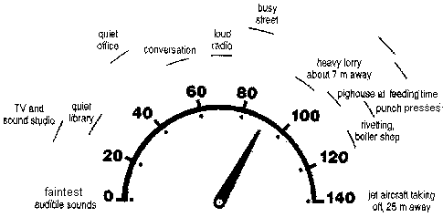
Noise
TYPICAL NOISE LEVELS

Slide 57
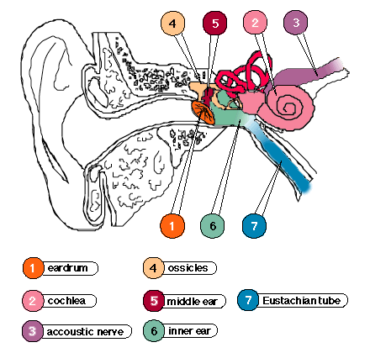
Noise
CONSEQUENCES
NOISE
Noise Induced Hearing Loss
Threshold Shift
Acoustic Trauma
Tinnitus
Notes:
NIHL – Results from the long term exposure to noise and causes hearing loss at the affected frequencies. Chronic condition – no cure.
THRESHOLD SHIFT – A shift in the level of sensitivity of the hearing mechanism – Chronic or temporary condition.
ACCOUSTIC TRAUMA – Caused by exposure to severe noise pressure and is often irreversible.
Tinnitus – Ringing in the ears caused by intense stimulation and can be permanent and life changing.

Slide 58
Noise
DUTY OF EMPLOYER
FIRST ACTION LEVEL – 85dB(A)
Carry Out Noise Assessments
Provide information & training to employees concerning the risks and controls
Issue Ear Protection to Employees who request this.
SECOND ACTION LEVEL – 90dB(A)
Take steps to reduce noise at source.
Establish Hearing Protection zones identified by signs.
Supply Hearing protection to all employees exposed.

Slide 59
Noise
REDUCTION TECHNIQUES
Engineering Solutions
Location
Maintenance
Enclosure
Silencing
Insulation
Damping
Isolation of Workers
P.P.E.
Notes:
ENGINEERING SOLUTIONS – Design the noise out of the process.
MAINTENANCE – Properly maintained equipment generates much less noise eg. Car
ENCLOSURE – Enclosing the noise can eliminate or more commonly reduce the noise.
SILENCING – Exhaust silencing can be adopted to drown exhaust noise.
DAMPLING – Damper pads installed to absorb vibration.
ISOLATION OF WORKERS – Same effect as enclosing the noise source.
PPE – Last line of defence – only when all other solutions have been assessed.

Slide 60
MANUAL HANDLING
Notes:
Estimates of the size of the problem vary, but the most recent yearly figures show that 59 million working days were lost through back problems alone. Some 55 000 injuries due to handling, lifting or carrying accidents were reported to HSE in 1996/97. Estimates from a recent large national survey suggest 600 000 people experienced musculoskeletal problems.

Slide 61
Manual Handling
RISKS
Musculoskeletal
Sprains
Strains
Slipped Disc
Trapped Nerves
RSI
Other
Lacerations
Slips, Trips & Falls
Notes:
1/3rd of all accidents reported to HSE involve to some extent manual handling – Reportable Injuries are those which are serious in consequence in terms of injury or damage to property.

Slide 62
Manual Handling
Duties
Employer
Avoid Manual Handling Operations
Carry out Risk Assessments
Reduce the Risk of Injury (AFAIRP)
Ensure that employees have received suitable and sufficient information, instruction & training.
Employee
Follow Systems of Work
Carry out Manual Handling in accordance with training and information received.
Notes:
Both Employer and employee have duties of care when engaging in lifting operations. These are included within the HASWA, The Management Regulations and the Manual Handling Operations Regulations.
Employers to AVOID where possible any manual handling operations – example – mechanise the lifting operations.
Where this cannot be done, then employers must a carry out a manual handling (risk) assessment and implement controls to reduce the risk as far as is reasonably practicable.
Employers must then ensure that all employees have received suitable and sufficient I,I&T and the employee must follow any safe system and follow any instructions given by his employer.

Slide 63
Manual Handling
Manual Handling (Risk) Assessment
ASK
TILE
NDIVIDUAL
OAD
NVIRONMENT
Notes:
When assessing manual handling tasks – always consider TILE

Slide 64
Manual Handling
Manual Handling (Risk) Assessment
TASK
AWKWARD POSITION
ARMS EXTENDED
EXCESSIVE MOVEMENT
EXCESSIVE PUSHING
SUDDEN MOVEMENT
HIGH PHYSICAL EFFORT
Notes:
Awkward Position – Does the task involve lifting and laying in difficult positions, eg. From top of cabinets etc.
Arms Extended – Does the task involve a prolonged requirement to hold the load away from the trunk eg. Hot loads?
Excessive Movement – Does the task involve moving excessive distances?
High Physical Effort – How heavy and how long will it take to carry out the task?

Slide 65
Manual Handling
Manual Handling (Risk) Assessment
INDIVIDUAL
TRAINED
CAPABLE
HEALTH RISKS
Notes:
Trained – All employees lifting any loads should have received formal training in Manual Handling
Capable – Does the employee have the strength to lift the load?
Health Risks – Does the employee have any existing medical conditions rendering him unfit to carry out the task? Eg. Back Injury / Hernia?

Slide 66
Manual Handling
Manual Handling (Risk) Assessment
LOAD
HEAVY
BULKY
DIFFICULT TO GRIP
UNSTABLE
SHARP/HOT/HAZARDOUS
SPECIAL PRECAUTIONS
Notes:
Heavy – How Heavy is the load? How do we know? Generally a maximum weight of 25-30Kilos to be carried by one person.
Bulky and Difficult to Grip – Does the load have handling points? Will the load block visibility?
Unstable – Is the load loose? Or is the centre of gravity liable to shift?
Hazardous – Hot, Sharp edges, chemicals
Special Precautions – Are there any Spillage precautions etc…

Slide 67
Manual Handling
Manual Handling (Risk) Assessment
ENVIRONMENT
ENOUGH SPACE
UNEVEN FLOORS
STAIRS
GOOD LIGHTING
SHARP/HOT/HAZARDOUS
SPECIAL PRECAUTIONS
Notes:
Enough Space – Is there enough room for the load to be physically moved and free from obstructions?
Uneven Floors – Is the floor level and sound – no pot holes, structural strip hazards etc
Stairs – Will the load be required to be lifted to other levels?
Lighting – Is there adequate light operating for the task to be safely carried out?
Special Precautions – Vehicles etc.

Slide 68
Manual Handling
REDUCE THE RISK
IMPROVE WORKPLACE LAYOUT
AVOID LIFTING FROM FLOOR LEVEL
AVOID LIFTING ABOVE SHOULDER HEIGHT
SHORTEN CARRYING DISTANCES
AVOID REPETITIVE HANDLING
Notes:
Improve Workplace Layout – Segregate pedestrian walkways / ensure good housekeeping practices / shorten carrying distances.
Floor & Height Lifting – Avoid storing materials which have to be manually handled at height or directly on the floor (Grip)
Avoid Repetitive Handling – Vary tasks / operate rotas where appropriate

Slide 69
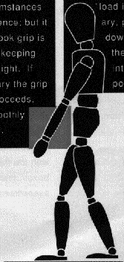
Manual Handling
LIFTING TECHNIQUE
FEET APART
AS CLOSE AS POSSIBLE
BEND AT KNEES
FIRM GRIP
TEST THE WEIGHT
STRAIGHTEN KNEES
KEEP BACK STRAIGHT
DO NOT MAKE SUDDEN MOVEMENTS
Notes:
Do Not Make Sudden Movements – Increased risk of balance failure, load shift, injuries.

Slide 70
WORK AT HEIGHT
Notes:
Many work and home injuries result from failures or falls from access equipment which has been incorrectly selected, erected, used or maintained. Access equipment is frequently used for short duration and emergencies without full consideration of a safe method of work. The consequences of falling from a height of more than 2 metres are generally serious disabling injuries or death. By far the most used and abused system of access is by use of ladders and we will concentrate on the use of ladders in this section.

Slide 71
Work at Height
RISKS
Falls from Height
1/3rd Workplace Fatalities
Falling Objects
Tools / Materials / Components.
Equipment Failure
Poor Selection & Design
Failure of Component
Failure of Foundation
Improper Use
Notes:
The Risks include –
Falls from Height – Resulting in 1/3rd of all workplace fatalities
Falling Objects – Tools and equipment from scaffolds and ladders resulting in impact injuries to people below.
Equipment Failure – Poor selection,design and installation of access equipment – eg. Inadequate scaffold design, ladder for long duration work. Failure of a component due to poor selection, damage and maintenance or overloading. Foundation collapse or subsidence, anchor point stresses beyond structural stability. Improper use by overloading, using the access for another purpose, overreaching etc.

Slide 72
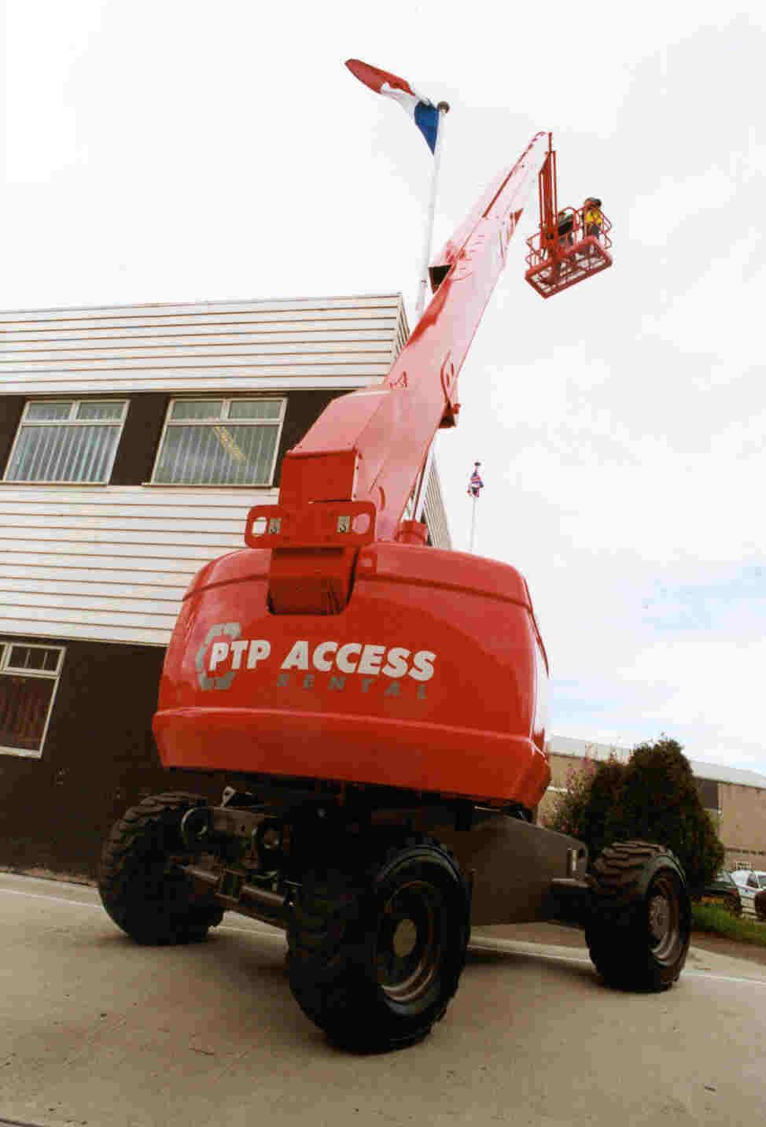
Work at Height
CONSIDERATIONS
TYPE OF WORK
DURATION OF WORK
LOCATION OF WORK
THE ENVIRONMENT
THE USER
LOADING REQUIREMENTS
COST AGAINST RISK
Notes:
Always consider the following on your risk assessment…
Type of Work – Heavy or light work? Inspection, maintenance, construction?
Duration – How long will the work take…the longer the work takes warrants more permanent forms of access
Location – Will the access obstruct highways, pedestrian paths or interfere with production
The Environment – Internal / External? Weather conditions / Lighting etc.
Loading Requirements – How many men and how much material?
Consider the balance of cost against risk – what is reasonably practicable?

Slide 73
Work at Height
TYPES OF ACCESS
FIXED SCAFFOLDING
PORTABLE TOWERS
ELEVATED PLATFORMS
STEPS / LADDERS
TRESTLES
ROOF ACCESS
Notes:
Fixed Scaffolding – Built for specific purpose(s) / Suitable for men, materials and access. Suited for high risk or prolonged duration tasks.
Portable Towers – Suitable for ad hoc access, maintenance type activities, light duty work.
Elevated Platforms – Suitable for short duration work where access interference is likely eg. Over roadways etc. Do not use as a crane or for mechanical lifting.
Step Ladders / Trestles – Suitable for light very short duration tasks where minimal materials are required at the work height.
Roof Access – Suitable for work on roofs where the roof provides edge protection (handrails) and is stable enough to take the weight.

Slide 74
Work at Height
FIXED SCAFFOLDING
ERECTED BY TRAINED, COMPETENT PEOPLE
FIT FOR PURPOSE
MODIFIED BY COMPETENT PEOPLE
ACCESS BY SECURELY LASHED LADDER 1.05 Mtrs CLEARANCE
INSPECTED BEFORE USE AND EVERY 7 DAYS
BE EQUIPED WITH DOUBLE GUARD RAILS
Notes:
Governed by legislation and British Standards – Special Scaffolds require design.
Trained People – CITB Scaffolder Registration
Fit for Purpose – Built to users specifications – if scope changes – re-assess the risk and capability of the scaffold.
Modifications – Only by CITB scaffolders – Many personal prosecutions have been as a result of unauthorised alterations to scaffolds.
Access by Ladder – Do not traverse the scaffold except by securely lashed ladder.
Inspections – The scaffold must be inspected by a competent person (CITB Advanced Scaffolder / CITB Scaffold Inspector) at time of erection and at least every seven days thereafter – A register of inspections to be maintained on site and available for inspection. The user is required to briefly inspect any scaffold prior to use – Items for consideration are scafftags and ladder tags (check the dates on the reverse), check the structure for damage (steel and timber), check the ladder for damage and securement.

Slide 75
Work at Height
MOBILE TOWERS
SPECIALIST TRAINING, COMPETENT PERSON
INSPECTED BEFORE USE AND EVERY 7 DAYS
CLEAR PLATFORM (MATL’s / PPL) PRIOR TO MOVING
TRAPDOOR ACCESS TO EVERY LIFT
INTERNAL ACCESS LADDER ON NARROWEST SIDE
MAXIMUM HEIGHT TO BASE RATIO 1:3
EXTEND BASE AREA BY USE OF OUTRIGGERS
Notes:
Generally as per fixed scaffolds however,
Training – Training as a scaffolder does not imply competence to erect a portable tower of the system type.
Moving the Tower – Ensure that the platform is not in use and is free of materials prior to moving – the majority of accidents occur on towers when people are moved with the tower. When in position, ensure that the wheels are locked.
Trapdoor access – Internal access – Close! The trapdoor when working on scaffold
Outriggers – Use outriggers to extend the base dimensions and increase the height of the scaffold.
Height – do not exceed ratio of 1:3 at any time – tie when above 9 metres or when possible.

Slide 76
Work at Height
MEP’s
SPECIALIST TRAINING, COMPETENT PERSON
MOVE ONLY WITH BANKSMAN
USE SAFETY HARNESS & LANYARD – ALWAYS HOOK ON
LOWER BOOM WHEN MOVING ON SITE
CHECK TEST CERTIFICATE
CHECK S.W.L.
IMMOBILISE WHEN NOT IN USE
Notes:
Specialist Training – CITB Approved training including theory and use of MEP’s generally 1 – 2 Days. Specific instructions to be given before use of any machine.
Movement – Only with Banksman – Dangers to Banksman – (Avecia Incident – Banksman crushed by wheel of machine)
Hook On – Use inspected safety harness when working or moving in basket.
Lower Boom – Increase visibility.
Check Test Certificates – Valid and applicable to the machine
Check SWL – People and materials
Remove key when not in use to avoid unauthorised use.

Slide 77

Work at Height
STEP LADDERS / LADDERS
Classification
BS1129 - TIMBER
BS2307 - ALUMINIUM
Class 1 Industrial
Heavy Duty, High Frequency
Maximum Weight 130Kg
Class 2 Light Trades
Medium Duty, Low Frequency
Maximum Weight 110Kg
Class 3 Domestic
Very Light Duty – SWL 90Kg
Notes:
Every year many people are killed or injured while using ladders on construction sites. More than half the accidents occur because ladders are not securely placed and fixed, and most happen when the work is of 30 minutes' duration or less. Other causes of accidents include climbing ladders while carrying loads, overreaching and overbalancing. A ladder is primarily a means of gaining access to a workplace. However it can also be used as a working place in its own right. You need to select the right ladders for the job.
DO NOT USE ALUMINIUM LADDERS FOR WORK NEAR EXPOSED ELECTRICAL CIRCUITS – HAZARD SIGNS SHOULD BE FIXES TO ALUMINIUM LADDERS

Slide 78
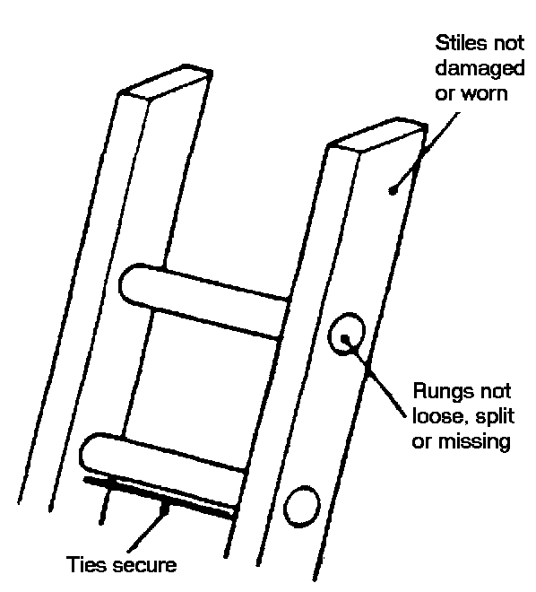
Work at Height
STEP LADDERS / LADDERS
Inspection
Damaged or Worn Stiles
Damaged or Loose Rungs / Treads
Mud, Grease or Liquids
Decayed Timber / Fitting Corrosion
Warping / Distortion
Ropes, Pulleys, Hinges etc.
Stability of Steps
Notes:
Maintenance – All ladders should be tagged with a unique identification number and inspected weekly and before every use – Damaged ladders should be destroyed or repaired (only minor faults). Painting ladders must be avoided – this may hide imperfections and damage.
LADDERS
Damaged or worn stiles, particularly at head and feet. (All ladders should have suitable feet fitted.)
Broken, missing, loose or worn rungs and treads.
Mud, grease or liquids e.g. (paint) on rungs.
Rungs or treads supported by nails, screws or spikes etc.
Decayed timber, corrosion of fittings.
Insecure tie rods.
Warping, sagging or distortion. Check that the ladder stands firmly.
Conditions of ropes cords, pulleys, hinges and other fixings.
STEPS AND TRESTLES
Steps, hinges, bolts, screws and fixings must be sound and secure.
Retaining cords or tie rods should be of equal length, secure and in good condition.
Stable when open and standing on a level base.

Slide 79
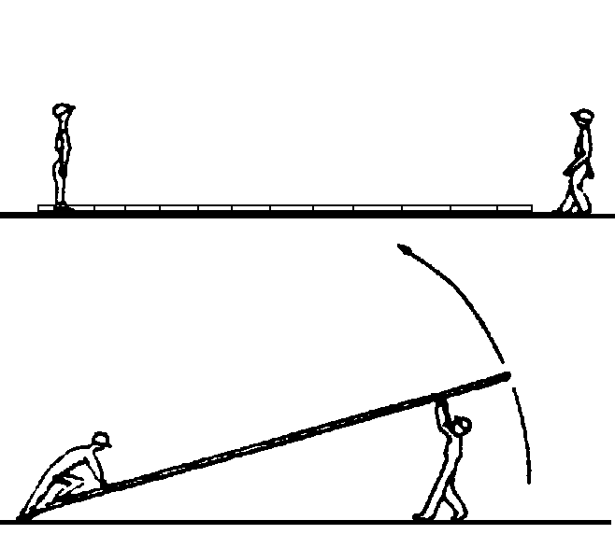
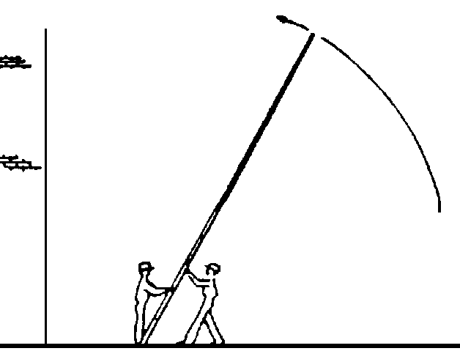
Work at Height
ERECTING LADDERS
Notes:
The procedure for erecting ladders, with two people involved, once the ladder is roughly in position for raising is as follows:-
a)One person stands at the base of the ladder (anchor man) while the other positions himself at the top of the ladder, and takes hold of the top rung and raises the
ladder over his head.
b)Moving towards the base, rung by rung, the adder is gradually raised. At the same time the anchor man grasps the stiles and draws the ladder towards him, steadying the ladder. The sequence is reversed when lowering.
Short ladders may be erected by one person placing the foot of the ladder against a wall or fixture and pushing upwards from the ladder top.
The legs on step ladders and trestles should be positioned as far as the retaining cord will allow, with all four feet on the ground.
Extension ladders with long sections are raised one section at a time and slotted into position. Latching hooks must be properly engaged. Extension ladders must not be lashed or spliced together.

Slide 80
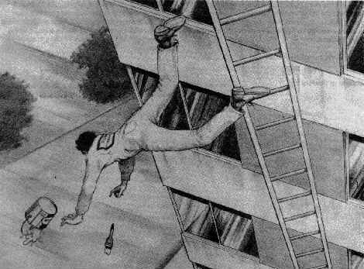
Work at Height
USE OF LADDERS
SUITABILITY
FOUNDATION
SECUREMENT
ANGLE OF ATTACK
THE ENVIRONMENT
OVERREACHING
MOVEMENT
STORAGE
Notes:
Use ladders only for their intended purpose and those which are free from defects.
Set ladders on a firm and level base.
Do not use makeshift props or bricks etc. to gain extra height or to level up the stiles.
Do not erect a ladder close to excavations, where it causes a hazard or obstruction, or where it may be struck or dislodged.
Place barriers around the base of ladders where necessary.
Secure ladders at the top whenever possible, or at the foot by lashing. If it is not possible to lash the ladder in any way, another person must stand at the foot of the ladder, with one foot placed on the bottom rung and holding onto the stiles to steady the ladder. This is only permissible if the ladder is 5 metres or under in length.
Do not rest a ladder against any fragile surface of fittings.
Set ladders at an angle of about 75º to the horizontal (i.e. 1 foot out to 4 foot up).
Do not secure ladders by their rungs. Lash around the stiles, or use ladders ties.
Use a ladder stay or stand off where necessary.
Lash or clamp at the mid point of ladders over 6 metres high, to prevent the ladder flexing.
Allow only one person on the ladder at any one time.
Wear suitable footwear for maintaining a good grip on the rungs.
Keep both hands free for holding the ladder when climing.
Carry tools and materials in a shoulder bag, on a special belt or hoist them up.
Always face inwards when ascending or descending the ladder.
Do not use tools requiring two hands when on the ladder.
Do not hook or otherwise secure tools to the ladder.
Do not overreach when up a ladder as this leads to over balancing. Thighs and hips should be kept between the stiles.
Work at least 5 rungs from the top of the ladder.
Do not reposition the ladder by jumping whilst standing on the rungs.
If it is necessary to leave a ladder standing after working hours, lash a board to the rungs to prevent unauthorised access.
Use steps on a stable and firm level base.
Whenever possible set steps at right-angles to the work.
Work with the knees level or below the top steps.
Platform steps are preferred as they have an integral secure hand hold as well as the top patform.
STORAGE OF LADDERS
Ladders, especially wooden ones, deteriorate if prolonged periods of exposure occur. If indoor storage is not available, ladders should be stored or covered in a protected ventilated place.
Ladders must not be stored near steam pipes, boilers or other source of heat.
Store ladders on racks, supported on the lower stile, and with enough support to prevent sagging. The top stile should be placed over hooks to prevent falling from supports.
Do not hang ladders either form the stiles or rungs where the long term weight loading may effect the ladder shape.
Aluminium ladders should be kept away from wet cement which may lead to corrosion.
Damage or deterioration should be noted and appropriate remedial action taken before further use.

Slide 81
Work at Height
EXTENSION LADDERS
Closed Length
Approx No. of Rungs
Overlap of Rungs
Under 5 metres
Under 18
2
5 - 6 meters
18 - 23
3
over 6 meters
over 23
4
Notes:
Raise one section at a time and follow these guidelines for overlapping of sections.

Slide 82
Work at Height
TRESTLES
INSPECT RUNGS / STILES PRIOR TO USE AND WEEKLY
FULLY BOARDED, ADEQUATELY SUPPORTED
SUITABLE EDGE PROTECTION AND ACCESS
MINIMUM WIDTH OF PLATFORM IS 600MM
MAXIMUM FALL OF 2 METRES
SUITABLE FOUNDATION
Notes:
Inspection – As for ladders.
Use – Used only as an aid to erecting a working platform.
Foundations – Suitably stable and level.
Platforms based on trestles should be fully boarded, adequately supported and fitted with suitable edge protection.
Access / Egress – must be fit for purpose and generally a step ladder
Minimum Width – Equivalent to three scaffold boards – most older trestles where narrower and are now obsolete.

Slide 83
Work at Height
ROOFWORK
SAFE ACCESS & EGRESS
EDGE PROTECTION
USE SAFETY HARNESS / LANYARD
HOOK TO SUITABLE ANCHOR POINT
FIT DEBRIS NETS WHERE REQUIRED
CRAWLING BOARDS / ROOF LADDERS
Notes:
Safe Access / Egress – By Means of fixed scaffolding / ladder arrangements.
Edge Protection – Suitable edge protection to be provided minimum of 910mm maximum gap of 475mm at least 3m from edge
Hook On – Identify or place suitable anchor point and hook on using inertia reel, lanyard and full body harness.
Debris Nets – fit nets where there is a risk of falling materials.
Use Load Spreading Devices such as crawling boards or roof ladders when working on fragile roofs.

Slide 84
WORK EQUIPMENT
Notes:
Every work task will involve the use of a certain amount of work equipment. Safe work equipment and safe use of work equipment is paramount in the prevention of accidents and is catered for directly within HASWA.
LEGAL REQUIREMENTS : HASWA, PUWER

Slide 85
Work Equipment
DEFINITION
Any machinery, appliance, apparatus or tool use to perform work including any assembly of components which are arranged and controlled so they function as a whole.
Notes:
Work equipment includes tools and machines, computers, work vehicles excluding private cars.

Slide 86
Work Equipment
DUTIES OF EMPLOYER
Suitability
Ensure that equipment is suitable for the purpose used.
Maintenance
Properly inspect and maintain records.
User Training
Supply adequate information, instruction & training. Written Instructions where appropriate.
Machine Guarding
Fixed Enclosing Guards
Other Guards
Protection Appliances.
Effective Isolation
All sources of energy.
Emergency Stops
Notes:
SUITABILITY – Equipment must be fit for the task intended – Consult manufacturers specifications and recommendations.
MAINTENANCE – Properly Maintained equipment is less liable to failure of components and inspection will allow early detection of deterioration or damage.
TRAINING – Users of work equipment must be trained in their use and have received adequate instructions to allow them to carry out the task safely and without risks to health.
MACHINE GUARDING – Specific Hierarchy Included in PUWER – Must be followed.
ISOLATION – All work equipment should have a suitable means of isolation for maintenance and emergency situations. This does not only mean electricity – other services such as steam, compressed air etc should be able to be effectively isolated.

Slide 87

Work Equipment
ELECTRICAL TOOLS & EQUIPMENT
CORRECT TOOL FOR JOB
INSPECT PRIOR TO USE
REGULAR TESTING
MAINTENANCE LOG
LOWEST VOLTAGE
RATED SUPPLY
SHOCK PREVENTION
P.P.E.
Notes:
USE CORRECT TOOL – This should be identified in any safe system of work.
INSPECTION – Look for signs of damage to the cable, plug, housing, moving parts.
REGULAR TESTING – Is a legal requirement – Dependant on the risks and environment – SIX monthly checks should be carried out on all electrical equipment – THREE monthly is recommended in harsh environments such as construction sites.
MAINTENANCE LOG – This is the only way to demonstrate compliance with the legislation and should be kept and updated for every piece of work equipment.
LOWEST VOLTAGE – Use voltage reduction techniques to minimise the risk – Transformers etc.
RATED SUPPLY – Ensure that the supply is capable of withstanding the current used by any equipment.
SHOCK PREVENTATION – Use circuit breakers to interrupt supply when faults develop.
PPE – Consider all the risks from using the equipment and supply adequate PPE to minimise residual risks.

Slide 88

Work Equipment
HAND TOOLS
CORRECT TOOL FOR JOB
FIT CONDITION
INSPECT PRIOR TO USE
REGULAR TESTING
SAFE ACCOMMODATION
P.P.E.
Notes:
AS FOR ELECTRICAL EQUIPMENT WITH THE EXCEPTION OF ELECTRICAL TESTING

Slide 89
Work Equipment
ALL EQUIPMENT SUMMARY
SUITABILITY
MAINTENANCE
INFORMATION
TRAINING
ISOLATION ARRANGEMENTS
CONTROL IMPROVEMENTS

Slide 90
Electricity
ELECTRICITY
Notes:
Risks when working with electricity are extremely high and in 1 in 40 cases of electric shock result in death at the workplace. Electricity is particularly hazardous as it is undetectable to the human eye.

Slide 91
Electricity
SOURCES
Exposed Services
Overhead Cables / Trunking
Buried Services
Underground Cables
Tools & Equipment
Electric Drills , Guillotines
Generation Equipment
Turbines, Portable Generators
Notes:
All equipment which is propelled or operated using electricity or any generating equipment produces a risk of electrical failure and subsequent injury.

Slide 92
Electricity
RISKS
Electric Shock
Permanent Injury & Death.
Electrical Burns
Internal & External Wounds
Electrical Fires
Causing Multiple Hazards
Notes:
Electrical Shock & Burns – Results from direct contact with a conductor of electricity or close proximity with high voltage supplies.
Electrical Fires – results from a fault with the supply or absorbing equipment or improper use. Such as overloading circuits resulting in overheating.

Slide 93
Electricity
PREVENTITIVE MEASURES
EARTHING
MAINTENANCE
SAFE SYSTEMS OF WORK
INSULATION
ISOLATION
BREAK DEVICES
REDUCED VOLTAGE
Notes:
EARTHING – Provides electricity with the path of least resistance to earth – Earth continuity should be checked periodically.
MAINTENANCE – Properly maintained equipment is far less likely to develop faults. Regular Inspection will easily identify visible damage to equipment.
SAFE SYSTEMS OF WORK – Work with electricity will always require a safe system of work, eg. Excavation permits, cable identification
INSULATION – Against arcing and conductivity to exposed parts of the equipment.
ISOLATION – Electricity must always be isolated prior to starting work on any electrical circuit. Isolation is not switching off!!.
BREAK DEVICES – Break devices should be used at operating voltages in excess of 230vac. These will detect most faults and interrupt the supply if a fault develops. Electronic devices such as RCD’s are more efficient at interrupting than traditional devices such as fuses.
REDUCED VOLTAGE – Always reduce the voltage of the equipment where it can be done. The lower the voltage the lower the risk.

Slide 94
TRANSPORT
Notes:
ACCIDENTS - NUMBERS, COSTS AND CAUSES
Every year about 70 people are killed in accidents involving vehicles at the workplace. In addition, there are more than 1000 major injuries, ie accidents which result in broken bones, amputations etc. These accidents usually involve people being struck or run over by moving vehicles, people falling from vehicles, people being struck by objects falling from vehicles (usually part of the load) or vehicles overturning. Cars and other types of vehicle are extremely common, both on public roads and at workplaces. Consequently employers and employees often do not recognize - until a serious accident actually happens - that vehicle activities can be very dangerous, and need to be properly managed to ensure a safe workplace.

Slide 95
Transport
ACCIDENT CAUSES
CONTACT
OVERTURNING
COLLISION
IMPACT
PEOPLE ERRORS
POOR MAINTENANCE
ENTANGLEMENT
Notes:
Contact – With structures & Service – Overhead Services / Beams
Overturning – Incorrect loading, speeding or surface conditions.
Collision – with other vehicles or pedestrians.
Impact – Falling materials or vehicle overturning onto operator.
People Errors – Errors of Judgement – Inadequate training or instruction
Poor Maintenance – Failure of components.
Entanglement – In moving parts of engine or controls.

Slide 96
Transport
TRANSPORT SAFETY CONSIDERATIONS
Driver Selection
Fitness, Age, Experience
Training – Vehicle Specific
Supervision – Safety Compliance
Notes:
Is the driver fit to drive – does the driver have any medical conditions or use drugs? Is the driver mature enough? Does the driver have enough experience of similar tasks?
Has specific training been provided for the vehicle to be operated – Controls, Limitations, Uses, Emergency Procedures?
Is the supervisor effective in controlling the drivers and enforcing safe driving policy? Eg Wearing Seatbelts?

Slide 97
Transport
TRANSPORT SAFETY CONSIDERATIONS
Driver Selection
Fitness, Age, Experience
Training – Vehicle Specific
Supervision – Safety Compliance
Traffic Control
Speed Limits / Controls
Safe Crossing Points
Signs & Signals
Notes:
Do the speed limits adequately reflect the risks to operators and pedestrians? Are there adequate enforcing measures?
Are safe crossing points provided across vehicle routes for pedestrians and other vehicles – are they suitably located and identified?
Are there adequate signs provided throughout the workplace? Has provision been made for busy traffic on a crossing path?

Slide 98
Transport
TRANSPORT SAFETY CONSIDERATIONS
Plant Maintenance
Regular Planned Maintenance
Daily Inspection by Operator
Adequate Vehicle Repairs
Notes:
Regular Planned Maintenance should be carried out in accordance with the manufacturers recommendations.
Daily Inspection by Operator should include the following as a minimum :-
Brakes
Headlights, Stop Lights and Indicators
Screens and Wipers
Glass
Horn
Mirrors
Instruments
Exhaust Condition
Emergency Equipment

Slide 99
Transport
TRANSPORT SAFETY CONSIDERATIONS
Plant Maintenance
Regular Planned Maintenance
Daily Inspection by Operator
Adequate Vehicle Repairs
Unfamiliar Drivers
Visiting Drivers / New Employees
Notes:
Unfamiliar drivers should be prevented from driving within the workplace as much as possible. Where this is required for delivery or other reason then suitable information should be given to the driver on the local rules at the entrance to the workplace.

Slide 100
Transport
TRANSPORT SAFETY CONSIDERATIONS
Plant Maintenance
Regular Planned Maintenance
Daily Inspection by Operator
Adequate Vehicle Repairs
Unfamiliar Drivers
Visiting Drivers / New Employees
Pedestrians
Adequate Provisions / Awareness
Notes:
Adequate Provisions Include –
Segregation – Identified walkways and no go zones – Can be painted but preferably by hard barrier.
Reversing Areas – Where possible to be suitably identified – hatchmarks etc.
Suitable crossing Points – Proper crossing points well situated away from blind bends and corners etc.
Awareness – Employees should be made aware of the transport system within the workplace and the procedures must be enforced to ensure compliance!

Slide 101
FIRE

Slide 102

Fire
HAZARDS
OXYGEN DEPLETION
FLAME / HEAT
SMOKE
COMBUSTION PRODUCTS
STRUCTURAL FAILURE
Notes:
OXYGEN DEPLETION – Caused by the oxygen use of the fire. Causes suffocation.
FLAME/HEAT – Burns resulting in serious injury or death.
SMOKE – Causing chronic lung damage and death – The primary cause of death in fires.
COMBUSTION PRODUCTS – Dependant on fuel, generally CO replacing oxygen in the blood – no symptoms of air deficiency.
STRUCTURAL FAILURE – Impact and crushing injuries, other Hazards, Electricity and Water.

Slide 103

Fire
THE FIRE ELEMENTS

Slide 104
Fire
PROTECTION STRATEGIES
Design Precautions
Remove Sources of Ignition
Control Source of Fuel
Detection & Alarms
Heat Detection
Smoke Detection
Fire Fighting
Suppression of an Element
Evacuation Procedures
Notes:
DESIGN PRECAUTIONS – Eliminate sources of ignition- eg Friction, Electricity, Smoking
Control Fuel – keep supply of materials to a minimum, use suitable waste receptacles.
DETECTION - HEAT – Melting of a metal causing trip.
SMOKE – Generally Obscuration or ionising radiation.
FIRE FIGHTING- In order for a fire to be eliminated, one of the three elements must be removed.
Suitable evacuation procedures must be in place for all workplaces and well rehearsed and publicised.

Slide 105



Fire
FIRE FIGHTING
Starvation Cooling Smothering
ALWAYS REMEMBER
RAISE THE ALARM BEFORE ATTEMPTING TO FIGHT A FIRE
ONLY DO SO IF COMPETENT AND COMFORTABLE
Notes:
STARTVATION – By removal of the source of fuel – Uncommon in practice – usually reserved for bush fires etc.
COOLING – Commonly used to reduce the temperature and thus source of energy.
SMOTHERING – Commonly used to exclude oxygen from the seat of the fire causing suffocation.
ALWAYS raise the alarm before attempting to fight any fire and only do so when you are competent and comfortable to do so.

Slide 106
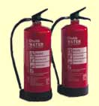
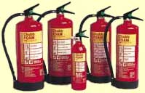
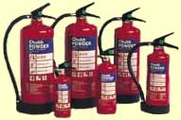

Fire
FIRE EXTINGUISHERS
Water
Class A Fires – Organic Solids
Foam
Class A Fires
Class B Fires – Liquefied Gases
Powder & CO2
All Fires
Electrical Hazards
Notes:
All fire extinguishers should now be red in colour with a colour band indicating extinguishing medium.
Fire extinguishers should be well located and identified with suitable signage.
Fire extinguishers should be inspected annually and after each use. Should be included as part of routine inspection.
ONLY USE IF TRAINED AND COMPETENT TO DO SO!!

Slide 107
END OF DAY ONE

Slide 108
HSE AWARENESS TRAINING
COPENHAGEN
CARGOTEC GROUP – DAY 2
17th/18th March 2014

Slide 109
Course Objectives – Environmental Management
Understand what ISO14001 is and how it applies to your company
Provide you with information on the requirements of the standard
Give understanding of Environmental Legislation and EMS documentation
Notes:
The purpose of the course is to help delegates understand the following:-
Legal System – The mechanics of Health & Safety Law and the Duties of Care imposed by the legal system in relation to Health & Safety
Hazard & Risk – To allow delegates to differentiate between hazard and risk to understand the risk assessment process.
Common Hazards – To allow delegates to understand the common hazards of the workplace and the steps that can be taken to reduce risks.

Slide 110
What is an Environmental Management System?
ISO 14001 is international standard for environmental management systems
ISO 14000: ‘Management system to direct and control an organisation with regard to the environment’.
What your company does to minimise the harmful effects on the environment caused by its activities, to conform to applicable regulatory requirements, and to achieve continual improvement in its environmental performance

Slide 111
Generic Standard
ISO 14001 is a generic standard
Can be applied to any organisation large or small, using any product or service, in any sector of activities
You can be a private business, government department. It does not matter!!
ISO 14001 standard tells you what the requirements are but not how to apply them. This is because every company is different in some way.

Slide 112
Origins of ISO 14001
ISO 14001 was developed in response to the environmental problems that the world face today. First published in 1996, the latest improved version is ISO 14001:2004 with a new revision expected in 2015

Slide 113
Main Benefits of ISO 14001
International, expert consensus on best practice for environmental management
Common language in dealing with clients and suppliers worldwide in B2B
Increase effectiveness and efficiency
Model for continual improvement
Address environmental concerns of clients and public

Slide 114
ISO 14001 – Environmental Management Standard
Comprised of four clauses:
1. Scope
2. Normative reference
3. Terms and definitions
4. Environmental Management System Requirements

Slide 115
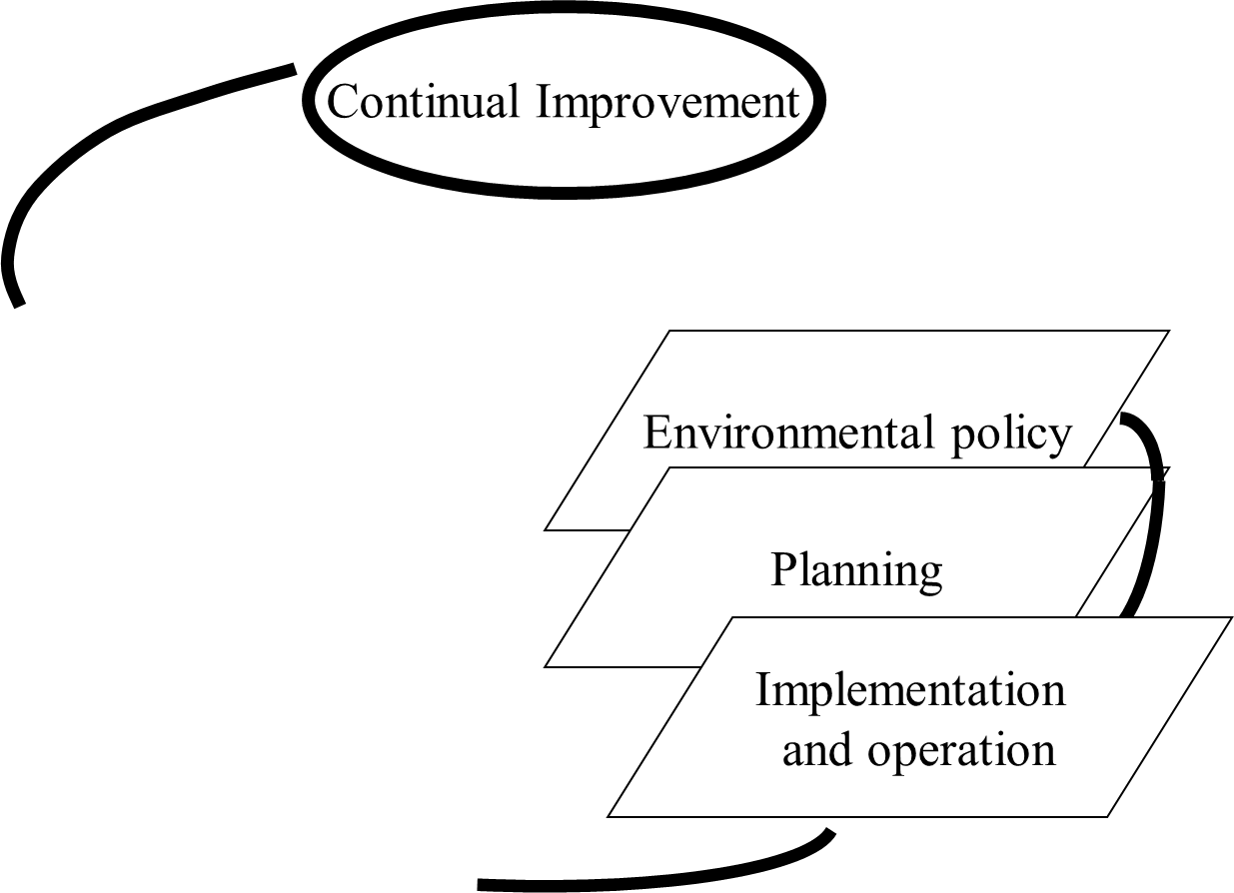

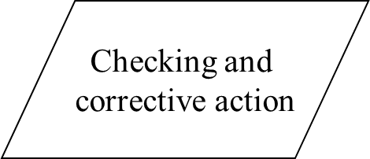
ISO 14001 – Environmental Management Standard

Slide 116
ISO 14001 is based on PDCA
Policy
Management
Review
Planning
Implementation
Checking
Corrective Action

Slide 117
ISO 14001 Key Elements
  Policy Statement
  Identification of Significant Environmental Aspects
  Development of Objectives and Targets
  Implementation Plan to Meet Obj. and Targets
  Training
  Management Review
  How you meet the elements is up to you

