Slide 1
Business Continuity
Protect your business, employees, suppliers and customer from potential business interruptions

Slide 2
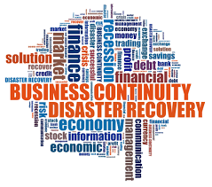
What is it?
Manage the operation of business during interruptions
Ensure rules are set and everyone is aware of their role
Demonstrate to stakeholder and interested parties how

Slide 3
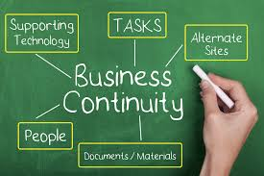
Benefits
Provide confidence to all parties you can continue operations (as best)
Communicate how business will operate
Set goals / target / timelines and responsibilities
Planning and testing to ensure works when required.

Slide 4
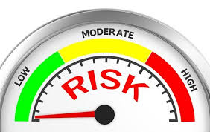
Method
Identify the potential risks
What impact they could have
Who will be impacted
Identify what will be done
Identify who will be responsible:
Name
Contact details
Responsibilities
Formulate a process

Slide 5
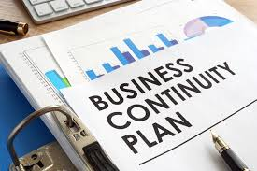
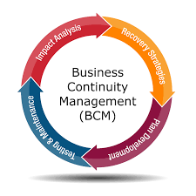
Plan and Test
Prepare a template
Populate plan
Share and train
Test the plan at periodic intervals
Identify areas for improvement
Improve, share and educate

Slide 6
Takeaways
Planning is the most important attribute
What are your greatest risks
Ensure everyone is aware of their role
It must be tested
Identify weaknesses to Improve on
Obtain copy of our template https://www.fqmltd.com/free-resources

